Slide 1














Eurhope
EU as a solidarity's house for minors out of home
Erasmus+ project n. 2023-2-IT03-KA220-YOU-000184370
Digital Skills Module 1
Information and Data Literacy
Notes:
This is a 4-hour module. You can teach it in one session, or two 2-hour sessions. Arrange for a 10-minute break every hour.
🛈 You will need:
a PC/laptop with access to the Internet and speaker to be able to listen to the videos.
A data projector to project this presentation.
A couple of pictures stored on your desktop before class (check slide 16)
A note on the videos used: Most videos are in English. You can add subtitles if you click CC at the bottom of the video. If you don’t see your language, click on settings, auto-translate, and select your language. Since most videos start with a short ad, it is advisable to open the video before class, skip the ad and stop. Open it again when it is time and start it. In this module there is only one video (slide 19).
Symbols used in the notes to help you teach the module:
☺ It is used for something you have to say or read in class. It represents your speaking.
 It is used for instructions. It gives you info on what to do.
🖈 It is used in any of the above (speaking or instructions). It represents a question to ask students, or an activity to do with students.

Slide 2
In this module we will talk about:
Understanding Digital Data and Information
Introduction to digital data types and sources
Effective Search Strategies (broad and narrow)
Bookmarking information
Cloud storage and file sharing services
Analyzing Data and Information
Critical evaluation of sources for credibility, relevance, bias, and accuracy
Techniques for assessing the reliability of sources
Notes:
Hi and welcome back. Together we will explore the digital world opportunities and threats in three modules. I assume that most of you have already been exposed to digital realities via a smartphone or PC. However, what we try to do here, is to systemize and deepen our knowledge, so that we can take full advantage of technology in a safe, pleasant and productive way. So, in this module we will talk about:
 Read the agenda.

Slide 3

Understanding Digital Data and Information
Notes:
So, we will start by examining digital data and digital information. We may have heard these two terms before, but do we know what is the difference between them?

Slide 4

Introduction to digital data types and sources
DATA
Raw, unorganized facts that need to be processed. Data can be something simple and useless until it is organized
INFORMATION
Data that is organized, structured or presented in a given context so as to make it useful
Notes:
Usually, the terms “data” and “information” are used interchangeably. However, there is a subtle difference between the two. Digital data refers to any fact that is stored, transferred, read, and used by networks, smartphones, computers, and other machines. Data can be numbers, symbols, characters, words, codes, graphs, etc. Digital information is data put into context to make it useful.

Slide 5
Here’s how you can remember the difference
Data doesn’t depend on information. | Information depends on data.
Raw data alone is insufficient for decision making | Information is sufficient for decision making
Notes:
Read the table from left to right. Read the entire first row and then the second row. Use the following examples to explain the difference between data and information
Let’s see an example: the words “sky” and “blue” are data. The phrase “sky is blue” is information (information derived from processing the data). Another example is the facts collected for writing a paper is data until it is presented in an organized manner. Then, it becomes information. Is it clear?

Slide 6






What are the different types of data?
Sores on exams e.g. 35, 70, 90….
Qualitative
Data
Quantitative
Data
Names as John, Patricia, Mary…
The weight of a person or subject
Smell e.g. aromatic, buttery…
Colors e.g. green, white, blue…
Your shoe size
Notes:
There are two main types of data: qualitative ones and quantitative ones. Qualitative data is non-numerical data. It describes qualities or characteristics. Quantitative data describes numbers, percentages, ratios, sizes, etc.
 Read the examples of qualitative and quantitative data that appears on the slide.

Slide 7







Where digital data come from?
A data source is the initial location where data is born or where physical information is first digitized
Notes:
Ok, we’ve seen what digital data and digital information are, but where do they come from? In other words, what are the data sources? A data source is the first location where data is born or the location where physical data is digitized. 🖈 Can you name some data sources?
 Ask students the question. If they cannot answer, or if they give only a few examples, you can give them the following information:
Websites and online platforms
Social media networks
Digital devices (e.g., smartphones, computers, IoT devices)
Sensors and surveillance systems
Online databases and repositories
Music or sound recordings
Blogs
Video games
Is everything clear? We have now finished examining digital data and digital information. It is important to remember though, that everything that is done online or saved online, creates digital data. We will come back to this, when we talk about digital footprints. Do you have any questions?

Slide 8
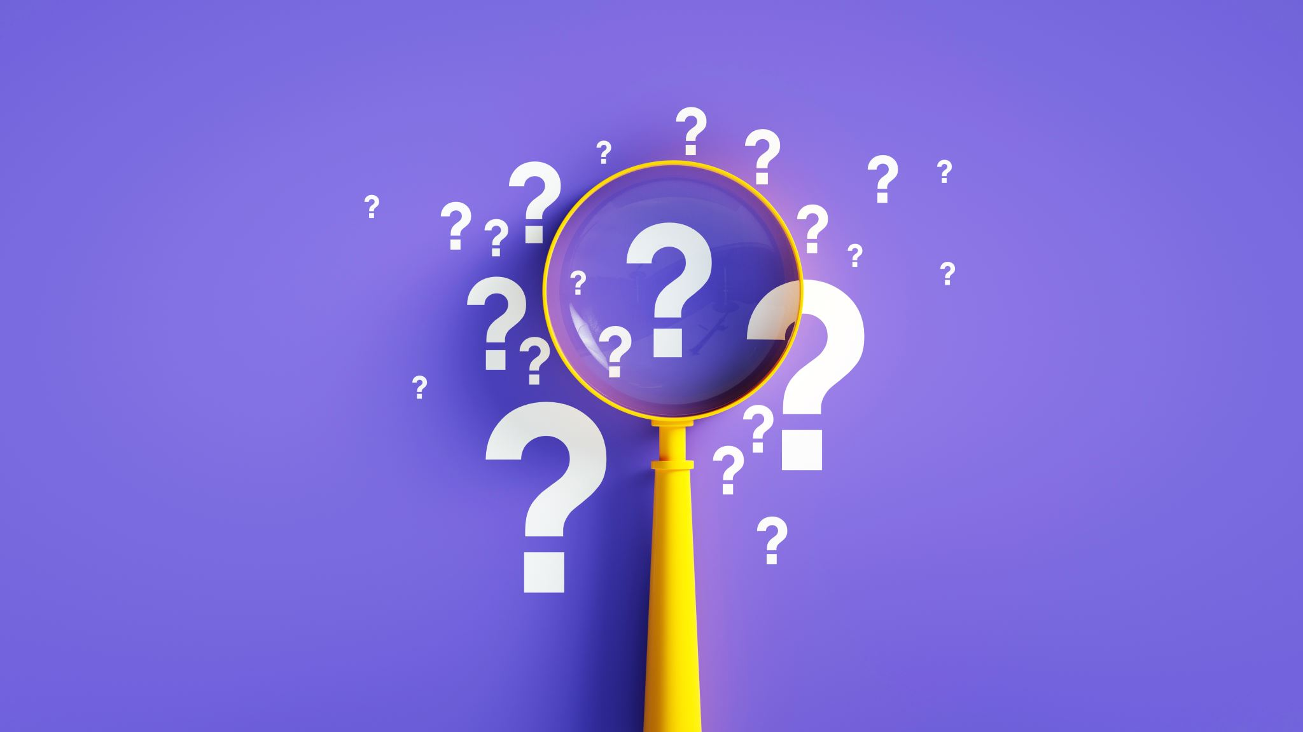
Effective Search Strategies
Notes:
We will now move on to more practical things. In this part, we will look at effective search strategies. We all search for different kind of information everyday. But sometimes, the search results are not what we were hoping. As we can imagine, the Internet is a huge library with billions of information. To retrieve what we want, we need to know how to search for it. This is our main topic in this part. We will see the strategies and practical examples together.

Slide 9

Different browsers
We use different browsers to search for information. Some of them are:
Google Chrome
Mozilla Firefox
Microsoft Edge
Internet Explorer
Apple Safari
….
Notes:
Let’s start with the basics. To search for information, we all use a browser. A browser is a software used to locate and display information on the Internet. Here, we can see the most widely used browsers. 🖈Do you recognize any of the above? Which browser do you use most of the time? In other words, which software do you open to access the Internet?
If students have their mobile phones with them, allow them to turn them on and check their browser.

Slide 10
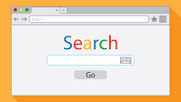
Different search engines
Search engines organize information from different sources and help us find what we are looking for. The most common ones are:
  Google
  Bing
  Yahoo
  …
There are also specialist search engines, like:
https://scholar.google.co.uk/ can help you with research papers, books, and other articles.
https://archive.org/ Search the past on the internet. Pages you thought were gone are stored here.
Notes:
To search the Internet, we all use a search engine as well. Search engines organize information from different sources and help us find what we are looking for. The most common are: Google, Yahoo, Bing. There are also some specialist search engines that help us locate specific information. Here’s two examples: scholar by Google helps us find books, articles or scientific information, when we have to write a paper or work on a project. Archive on the other hand, helps us find old pages and has organized past activities, books, comics, movies, etc.
You can open the specialist search engines to show them to students. You can search the term “biology” in the Scholar engine and “Spiderman” in Archive engine. If students want to search for something different, you can use their preferences.

Slide 11

Keywords
Keywords are the words and phrases that we type into search engines to find what we're looking for.
Notes:
Now we are going to dive into the different search strategies. Knowing how to search for information can save us a lot of time. We will also get more accurate results. Let us explore different search strategies together, before you can try them on your own. The same strategies are used for PCs and smartphones. First of all, we will look at keywords. Keywords, are the terms or phrases we type to find what we are looking for. 🖈For example, what keywords would you use to find a pharmacy in your area?
Let the students suggest keywords and type them online. If none wants to say anything, type the word Pharmacy. You will get a lot of results, starting from sponsored content and then different pharmacies. Explain to the students, that searching for a single word, without specifying anything else, is called “broad keyword” and that it usually brings broad results.
But remember, we are looking for a pharmacy in our area. How can we do that?
 Allow students to express themselves, if they have ideas. If not, move on to the next slide.

Slide 12
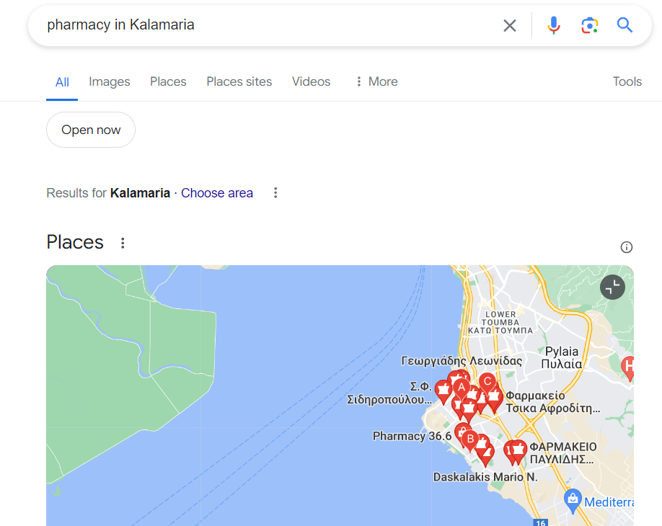
Refine search by adding a place opening hours, etc
Notes:
We can refine and narrow our search results by adding a place, or a street, opening hours, delivery options, etc. The narrow search and narrow results may be fewer but more useful for us. In our example, if we type Pharmacy in Kalamaria we get more useful results.
Navigate the results with the students, to show that when they make their search more specific, the results are also more specific, thus more useful.
☺ What more can we do to get the results we want or need?

Slide 13
Use “…”
You can use “….” to narrow your search for a specific phrase.
If you type the phrase without “”, the results will be for all the component words as individual items.
Notes:
We can use “…” to narrow our search for a specific phrase. If we search for the same phrase without “…” we will get results for all the words in the phrase as individual items. Spot the difference
Open a browser and type: The sun shines in the summer, and then: “The sun shines in the summer”. Go through the results with the students each time. In the first case, you will get results for some of the words of the phrase, but not the whole phrase. In the second case, you will get results that contain the whole phrase.

Slide 14
Use a - to exclude words
Use a minus sign (-) immediately before a word to exclude it from your search. This will tell the search engine to ignore that word from the overall search. This is useful for times when you’re searching for a word or term that has multiple meanings.
Notes:
When we want to exclude some results, we can use the minus sign immediately before the word we want to exclude. This strategy is useful with same sounding words that have different meanings.
Use the following example: type -animal jaguar. This will bring you results for only the car jaguar and not the animal.

Slide 15
Use *
Add an asterisk (*) as a placeholder to complete a phrase you’ve forgotten or to see variations of that phrase. The search engine will fill in the word(s) where the asterisk is. To get even better results put the phrase in “…”
Notes:
Another great search strategy to use, when we don’t remember a whole phrase, but just a part of it, is the asterisk. We can use the asterisk before or after the word or phrase. The asterisk will get us all the results that precede or follow the word or phrase we have typed. We can combine the asterisk with “…” to get the results we want. Let’s see two examples
Type: *Georgiou. It will bring different results that contain the surname Georgiou. Type: Albert*. It will bring different results that contain the name Albert. Type: *”animals in the world“. It will bring results like most amazing animals, most dangerous animals, all animals, fastest animals, etc. Explore and discuss the results with the students.

Slide 16
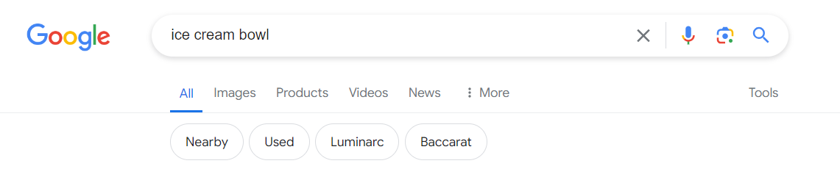
Using tools and suggestions
Notes:
It is not only words and phrases we can search for on the Internet. We may search for a video, news, images, etc. We can specify what kind of results we want by using Tools. For instance, if we are looking for an icon of an ice cream bowl, we can type “ice cream bowl” and then click on images to check pictures as results. We may also want to buy an ice cream bowl. Then, it is useful to click on Products. Or, we may want to see videos with ice cream bowls. we can click Videos, etc.
While you describe the above, type the term “ice cream bowl” and then press Images. Check the results with the students. Then, click on products to see what ice cream bowls are available for purchase. Then click on videos to check videos that contain ice cream bowls. Explore the results with the students. You can also ask the students what they would like to search for, and use the term/phrase they will suggest.

Slide 17
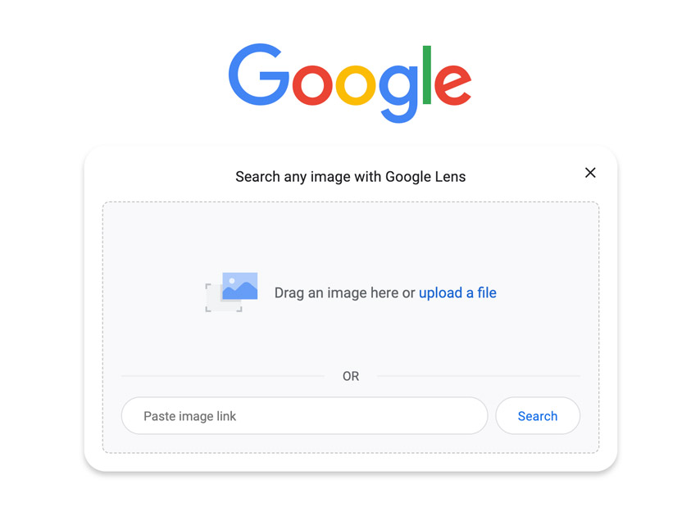
Reverse Image search
You can locate the same image if it’s been used somewhere else online and related or similar images.
Notes:
Reverse image search is a useful strategy when we want to find if a certain image has been used somewhere else, in another website for instance, or to find similar images. Let’s say we found a pair of shoes we like on a website but they’re sold out. A reverse image search will help us locate the exact same pair on another website (if they’re being sold elsewhere) as well as discover other options similar to the pair we’re looking for. Let’s see it in action.
It is easier to demonstrate this to students, by using Chrome: You need to use the picture that you have saved on your desktop. For example, you can save the EU flag, a flower, a bottle, etc. Open Google and select the camera icon to the right, in the search bar. It is next to the microphone icon.
Drag the saved image or click on Upload a file to select and upload it. Explore the results with the
students.
Explain to the students, that if they want to use reverse image with a smartphone, they have to open
Chrome, click on the camera/lens, and select an item in front of them. They can then check the
results. This kind of search with a smartphone is useful when you see a plant you don’t know the
name of. Select the plant with lens and check the results.

Slide 18
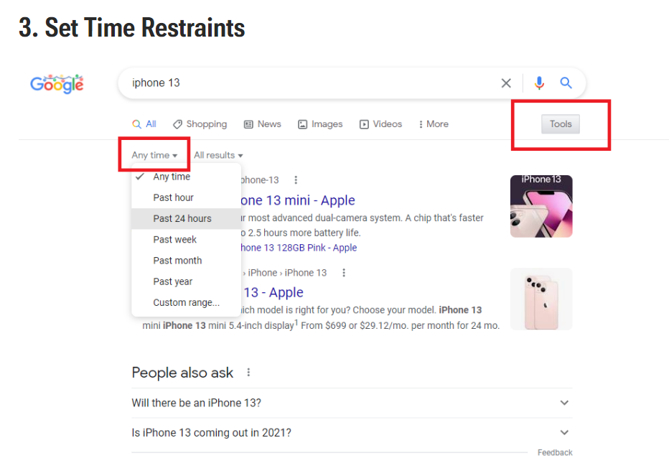
Set time restraints
Notes:
Sometimes, we want to get recent results only. For instance, if we are looking for a new smartphone, we probably want to check what is available the latest month only, not the old models. We can set time restraints from the Tools and look for results that have appeared the past hour, the past 24 hours, the past week, month, year, or during a specific range of time.
Open a browser and type samsung galaxy s21. Open Tools and change the time, from anytime to past month, or year. Then, click on Custom range, and type from 1 September to 3 September 2024. Discuss the results with the students. If students want to search for something different, go for it. As this is the last slide that deals with search strategies, ask the students if they want to practice more together with any of the strategy. If they do, allow 10 minutes to deal with such practice.

Slide 19

How to bookmark a page
Bookmarks allow you quick access to pages instead of having to browse to them or search for them.
How to do it:
https://www.youtube.com/watch?v=UhZKffAcGAA
Notes:
There are some webpages that we want or have to visit on a regular basis, because they contain important information for us. It could be the page of a public authority, an online library, or a travel service. We can bookmark such pages instead of having to browse them or search for them again. Let’s see how we can bookmark a page. The same instructions apply for pages you search for via your smartphone.
Watch the video together with the students and then try to bookmark a page as a demonstration. Students can also try to bookmark a page via their smartphones.

Slide 20
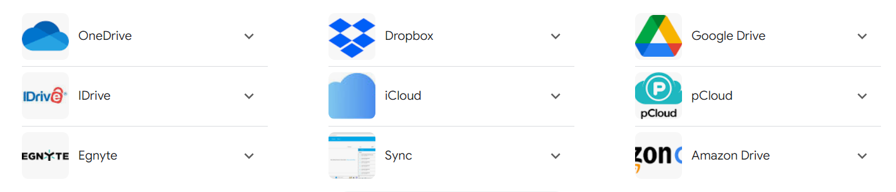
Cloud storage and file sharing services
Cloud storage allows you to easily share and access files from anywhere and restore them if something goes wrong.
Notes:
Now, let’s talk about cloud storage and file sharing. Cloud storage allows us to share and access files from any device or restore it if something goes wrong. For instance, when we change our mobile device, we can transfer all our content from the old device to the new one in seconds. We just save everything on the Cloud and then transfer them to our new mobile. Cloud storage also adds safety and security to our online life because when we synchronize files via the cloud, we create a backup of them by default. No more lost contacts, pictures, or videos. There are many different cloud storage and file sharing services. Some of them are provided for free, like Google Drive, and others for a fee. Services like Google Drive and OneDrive enable us to store, share, and collaborate on documents, presentations, and multimedia files for free. What does this mean? For example, we and our friends have gone to a party. We have all taken pictures with our mobile phones and now we want to share them among us. Instead of sending multiple files to each other, we can upload them on a folder named “Party” on Google Drive, and all have access to all of them from there. Another example is a group project we may have at school. Instead of writing our part, send the paper to the next person and he/she does the same with a third person in the team, we can upload the document on Google Drive, give access to all team members and everyone can work on the same document at the same time. With this information, we conclude with the first part of this module.

Slide 21

Analyzing Data and Information
Notes:
In the second part of this module, we will discuss how we can check the sources of information we search to see if we can rely and trust them.

Slide 22
Organic results Vs. Ads
When you do a search online you get two types of results: search results and ads.
With search results, the search engine determines which results are most relevant to your search query. These are also known as organic search results.
In your search results, you can also be served ads which are paid for by businesses to appear when there’s a match with the term you’re searching for. This is why, for example, you might see an ad from a bank when you search for ‘best savings rates’.
Notes:
To start with, we need to clarify two key terms: organic results and ads that appear on screen for anything we search for. Organic results are the ones that the search engine determines as relevant, based on our keywords and search strategies, that we discussed in the previous part. Ads usually appear first, above search results, with a small ‘Ad’ or ‘Sponsored’ label so we can separate them from organic search results. They can also appear under the search results, towards the bottom of the page, or to the right of the screen when searching on a computer. Ads appear also on social media, and YouTube. Just like we use a keyword to search for something, companies pay the search engine to connect keywords with their brand. Let’s see a couple of examples
Search for cat food. You will get sponsored content first and then organic results. Then search for “soft drinks”. You will get results for cola cola, pepsi cola, fanta, etc. Explain to students that this is because those companies have paid to connect the keyword “soft drink” with their brand.
While some ads can be useful, it’s worth noting that fake ads do exist online. As a safety precaution, it’s best to select the organic listing over an ad when our search returns both options for the same company. For example, if we search for “trivago” the sponsored site appears first and the corporate site comes second. It is better to visit the second one.

Slide 23
Criteria to use to evaluate information
Credibility
Author’s credentials (qualifications, role, etc)
Publisher (academic publishers, government agencies or reputable organizations are more credible than blogs, social media, etc)
References and Citations: Reliable sources often cite other credible sources
Relevance
Scope: Determine if the source covers the topic comprehensively and appropriately.
Purpose: Understand the purpose of the source— e.g. to inform, persuade, entertain, or sell.
Bias
Objectivity: does the source present information fairly and without a significant bias?
Point of View: does the source present multiple perspectives on the issue?
Language: Is the language full of emotional or loaded words?
Accuracy
Evidence and Support: Evaluate whether the source provides evidence, data, and references to support its claims.
Errors: Look for any factual errors, typos, or grammatical mistakes which can undermine credibility.
Notes:
We are served a lot of different information online everyday. From news agencies to blogs to social media, we need to critically examine the type of information we get, especially the news, to be certain that we have the true picture of any situation. There are 4 criteria to use for that: Credibility: a credible source always provides the author’s name and even credentials. Some publishers are more credible than others. For instance, a government agency, an academic publisher or international organizations are usually more credible. Credible sources also refer to other credible sources. A second criterion is relevance: this has to do with the scope and purpose of information. Does the source cover a topic appropriately and comprehensively? Why has the source provided this information? To inform us, to persuade us on something, to sell something? The third criterion is the bias: does the source present information objectively or is taking sides? News about politics and finance are full of bias. Does the source present multiple perspectives of the issue? And, is the language used to write the news plain or full of emotional words? (tragedy, shock, monster, huge, etc). Finally, we need to check for accuracy: does the source provide data and evidence to support the information? Is the text well written, or full of errors and grammatical mistakes? Of course, it takes time and practice, to be able to accurately evaluate the information that comes our way, but it is very important to do it, if we want to be an informed citizen and make our own judgments.

Slide 24
Techniques to use to evaluate a source
Publication Date: Ensure the source is up-to-date, especially in fields where information changes rapidly.
01
References: Examine the references cited to ensure they are from credible sources.
02
Cross-Checking for Consistency: Compare the information with other sources to identify potential biases.
03
Notes:
Here’s some simple techniques we can use to evaluate a source of information, as well as the information itself: publication date: what goes online, stays online forever. That doesn’t mean that the information found is up-to-date, or that the publisher is still active. For example, if we search to book a hotel for a weekend, and we come up with some results, we need to check if the hotel is still open, or is it old information, that the rates presented are this year’s rates, etc. References: Reliable and credible information use references to credible sources. For example, and this is very common today in political news, it is written “anonymous sources reveal that…” this is not a reliable reference. It cannot be checked. The reporter may use this trick to write his/her opinion or to create a scandal. The last, and most useful technique, is to check the information from different sources or, in other words, to cross-check the information. What is common in different sources is usually the actual news. The rest, is opinions, biases, and emotional language.
Find a current new story on two or three different websites and/or social media and examine it together with the students as practice. Spot the difference in focus, bias, credibility, accuracy, etc. (this is practice for both slides 23 and 24).

Slide 25
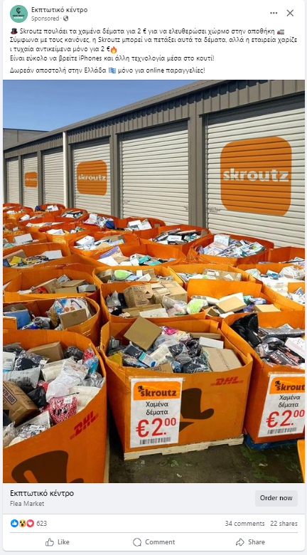
Extra tips:
If the information is too good to be true, it is not
Never trust social media for important information (i.e. medical questions, political analysis, etc)
Don’t spread fake news to your contact lists. First check if the information is true. If everybody did the same there would be no room for fake news
Be cautious of misinformation or propaganda, designed to manipulate or deceive the audience.
Notes:
Before we conclude this part, here are some additional tips we should all pay attention to: If the information is too good to be true, then it is not. Super discounts, products that are given for free, etc. In the picture, we can see a misleading ad, that uses the name and logo of Skroutz (a well-known e-commerce service in Greece). It says that Skroutz sells lost packages for €2 to free space in its warehouse. It also says that according to rules, Skroutz can throw away these packages, but instead it decided to give away the items included in the packages for only €2. This is false and tricky information. Remember that social media should be used for fun, not for learning important information. If we are looking for medical advice, or political analysis, we should never trust social media as sources. We should not spread fake news to our contact lists. We should not send a prayer that came to our Facebook wall and says that if it is shared it with 10 friends we will be blessed; we will not be more blessed that we already are. Don’t forward emails with intimidating news, like that the supermarkets had food supplies for 10 days only because of a war. Remember, we need to check first, if the information is valid. Fake news are spreading around the world because people don’t evaluate the sources and the information they receive. Finally, and this is also very common today, we need to be cautious of propaganda and misinformation that is designed to either manipulate or deceive people. A good example for this is the misinformation about vaccination that runs mainly on social media. So many people have been deceived by lies that are served as information, and they put their health in danger. We have now concluded Module 1. Do you have any questions? Is there anything we have discussed so far that you want to comment on? Did you find the module useful?

Slide 26

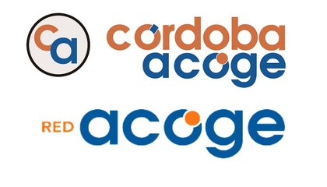






Eurhope
EU as a solidarity's house for minors out of home
Erasmus+ project n. 2023-2-IT03-KA220-YOU-000184370
Funded by the European Union. Views and opinions expressed are however those of the author(s) only and do not necessarily reflect those of the European Union or the European Education and Culture Executive Agency (EACEA). Neither the European Union nor EACEA can be held responsible for them.

