Slide 1














Eurhope
EU as a solidarity's house for minors out of home
Erasmus+ project n. 2023-2-IT03-KA220-YOU-000184370
Life Skills Module 1
Personal Area
Notes:
This is a 4-hour module. You can teach it in one session, or two 2-hour sessions. As the concepts of this module are deep, arrange short breaks when you feel that students need some time to digest the content.
🛈 You will need:
a PC/laptop with access to the Internet and speaker to be able to listen to the videos.
A data projector to project this presentation.
A hat and half A4 papers with an emotion written on each one of them for the activity for slide 11
A4 and half A4 papers and pens for students
A note on the videos used: Most videos are in English. You can add subtitles if you click CC at the bottom of the video. If you don’t see your language, click on settings, auto-translate, and select your language. Since most videos start with a short ad, it is advisable to open the video before class, skip the ad and stop. Open it again when it is time and start it. In this module there are two videos (slides 10 and 20).
Symbols used in the notes to help you teach the module:
☺ It is used for something you have to say or read in class. It represents your speaking.
📄 It is used for instructions. It gives you info on what to do.
🖈 It is used in any of the above (speaking or instructions). It represents a question to ask students, or an activity to do with students.

Slide 2

In this module we will talk about:
Self-awareness and self-management
  Self-understanding
  Recognizing and labeling emotions
Emotional Regulation and Behavior Management
  Techniques for managing emotions in different situations
  Finding your strengths and weaknesses
Building resilience
  coping with setbacks and adversity
  coping with uncertainty and stress
Notes:
Welcome the students. Introduce yourself in a funny way, as suggested below. Then ask students to introduce themselves in a similar way. Only when everybody is finished, show slide 2 and read the agenda.
Hi and welcome to this class. Together, we will discover interesting, useful and funny things about ourselves and the world around us. But before we do so, let’s introduce ourselves. My name is….and I would like to share 3 statements about myself: I own a cat. My favorite color is blue. And, this is not my natural hair color [you can use your own statements]. Now, who wants to start? Just share your name, and 3 statements about yourself; it can be anything, like when you come from, what is your favorite food or artist, or whatever you want to share.
Hi again! We now enter the part of important and exciting life skills. These are competencies and skills that help us make informed decisions, deal with demands and challenges, think critically and creatively, communicate effectively, build healthy relationships, empathize with others, and managing our life in a healthy and productive way. We will examine these skills in different modules. In this module, we will deal with our personal area, and we will talk about:
Read the agenda to the students

Slide 3

Self-awareness and Self-management
Notes:
☺ Let’s start with self-awareness and management

Slide 4

What is self-awareness and why is it important?
Self-awareness is the ability to recognize and understand different aspects of yourself, including traits, behaviors and feelings.
Self-awareness is crucial for several reasons:
Emotional Regulation
Better Decision Making
Improved Relationships
Personal Growth
Mental Health
Notes:
☺ What is self awareness and why is it important? Self-awareness involves being mindful of how we feel, why we feel that way, and how our emotions and behaviors affect both ourselves and others. It is also to understand our strengths, weaknesses, desires and dislikes. In other words, it means knowing ourselves better. And it can be learned. Why is it crucial? There are 5 main reasons: 1. Emotional Regulation: understanding our feelings help us better manage and regulate them and reduce the likelihood of impulsive or destructive behavior.
Better Decision Making: Understanding our strengths, weaknesses, and values, leads to more informed and thoughtful decisions for now and for the future.
Improved Relationships: Understanding our own emotions and behaviors can help us empathize with others, improving our social interactions and relationships.
Personal Growth: Self-awareness help us to set realistic goals, recognize areas for improvement, and work towards becoming the best version of ourselves.
Mental Health: Self-awareness is a foundational skill that supports emotional intelligence, resilience, and overall well-being

Slide 5
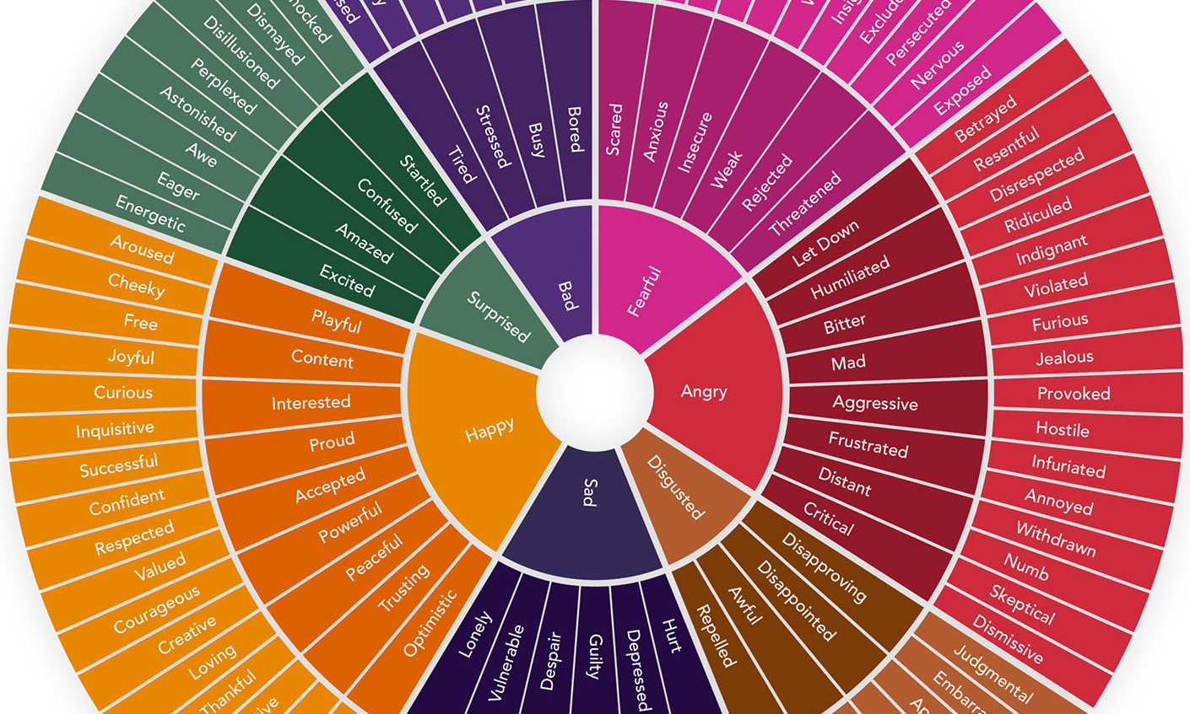
https://feelingswheel.com/
Notes:
Before you reveal the feelings wheel picture, ask the students 🖈Do you know how many different emotions exist? Can you name some emotions? They can be positive or negative. Allow students to share their opinion. Then click to reveal the feelings wheel, and open https://feelingswheel.com/ , which is the full version of the feelings wheel that is depicted on the slide.
There are many different emotions and their variations. Gloria Willcox created the feelings wheel, in 1982, which is designed to help us describe our feelings with more accuracy. Fascinating, isn’t it? Of course it is not a complete overview of all possible emotions, but it can serve as a stating point to identify and label our emotions. Starting from the center with 7 basic feelings, we can go to the second and third level
Go through a couple examples together with the students. For example. Angry, let down, betrayed. Then, keep the feelings wheel link open and move to the next slide.
☺ The feelings wheel show us in a simple way, that we may express one feeling, but that there is another feeling behind it.

Slide 6
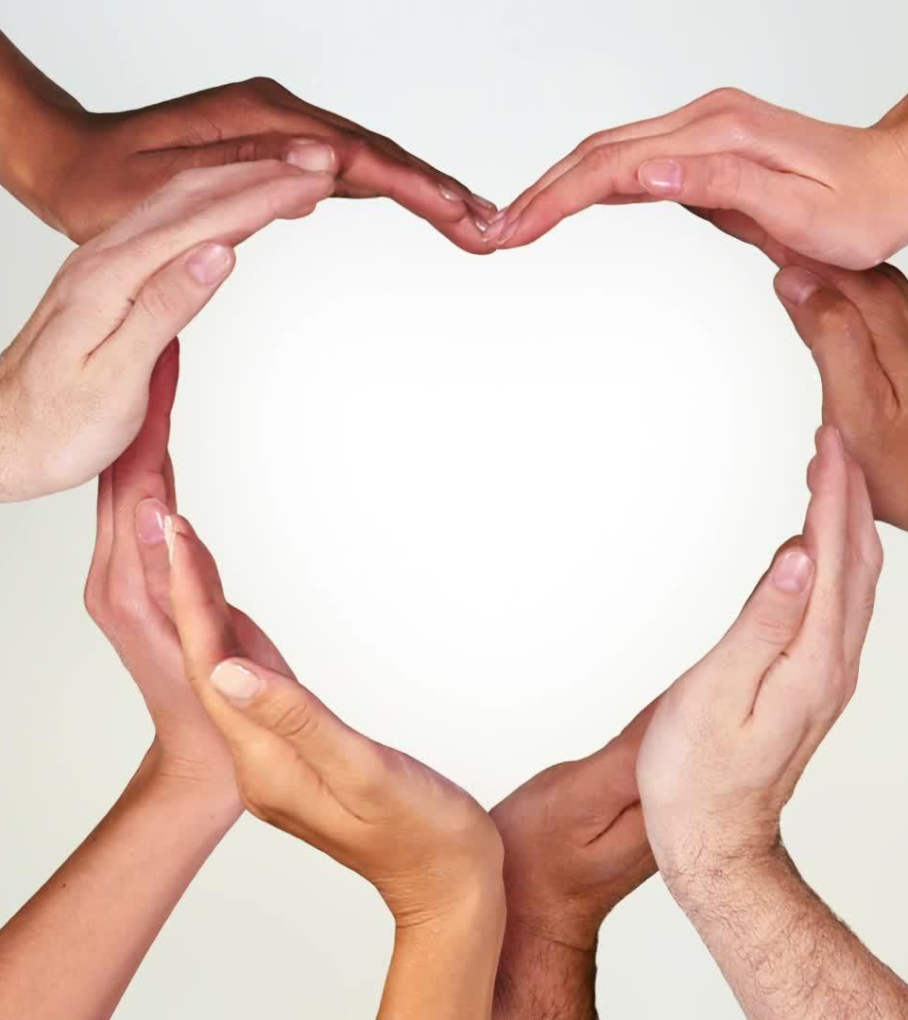
Recognizing and labeling emotions
Pause and Reflect
Identify Physical Sensations
Acknowledge the Emotion
Use Specific Labels
Consider the Context
Express the Emotion
Notes:
Going back to self-awareness, it starts by recognizing our emotions at any given time and giving them specific names. It may seem easy and straightforward procedure, but on many occasions, a feeling has other feelings hiding underneath, as we saw on the feelings wheel. For example, we may feel angry. But, do we feel angry because someone has accused us of something? Do we feel angry because we are tired and hungry and a lesson does not end? Do we feel angry because we cannot afford to buy something? It is important to understand our feelings, and what causes them, so that we can manage them. Let’s see 6 steps to do that and let’s try them right now; 🖈each of you will think for him/herself. We will use the feelings wheel to help us.
Have the feelings wheel open when you read the steps to the students. Ask the students to write on a piece of paper. Explain that this is personal. Allow a minute or so for each step, so that students can actually follow the exercise. Ask them if they need more time after each step
🖈Pause and Reflect: Take a moment to stop and consider what you are feeling right now. Identify Physical Sensations: Emotions often manifest physically. Pay attention to any physical sensations in your body, such as a racing heart, tense muscles, or butterflies in your stomach. Acknowledge the Emotion: Once you notice a physical sensation, try to identify the corresponding emotion. Are you feeling happy, sad, angry, anxious, or something else? Use Specific Labels: Be as specific as possible when labeling your emotion. Instead of just saying "I'm upset," try to determine if you are feeling frustrated, disappointed, or hurt. Consider the Context: Think about what might have triggered this emotion. Understanding the context can help you better understand your emotional response. Express the Emotion: Communicate your feelings, whether it's through talking to someone you trust, writing in a journal, or expressing yourself through art or music.
📄 You can share in class your emotion, how you recognized it and what label you have given to it. If any of the students want to share their own example allow it.

Slide 7

Understanding strong emotions
Fear
Sadness
Anger
Physical reactions
What it is usually connected to
How it is expressed
Notes:
Now, there are some emotions that we call strong, as they can affects us in many ways. We all have strong emotions at times. We will examine 3 very common strong emotions together: fear, sadness, and anger. We will look at how the body is affected by the emotion, what the emotion is usually connected to, and how it is expressed most times.

Slide 8
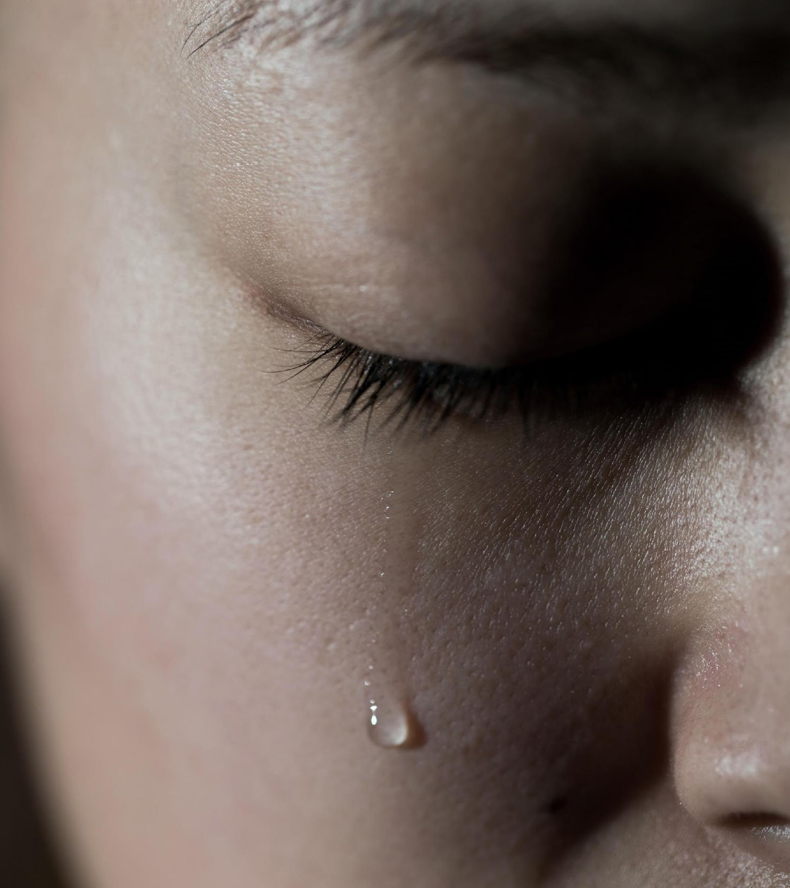
Sadness
Metabolism slows, giving us time to mourn
It comes from not getting what we want or stress of what might happen, or from sorrow when loosing someone important
When sad, many people try to isolate themselves, but this cuts us off from resources to get over sadness
It is connected to depression, shame, disappointment, regret, guilt, embarrassment, and insecurity
Notes:
We start with sadness. We have all felt sad at some or many points in our lives. So, when we feel sad, our metabolism slows to give us time to mourn. We may feel sad because we didn’t get what we wanted, or from stress of what might happen, for example, if we are unemployed and we are stressed about finding a job, or because we grieve for loosing someone important to us. When people feel sad, they tend to isolate themselves. This is not a good tactic however, before it cuts us off from resources, such as friends, teachers, or other that can help us get over sadness. Sadness is connected to other emotions, such as depression, shame, disappointment, regret, guilt, embarrassment or insecurity. 🖈Do you want to add any other reason why we might feel sad?
Ask the students to think of a time when they felt sad, and what was the general context that created sadness. If no student wants to answer, you can give a personal example of your own.

Slide 9
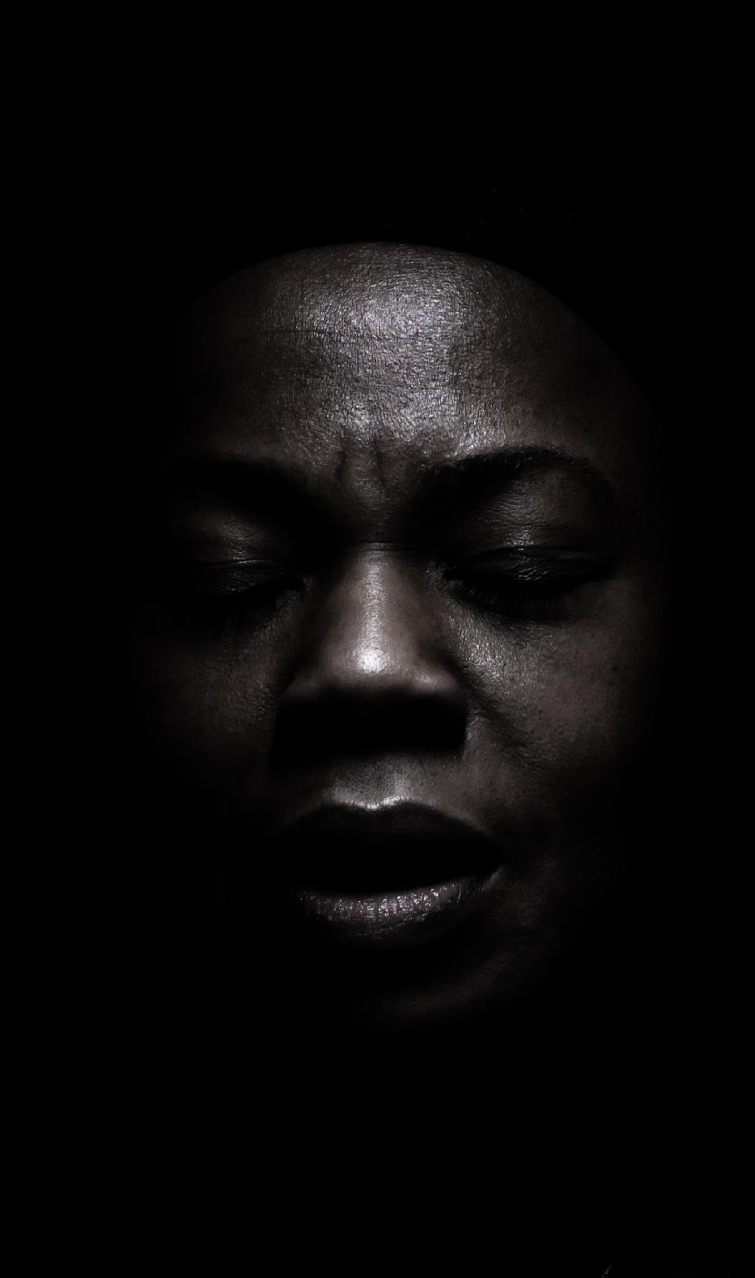
Fear
Blood rushes to our arms and legs so we can run or fight
It immobilizes us and forces us into fright, flight or fight
It is connected to worry, anxiety, stress, nervousness, panic, and phobias
Notes:
We move on to fear. A very strong emotion that has affected us all in different points in our lives. When we fear, our body prepares to run or fight, so the blood rushes to our arms and legs. Fear may paralyze us, and it may force us to fright, flight or fight, depending on our character and the situation. Fear is connected to worry, anxiety, stress, nervousness, panic, and different phobias. 🖈Did you fear darkness when you where younger? Are you afraid of spiders or animals? There are so many examples and variations of fear.

Slide 10

Anger
Blood rushes to our hands so we can fight
It is one of the most dangerous emotions because it is energizing, it builds momentum. The more often we are angry, the less arousal we need to stay in this state.
It can be an expression of frustration, stress, anxiety, loss, confusion, embarrassment, jealousy, rejection, threat, etc
Anger iceberg https://www.youtube.com/watch?v=AQIQCOY_Im0
Notes:
Finally, anger. I hope you don’t feel angry for being here! When we feel angry the blood rushes to our hands so that we can fight if needed. Anger is one of the most dangerous emotions because, instead of immobilizing us, like fear, it is energizing, and it builds momentum. The more often we are angry, the easiest it becomes to stay in this state. Anger can be an expression of different hidden emotions, like frustration, stress, anxiety, loss, confusion, embarrassment, jealousy, rejection, or threat. Let’s see a relevant video.
After you show the video, ask the students if they have any questions about the different emotions, or if they want to comment on the video. Then move on to the next slide.

Slide 11

Can you identify the emotion?
Notes:
Now that we have discussed different emotions, let’s play a game.
Write different emotions on pieces of paper and put them in a hat. You can use: anger, fear, joy, confusion, surprise or any other. The feelings wheel can help you choose. Ask a student to pick a paper and act out the emotion without speaking. The other students will then have to guess which emotion is being portrayed. This helps students to identify what others are feeling and how emotions can be displayed differently. Depending on how much time you want to spend, you can play this game with 3-4 students, trying different emotions.

Slide 12

Emotional Regulation and Behavior Management
Notes:
That was fun! And there are many good actors in this class! Remember us when you get famous! Now, let’s move on to how we can regulate our emotions and manage our behavior.

Slide 13

Emotional regulation
You control your emotions; they don’t control you
There are no wrong emotions, they all are valid.
You cannot control how you feel about circumstances or events. The initial feelings you have in response to events are always okay.
What you can control is how you choose to react and respond when emotions are heightened.
Just because your feelings and emotions are valid, doesn’t mean they give you an excuse to behave however you want
Notes:
Emotional regulation or self management, as we call it, is the ability to control our emotions so that they don’t control us. We need to keep in mind that there is no such thing as wrong emotions. They are all valid. In different circumstances we may feel positive or negative feelings, and this is ok. We cannot control how we feel about circumstances or events. The initial feelings we have in response to events are always okay. For instance, when someone pushes us intentionally, we will probably feel irritated. This is something we cannot control, and it is ok. However, what we can control is how we choose to react when an emotion is heightened. In our previous example, that we felt irritated, we may decide to let go, to push back, to yell, etc. Just because our feelings are valid it doesn’t mean that we are excused to behave however we want. This is something we need to remember.

Slide 14

Typically, when we experience a feeling we don’t like…
we try to get rid of it, either by problem solving (rationalize the problem) or trying to control how we feel (“stop feeling sad”)
Or
we try to block and avoid it
All of the above do not work. The effort put in such actions make the feeling worse or more intense.
So what really works?
Notes:
Now, let’s see how we can handle our emotions. Typically, when we experience a negative feeling, we try to get rid of it, by rationalizing it or by trying to control how we feel – we usually say to ourselves stop feeling sad – or we try to block and avoid it. None of these strategies work. On the contrary, if we put effort in any of the above, we make the feeling worse or more intense. So, what can we actually do?

Slide 15

Accepting the feeling
Instead of fighting a bad feeling, accept that you feel it.
Name and acknowledge it. To give a specific name to your feeling helps you better understand it and it usually takes its real dimensions instead of escalating
Validate it. Don’t judge the feeling “I should not feel sad” but give yourself permission to have it. It doesn’t mean that you like it or don’t want to change it, but just that you acknowledge the presence of the specific feeling that specific time.
Take opposite action. For example, when you feel anger, you want to attack and fight back. But that irritates you even more and the situation escalates until you explode. Instead, you can take the opposite action to take a step back and remove yourself from the situation. This will gradually make you feel calmer
Notes:
Instead of fighting a bad feeling, we need to accept it. And what does this mean? Remember the feelings wheel? We need to name our feeling and acknowledge it. When we give a label/name to the feeling, we understand it better. And instead of making a big deal out of it, we ground it to its real dimensions. Then, we need to validate the feeling. Remember that all feelings are valid. So, instead of judging ourselves for feeling bad, sad, angry, or whatever, we should give ourselves permission to feel it. It doesn’t mean that we like it or don’t want to change it, but just that we acknowledge the presence of the specific feeling that specific time. Then, we can take opposite action and remove ourselves from the situation. Remember that we cannot control how we feel but we can control how we react when we feel something. So, for example when we are angry, we have the urge to fight back and attack. But we can choose to take the opposite action of removing ourselves from the situation. This will help us calm down. This technique needs practice before we can totally take advantage of it, but it is worth trying.

Slide 16
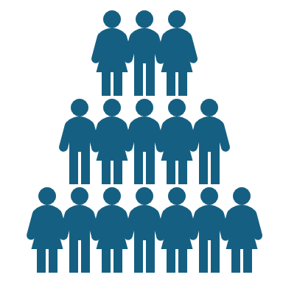


Stay on the positive side
There will always be people in better and worse position than you.
Try to appreciate what you have on a regular basis.
Let’s “count our blessings” together. Let’s find and list 5 things you are grateful for, this week.
Notes:
We need to try to stay on the positive side as a general attitude. We all face difficulties, problems or tragedies many times in our life. But as long as we breath we can change our lives for the better. Some people are by nature optimistic and others pessimistic. Again, we need to focus on the real picture and not exaggerate with any problem we face. There are and will always be people in a better and worse position than us. This is something we have no power on. To stay on the positive side, we need to concentrate and appreciate all the good things in our lives, or our blessings as we call them, regularly. We can try to count our blessings for this week together. 🖈Take 5 minutes to think of 5 positive things that happened to you this week, or things that you feel grateful for. Write them down. This list is personal. You don’t have to share it with anyone else. They are your blessings after all. Here are some ideas: did you receive help from anyone on something? Did you help anyone and felt good about it? Did you have a good exam score? Did you meet a new friend? Did you manage to deal with a problem effectively? Did you hear some good news?
Allow students some time to think and write down their blessings.
Great! Let’s try to count our blessings every week. Soon, we will start focusing on the good things, instead of the bad.

Slide 17



Understanding your strengths and weaknesses
…………..
…………..
…………..
…………..
…………..
…………..
Notes:
Remember that self-awareness has also to do with recognizing our strengths and weaknesses. To better cope with any situation in our life (school, work, sports, art, etc) it is useful to know what our strong points are. We can rely on our strengths to effectively deal with a challenge. It is also useful to know what our weak points are. These can make a problem look worse or can stop our progress. If we acknowledge our weak points, it is easier to work on them to improve them. 🖈Take a piece of paper and write down 3 of your main strengths. Then list 3 of your main weaknesses. Once you have chosen traits that need improvement, think about and briefly describe how you will attempt to improve them. Here’s a list of some strengths and weaknesses that can give you ideas for your own list.
📄 Once you have introduced the instructions, move to the next slide and keep it open until the exercise ends.

Slide 18
Strengths
Adaptability
Assertiveness
Attention to detail
Communication skills
Compassion
Confidence
Courage
Creativity
Critical thinking
Decision-making
Empathy
Fairness
Flexibility
Forgiveness
Goal-setting
Gratitude
Honesty
Independence
Initiative
Interpersonal skills
Leadership
Loyalty
Open-mindedness
Organization
Patience
Problem-solving
Resilience
Resourcefulness
Respect
Responsibility
Self-esteem
Self-motivation
Teamwork
Time management
Tolerance
Trustworthiness
Weaknesses
Disorganization
Intolerance
Lack of communication skills
Lack of compassion
Lack of confidence
Lack of creativity
Lack of decision-making
Lack of discipline
Lack of emotional regulation
Lack of empathy
Lack of flexibility
Lack of focus
Lack of interpersonal skills
Lack of motivation
Lack of patience
Lack of respect
Lack of self-control
Lack of self-esteem
Lack of teamwork
Lack of time management
Negative thinking
Perfectionism
Procrastination
Rigidity
Notes:
When students have finished, tell them to keep this list, review and reflect on it on their own time and pace.

Slide 19

Building resilience
Notes:
☺ Now, in the last part of this module, we will focus on how to build resilience. In simple words, resilience is the ability to recover quickly from difficulties we face in life.

Slide 20

3 universal truths
Uncertainty is the only certainty there is
Becoming is better than being . Intelligence and skills can be cultivated through effort and persistence.
Failure is part of everyone’s life. The lessons you learn from failing are going to prepare you for the success you seek! https://youtu.be/hV40u2FNFBk?feature=shared
Notes:
Before we talk about how we can prepare for difficult times, let’s see together 3 universal truths. First of all, the only certainty in life is that nothing is certain. What is valid today, may not be valid tomorrow. There are people who started with nothing and gained a lot during their life, and other who started with everything and lost everything over night. Let’s think about an earthquake. We may have a nice house or car, and after the earthquake hits, we lose everything, and we are forced to start from scratch again. Things change rapidly for good or for bad. We cannot change that. We can only be strong to cope with the situations ahead. Secondly, Becoming, is better than being. For example, becoming a good student is better than being a good student from the start. Because to become a good student, we have put effort, we have built important skills, we have overcome difficulties. That means that we are stronger than someone who counts on his/her intelligence only to get good grades. If studies get harder later on, the intelligent guy will have a hard time because he has not learnt to try. The student who has become better through effort, will have an easier time, as he/she determined and knows the way that has to be followed. Finally, and equally important, is that there has been no person on earth who has been successful all the time. All people fail in some stage of their life, and some fail many times before they succeed. We should not be afraid of failure. It is part of life. If w analyze failure, we get valuable lessons that will help us to succeed eventually. Let’s see examples of famous people who have failed, and failed again, before success.
Try to raise a discussion with students about the universal truths. Ask them if they can give examples that prove the truths. If students are reluctant to say anything, talk about the video and see if students were impressed or inspired.

Slide 21

Prepare for the rough times to come
Take care of yourself: physically, mentally and spiritually
Put things in perspective
Take control: Bad times make us feel out of control. Leave the situation to evolve and deal with small, everyday things you can still control.
Talk to someone: you are not alone. You can call the European Helpline for Children and Adolescents 116111, operated in Greece by “The Smile of the Child”. Calls to the Helpline are free from landline and mobile telephones.
Notes:
As we said, difficult times, such as failure, or tragedy, or loss, come in various stages in life and in most cases, there is nothing we can do to avoid them. Let’s do what we can: prepare for the rough times. How? First of all, we need to take care of ourselves. Good health is a prerequisite for coping with any difficulty. By good health, we mean our body, our mind, and our spirit. We need to take care of our body, keep our mind active and alert, take care of our spirit: meditate, pray, or do anything that gives us peace. Put things in perspective. We should try to step back, think about the big picture, and gain a sense of perspective. This is not easy to do when we are too close to a situation. It is better to wait for time to pass in order to gain a sense of perspective. But it is helpful to see the situation in its realistic dimensions and in relation to our actions and to the rest of the world around us. It helps if we compare the situation to another situation. For example: we have failed a test. This is like a cook has failed to make whipped cream for a cake. We can retake the test, as the cook can make a new whipped cream. Take control: a lot of things are out of our control, and rough situations are not an exemption. We cannot change the situation. We should let it evolve and end, and we deal with everyday things we can still control. For example, our friend has decided to break up with us and there is nothing we can do to change the situation. We feel sad, even depressed. We cannot control this at the beginning. But we can put effort to get out of bed, get dressed, go out, deal with our hobbies. Eventually, life will get back to normal again, and we will be ready to meet a new mate. Ask for help. If we feel that we cannot handle a difficult situation we can talk to a teacher or a psychologist. There is also the European helpline for children and adolescents that we can call for free from a landline or a mobile phone.
All the above advice takes time to digest, even for older people. Tell students that they can review this presentation anytime, and can discuss the content with teachers or carers if they need help. Ask them if they want to comment on any point and then end the module.

Slide 22








Eurhope
EU as a solidarity's house for minors out of home
Erasmus+ project n. 2023-2-IT03-KA220-YOU-000184370
Funded by the European Union. Views and opinions expressed are however those of the author(s) only and do not necessarily reflect those of the European Union or the European Education and Culture Executive Agency (EACEA). Neither the European Union nor EACEA can be held responsible for them.

