Slide 1














Eurhope
EU as a solidarity's house for minors out of home
Erasmus+ project n. 2023-2-IT03-KA220-YOU-000184370
Life Skills Module 2
Social Area
Notes:
This is a 4-hour module. You can teach it in one session, or two 2-hour sessions. As the concepts of this module are deep, arrange short breaks when you feel that students need some time to digest the content.
🛈 You will need:
a PC/laptop with access to the Internet and speaker to be able to listen to the videos.
A data projector to project this presentation.
Post-it notes, A4 pages and pens for the students
It is better if the seats can move in the classroom, for the activities of slides 11 and 20
A note on the videos used: Most videos are in English. You can add subtitles if you click CC at the bottom of the video. If you don’t see your language, click on settings, auto-translate, and select your language. Since most videos start with a short ad, it is advisable to open the video before class, skip the ad and stop. Open it again when it is time and start it. In this module there are two videos (slides 8 and 15).
Symbols used in the notes to help you teach the module:
☺ It is used for something you have to say or read in class. It represents your speaking.
 It is used for instructions. It gives you info on what to do.
🖈 It is used in any of the above (speaking or instructions). It represents a question to ask students, or an activity to do with students.

Slide 2
In this module we will talk about:
Effective communication
Emotional Intelligence
Understanding empathy and its importance in communication
Body language and nonverbal communication
Active listening
Relationship management
Healthy and unhealthy relationships
Tips to build and retain healthy relationships
Signs that show that you need to end a relationship
Notes:
Hi again! In the previous module we discussed topics around our personal area. In this module we will talk about the social area and more specifically:
 Read the agenda to the students.

Slide 3

Aristotle, a famous Greek philosopher said:
“Man is by nature a social animal”
Social skills are essential to be able to participate in the society
Communication + Teamwork
  =
  Meaningful relationships (personal and professional)
  Overall well-being
Notes:
Aristotle, a famous Greek philosopher said: Man is by nature a social animal. Social skills, such as communication and teamwork are important for us, to be able to participate in society. Moreover, when we enhance our communication and teamwork skills, we can build meaningful relationships, at personal or professional level, which in turn, contributes to our overall well-being. During this module, we will have the chance to practice communication and teamwork skills through easy and pleasant exercises.

Slide 4
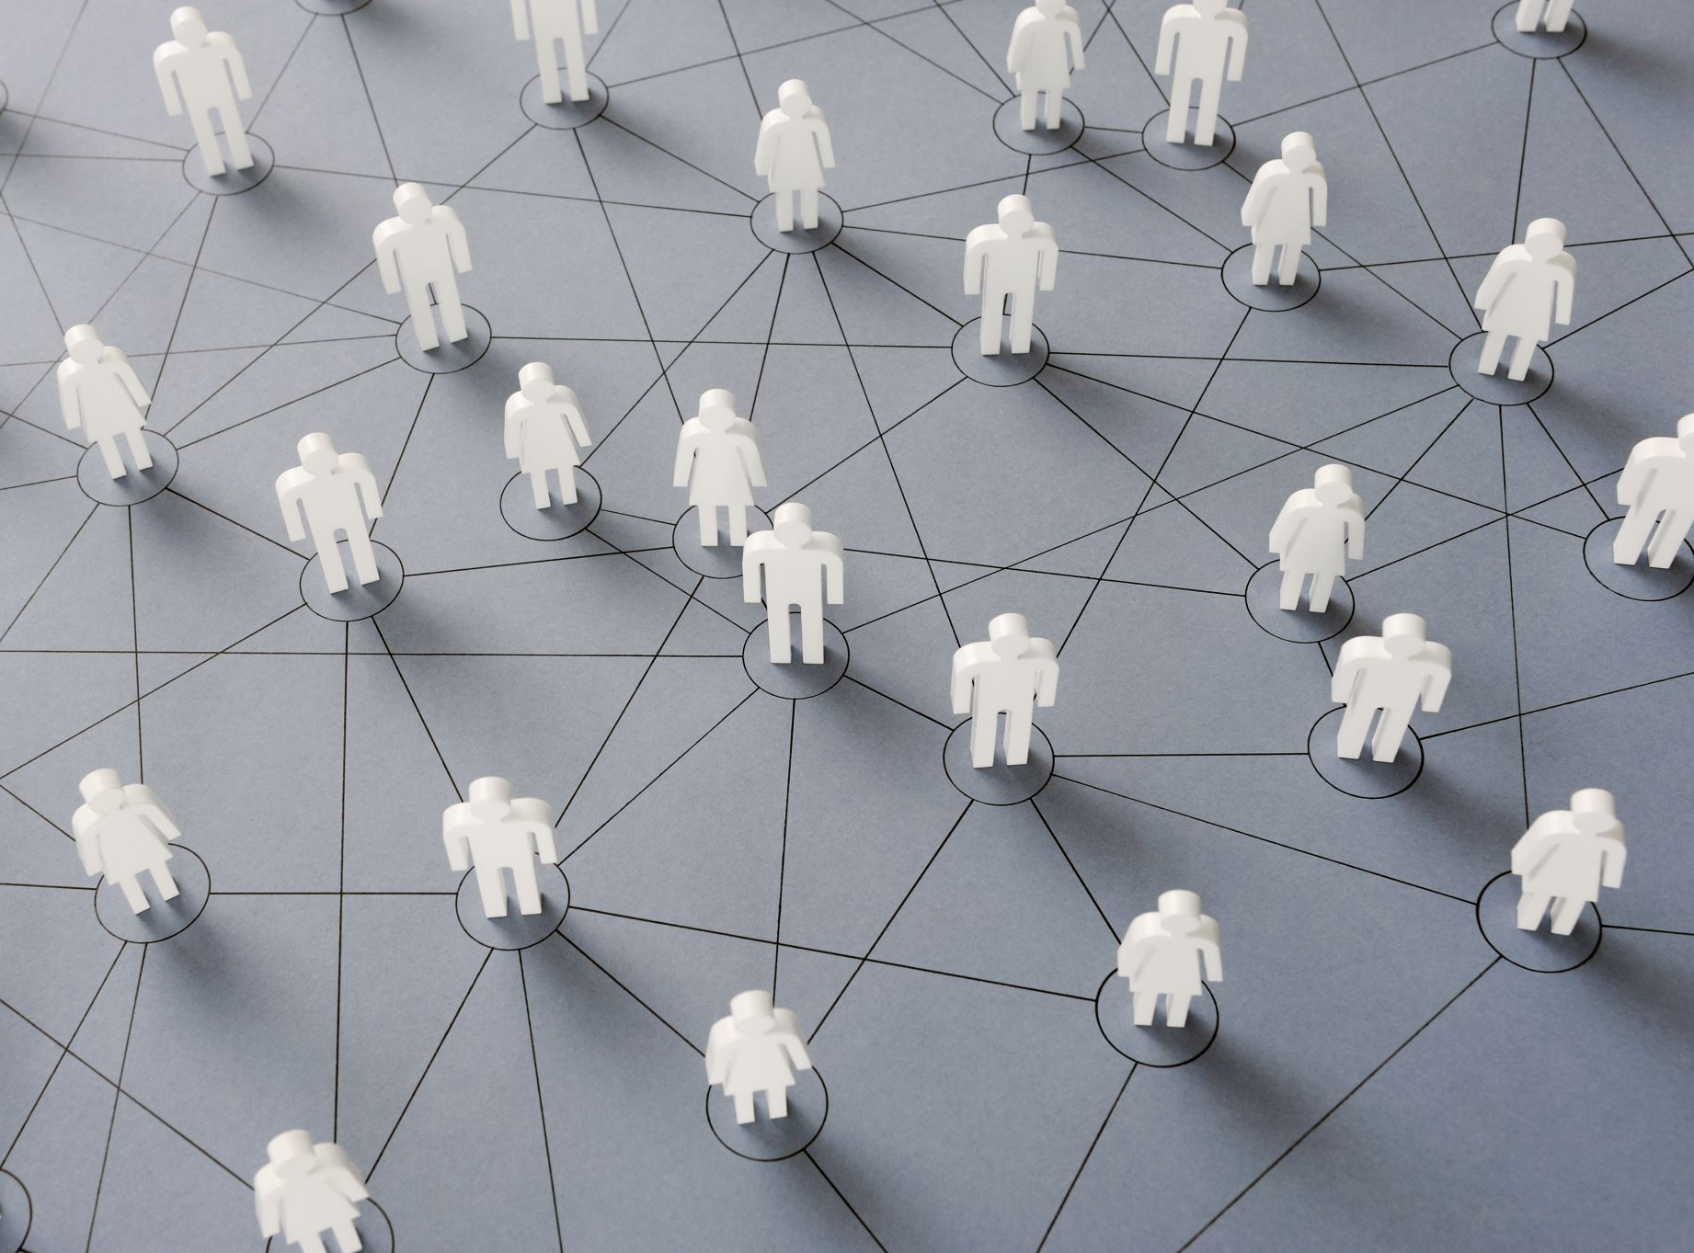
Effective communication
Notes:
Some people believe that they can communicate just because they speak a language. However, effective communication requires much more. Let’s explore this interesting topic.

Slide 5
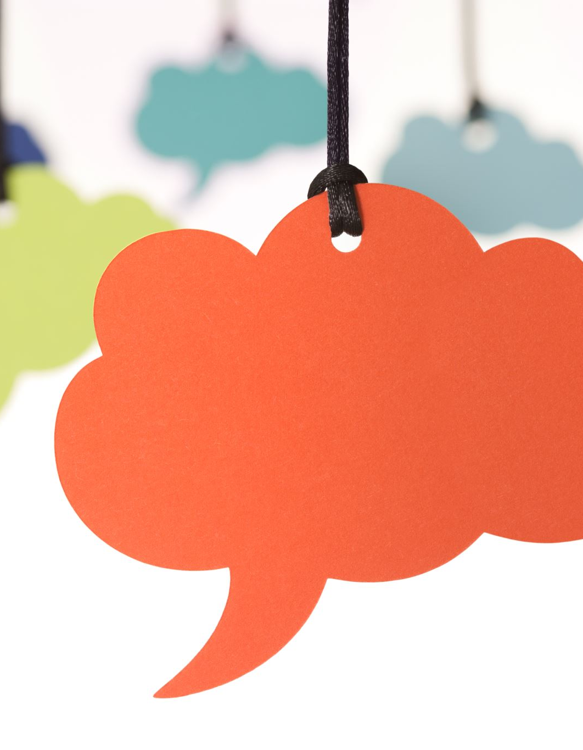
To be able to effectively communicate with others, you need to:
  Know and understand yourself
  Try to understand the other people
    Emotional intelligence
    Empathy
    Active listening
Notes:
To be able to communicate with others in a meaningful way, we first need to know ourself, understand our needs, motivations and emotions. We have discussed all these in the previous module. Then, we need to understand the other people around us. To be able to do so, we need to build emotional intelligence, develop empathy and listen actively. We will see all three prerequisites in detail.

Slide 6
What is emotional intelligence?
Self-awareness
Social awareness
Relationship management
Self-management
Emotional intelligence (also called EQ) is the ability to understand your own emotions and the emotions of others.
Notes:
Emotional intelligence is the ability to understand our own emotions and the emotions of others. While IQ (Intelligence Quotient) is a measure of our ability to solve problems and think logically, EQ (Emotional Intelligence Quotient) measures our ability to understand and manage emotions. Our EQ can have a greater influence on our success in life than our IQ. There are 4 key skills to Emotional intelligence: Two of them have to do with ourselves: Self-awareness: we recognize our own emotions and how they affect our thoughts and behavior. We know our strengths and weaknesses. Self-management: We are able to control impulsive feelings and behaviors, manage our emotions in healthy ways, and adapt to changing circumstances. We have discussed these 2 skills in the previous module. We will now look at the other 2 that have to do with our connection to others: Social awareness: we have empathy. We can understand the emotions, needs, and concerns of other people, and feel comfortable socially, and Relationship management: we know how to develop and maintain good relationships, communicate clearly, work well in a team, and manage conflict. We will talk about these two skills in more detail.

Slide 7
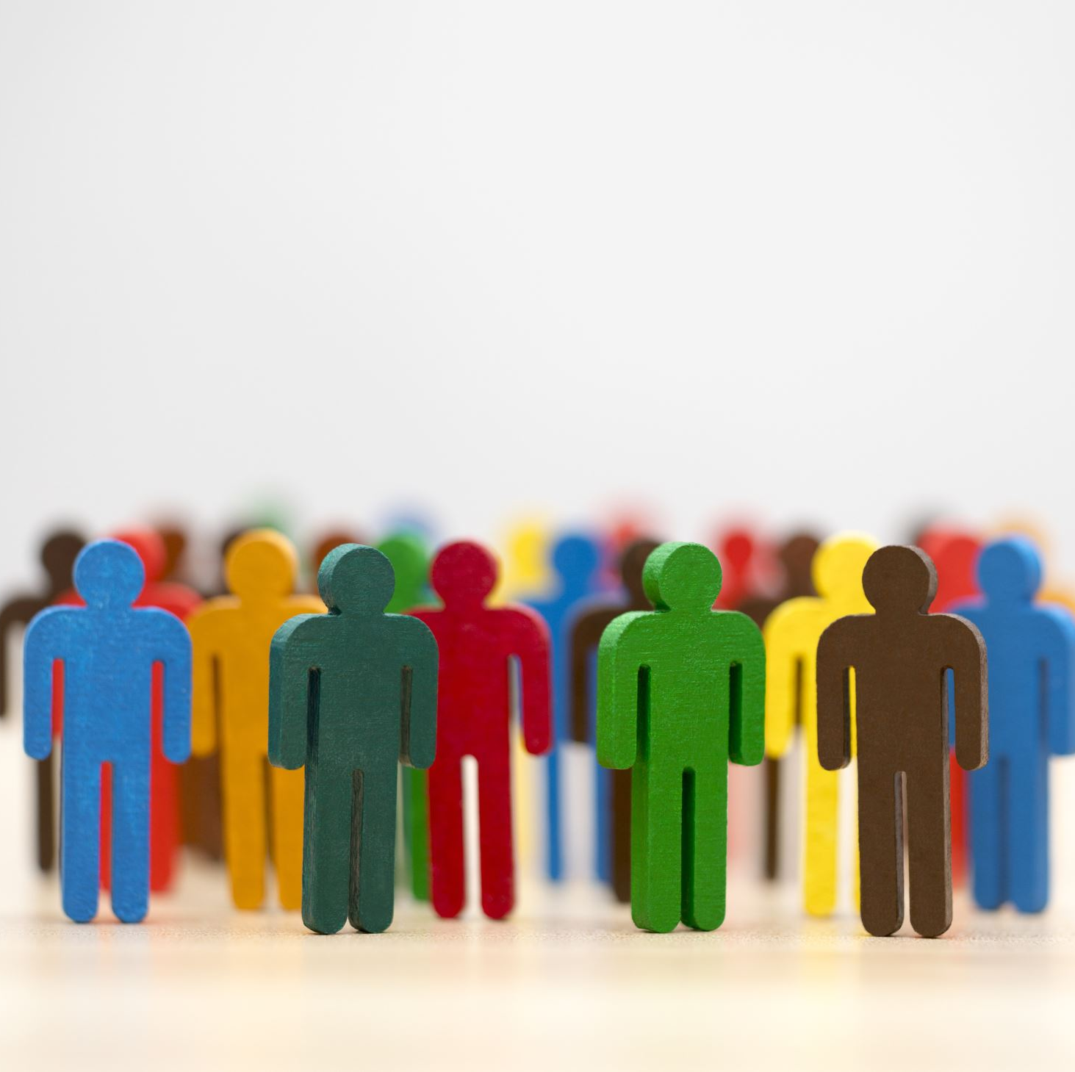
Social awareness
Social awareness enables you to recognize and interpret verbal and nonverbal clues others are using to communicate with you.
Empathy is a key component of social awareness, allowing us to step into someone else’s shoes and view the world from their perspective.
Social awareness requires your presence in the moment.
Notes:
What exactly is social awareness? It is a valuable skill that enables us to recognize and interpret verbal and nonverbal clues others are using to communicate with us. These clues let us know how others are really feeling, how their emotional state is changing from moment to moment, and what’s truly important to them. Sometimes, verbal and nonverbal clues contradict each other. For example, a person who speaks very low can be afraid or shy or secretly asking for help. A person who says is fine but sits curved and does not look at us when answering, is not fine at all. Evaluating body language and nonverbal signals can be practiced. We will talk about this is a little while. A key component of social awareness is empathy. It allows us to step into someone else’s shoes and view the world from their perspective. Social awareness requires our presence in the moment, our attention.
Ask students if social awareness as a concept is clear to them. If not, try to rephrase and explain.

Slide 8
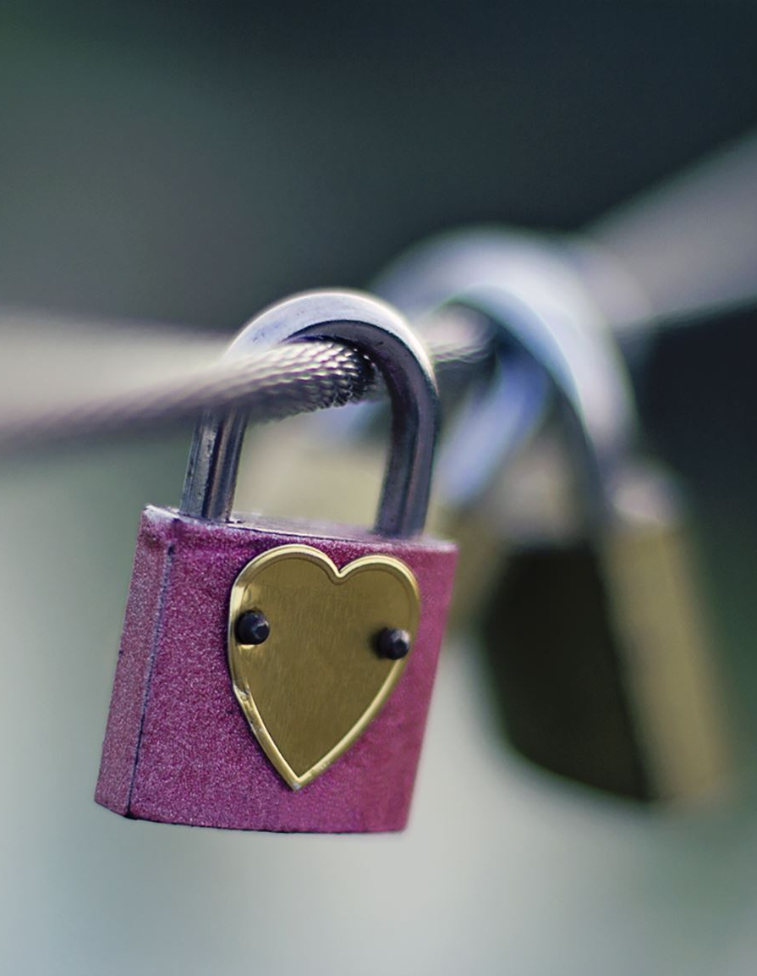
What is empathy?
https://www.youtube.com/watch?v=Itp21tly8nM
Empathy is the ability to put yourself in someone else’s shoes.
Understand that all people are different. Something that does not bother you at all, may hurt another person
Empathy relies upon your ability to detect, feel, and share emotions.
Notes:
But what is empathy? Let’s see a short video about it.
After watching the video open a discussion with the students to make sure they have understood what empathy is, and why it is important. Then click to reveal the content of the slide, which serves as a sum up.
Empathy is the ability to emotionally understand what other people feel, see things from their point of view, and imagine ourselves in their place. There are different levels and expressions of empathy, but essentially it has to do with the ability to put ourselves in someone else’s shoes. As we saw in the video, to practice empathy, we need to understand that each person is different. Something that does not bother us at all, could hurt another person. This is even more true, when it comes to people from different cultural backgrounds. Then, we need to pay attention to the signs that show how a person might be feeling. This includes their body language, tone of voice, and words used. Once we have understood how a person might be feeling, we need to be careful to respond in a relevant way. A friendly hug, some words to show our compassion for the other person’s sadness or our joy for the other person’s happiness or success, are welcome most of the times. If we can, we may help people who need it.

Slide 9
Why is empathy important?
It improves human interactions in general and improves your capacity to communicate with others, to be part of a team.
It enables you to build meaningful social connections.
You’ll become a better friend, worker and leader.
You’ll learn to look at the bigger picture.
Notes:
Why should we put effort to build empathy? Why should we care? Empathy improves all human interactions and improves our capacity to communicate with others and to be part of a team. It enables us to build meaningful social interactions. To feel connected to others is hugely important for our optimal wellbeing. It is the very basis of human relationships and helps us to feel valued, loved, and cared for. Being connected to others is good for our mental wellbeing. Empathy helps us become better friends, and later on, better workers, team members and leaders. It allows us to understand our friends, partners, and co-workers better. We’ ll be in a better position to develop more caring and compassionate relationships and to effectively lead and inspire others in the future. Finally, empathy train us to look at the bigger picture and build our resilience. When we incorporate several different perspectives or worldviews, we are able to see the bigger picture of an issue or concept, thus become more resilient, as we discussed in the previous module. It is apparent, that if all people practiced empathy, the world would be a better place.
Open a discussion with students about the importance of empathy. What do they think about all the above? Will they try to practice empathy in the following days?

Slide 10

Evaluating body language and nonverbal signals
Eye contact – Is the person making eye contact? If so, is it overly intense or just right?
Facial expression – What is their face showing? Is it unexpressive, or emotionally present and filled with interest?
Tone of voice – Does the person’s voice project warmth, confidence, and interest, or is it strained and blocked?
Posture and gesture – Is their body relaxed or stiff and immobile? Are their shoulders tense and raised, or relaxed?
Touch – Is there any physical contact? Is it appropriate to the situation?
Intensity – Does the person seem flat, cool, and disinterested, or over-the-top and melodramatic?
Notes:
As we said before, our social awareness and empathy rely on our ability to be present and observant of verbal and non-verbal clues of others. Verbal signs are obvious, it is what people say. Evaluating nonverbal signals of other people takes time and practice. We talk about body language and the different elements it includes. Let’s see a short overview of them together.
Read each of the blocks on the screen and stop every time a student has a question. If there are questions for any of the blocks, try to give examples.
We can try to check all the above when we meet new people, or when we are spending time together with our friends. Body language can reveal more about the emotional situation of a person, than his/her words. As we said, it takes time and practice, but it pays off in different ways.

Slide 11





Social awareness activity
Stressed
Peaceful
Excited
Angry
Disappointed
Anxious
Sad
Relaxed
Upset
Concerned
Joyful
Tired
Happy
Worried
Calm
frustrated
Match the pictures on the left with the emotions listed on the right. You can connect a picture with more than one emotion.
Notes:
As a start, we will practice this now, together. This activity urges us to observe the faces of different people and try to match them with certain emotions we guess they feel.
This is a group activity (5-10 minutes). Divide your class in teams of 2-3 students. It is better if each team can sit at a distance from the other teams. Give each team an A4 and a pen. Ask students to match the pictures with the emotions. They can use more than one emotion for each picture. When they finish, ask each team to say loud what emotions they have assigned to each picture. If they are conflicting views among the teams, ask students to explain why they have chosen a specific emotion and open a discussion. This exercise might take only 15 minutes, but if different views appear it could take up to half an hour. It is important to allow time for discussion. This will help students understand exactly what we have discussed before, that all people are different and have a different perspective.

Slide 12

What’s going on in this picture?
https://www.nytimes.com/2024/04/28/learning/whats-going-on-in-this-picture-april-29-2024.html
Notes:
Now, this exercise is very interesting and provides us with an opportunity to practice our observation skills. We will see a photo all together and we will try to understand what is going on and how people in the photo feel.
This is a group activity, while the whole class together will be the team. This New York Times series presents a photo without a caption and prompts students and readers to make their own observations on what might be happening in the photo. Open the link and start a discussion with students:
What they think is going on?
Why they say that?
Choose a person in the photo and ask students what his/her feelings might be. Focus on body language, as we have examined it before
Give a title to the picture. Allow student to be creative
The Reveal: This week’s image comes from the article “Ready, Set, Garçon! Paris Waiters Race as Storied Contest Returns,” published on March 24, 2024. The original caption reads: “The waiters began the competition at Paris City Hall, headed to the Centre Pompidou, then wound through the Marais before looping back to the starting point.”
This exercise should not take longer than 12 minutes.

Slide 13
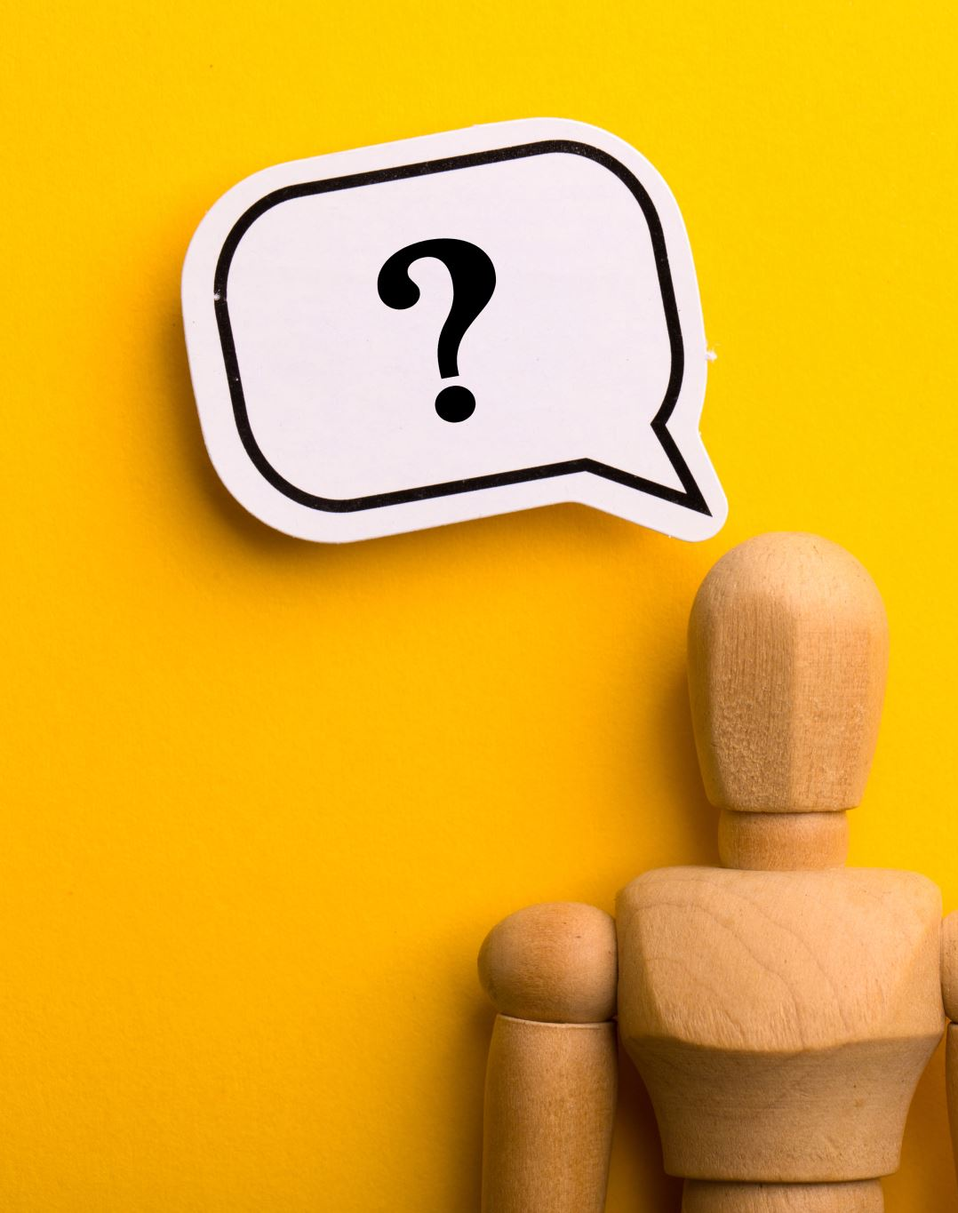
If you are interested in testing your emotional intelligence, try these quizzes (in English)
https://www.mindtools.com/axbwm3m/how-emotionally-intelligent-are-you
https://greatergood.berkeley.edu/quizzes/ei_quiz/take_quiz
Notes:
The best way to test our emotional intelligence ability is by monitoring how our relationships evolve. However, if we are interested also in personality tests and our English is good, we can try these two quizzes about emotional intelligence.

Slide 14
Active listening for effective communication
Hearing Vs. Listening
 | Hearing | Listening
Nature | Involuntarily | Voluntarily
Process | Passive body process | Active mental process
Act | Physiological act | Psychological act
Focus | Not required | Required
Senses involved | 1 | More than 1
Initiation point | Hearing begins before listening | Listening commences after hearing
Notes:
Now, as we said at the beginning of this module, active listening is also an essential social skill for effective communication, that helps us build strong relationships and engage in meaningful conversations. Learning to listen expands our capacity for empathy. People often say “I listen” but in reality, they just hear. What is the difference? Hearing and listening are different in nature, process, focus, act, senses involved and initiation point. Let’s look at this table
Read the table from left to right to show the difference between hearing and listening: Nature: we hear just because we have ears, not because we want to. Listening on the other hand is voluntarily. We listen if we really want to. Process: hearing is a passive process based on an organ, the ear. Listening is an active mental process. We have to put effort to do it. Therefore, hearing is just a physiological act, while listening is a psychological act. Hearing does not require any focus. Our ear hears different sounds at the same time. In Listening we need to be focused on what is being said. In hearing there is only one sense involved, while in listening there are more: vision, mental senses, etc. Finally, when there is some kind of sound, hearing will hep us realize it, but nothing else. After we have heard the sound, we start listening. Ask students if they have any questions.

Slide 15

Active listening involves reflecting what you understand, asking thoughtful questions for clarity, and withholding judgment or interruptions
https://youtu.be/rzsVh8YwZEQ?feature=shared
Notes:
So now that we have understood the differences between hearing and listening, let’s focus on active listening. It involves reflecting what we understand, asking thoughtful questions for clarity, and withholding interruptions or judgement. Let’s see some strategies for active listening in a short video
After showing the video, stress the part of no interruptions. Use the common example of discussions shown on TV, that the speakers interrupt each other all the time. Point out that this is not effective communication, and it is annoying and almost impossible for the audience to understand what it is said.
With active listening, we finish the part that is dedicated to effective communication. Do you have any questions? Is there anything we need to clarify further?

Slide 16

Relationship Management
Notes:
We will now enter the interesting part of relationships management. We are social animals by nature, remember? We will see how we can relate to other people, like friends, classmates, caregivers, or partners.

Slide 17
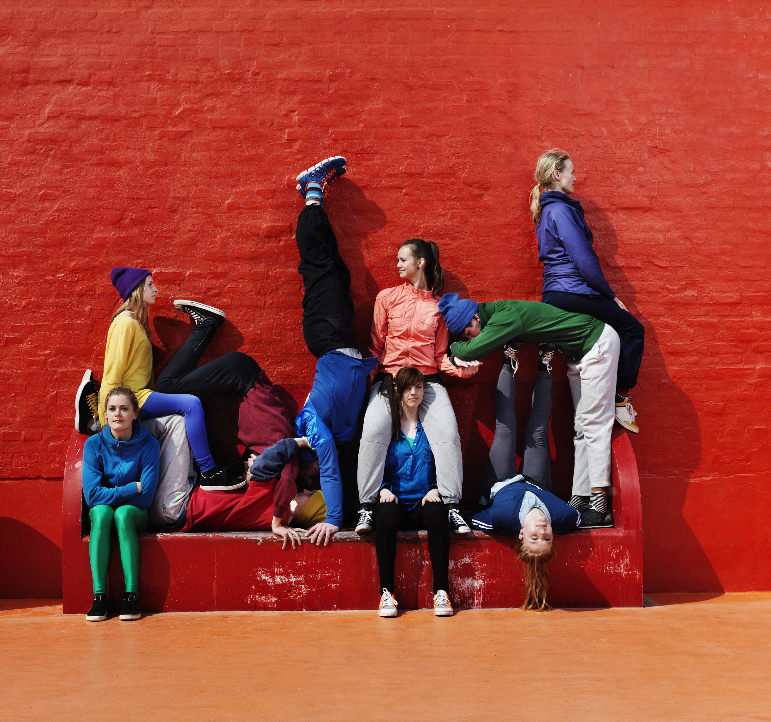
Healthy Vs. Unhealthy relationships
Healthy: the ones where you can feel safe and express your views freely and with respect for yourself and others. They are based on mutual trust, honesty, good communication, being understanding and calm during arguments, and consent
Unhealthy: the ones that have a power imbalance; there is no consent, mutual trust, compromise, or honesty. One or both people in the relationship may have trouble communicating and controlling their anger. Some unhealthy relationships become physically, emotionally, or sexually violent.
Notes:
We will begin by explaining the two main kinds of relationships: the healthy and unhealthy ones, which cover all types of social interaction: friendships, teams, and romantic relations. Healthy relationships are ones where we can feel safe and express our views freely and with respect for ourselves and the others. They are based on mutual trust, honesty, good communication, being understanding and calm during arguments, and consent. Unhealthy relationships, by contrast, have a power imbalance; there is no consent, mutual trust, compromise, or honesty. One or both people in the relationship may have trouble communicating and controlling their anger. Some unhealthy relationships become physically, emotionally, or sexually violent. What we have discussed already, self-understanding and social understanding, empathy, active listening, can help us build healthy relationships and stop or move away from the unhealthy ones.

Slide 18

Tips for Healthy relationships
Become aware of how effectively you use nonverbal communication. Recognizing the nonverbal messages that you send to others can play a huge part in improving your relationships.
Use humor and play to relieve stress.
Conflict and disagreements are inevitable in human relationships. Two people can’t possibly have the same needs, opinions, and expectations at all times. However, that is not a bad thing. Resolving conflict in healthy, constructive ways can strengthen trust between people.
Understand that every person is different, and this is interesting.
Notes:
Our aim of course is to build and retain healthy relationships. Let’s see some tips toward that direction. Nonverbal communication and body language pay a very important role in relationships. We need to pay attention to our own body language. The many muscles in the face, especially those around the eyes, nose, mouth and forehead, help us to wordlessly convey our own emotions as well as read other peoples’ emotional intent. We may say something, but our facial expression convey something different. People around us will notice. Humor, laughter and play are natural antidotes to stress. Laughter brings our nervous system into balance, reducing stress, calming us down, and sharpening our mind. We should use humor to our relationships. However, we should not use humor to make a fool of another person’s feelings, or his/her strong beliefs. Two people cannot agree on everything. And they can’t possibly have the same needs, opinions, and expectations at all times Conflict and disagreements are part of human relationships. When conflict isn’t perceived as threatening or punishing, but just as what it is, meaning two people who have different opinions, it fosters freedom, creativity, and safety in relationships. Resolving conflict in healthy, constructive ways can strengthen trust between people. We need to remember that every person is different. Even our best friend is probably totally different than us. This is ok, as long as we can have a healthy relationship. It is interesting too. Some friends or partners can complement each other, just because they are different, and they pay attention to different aspects of a topic. We must focus on all the positive things that this difference can bring in the relationship.

Slide 19
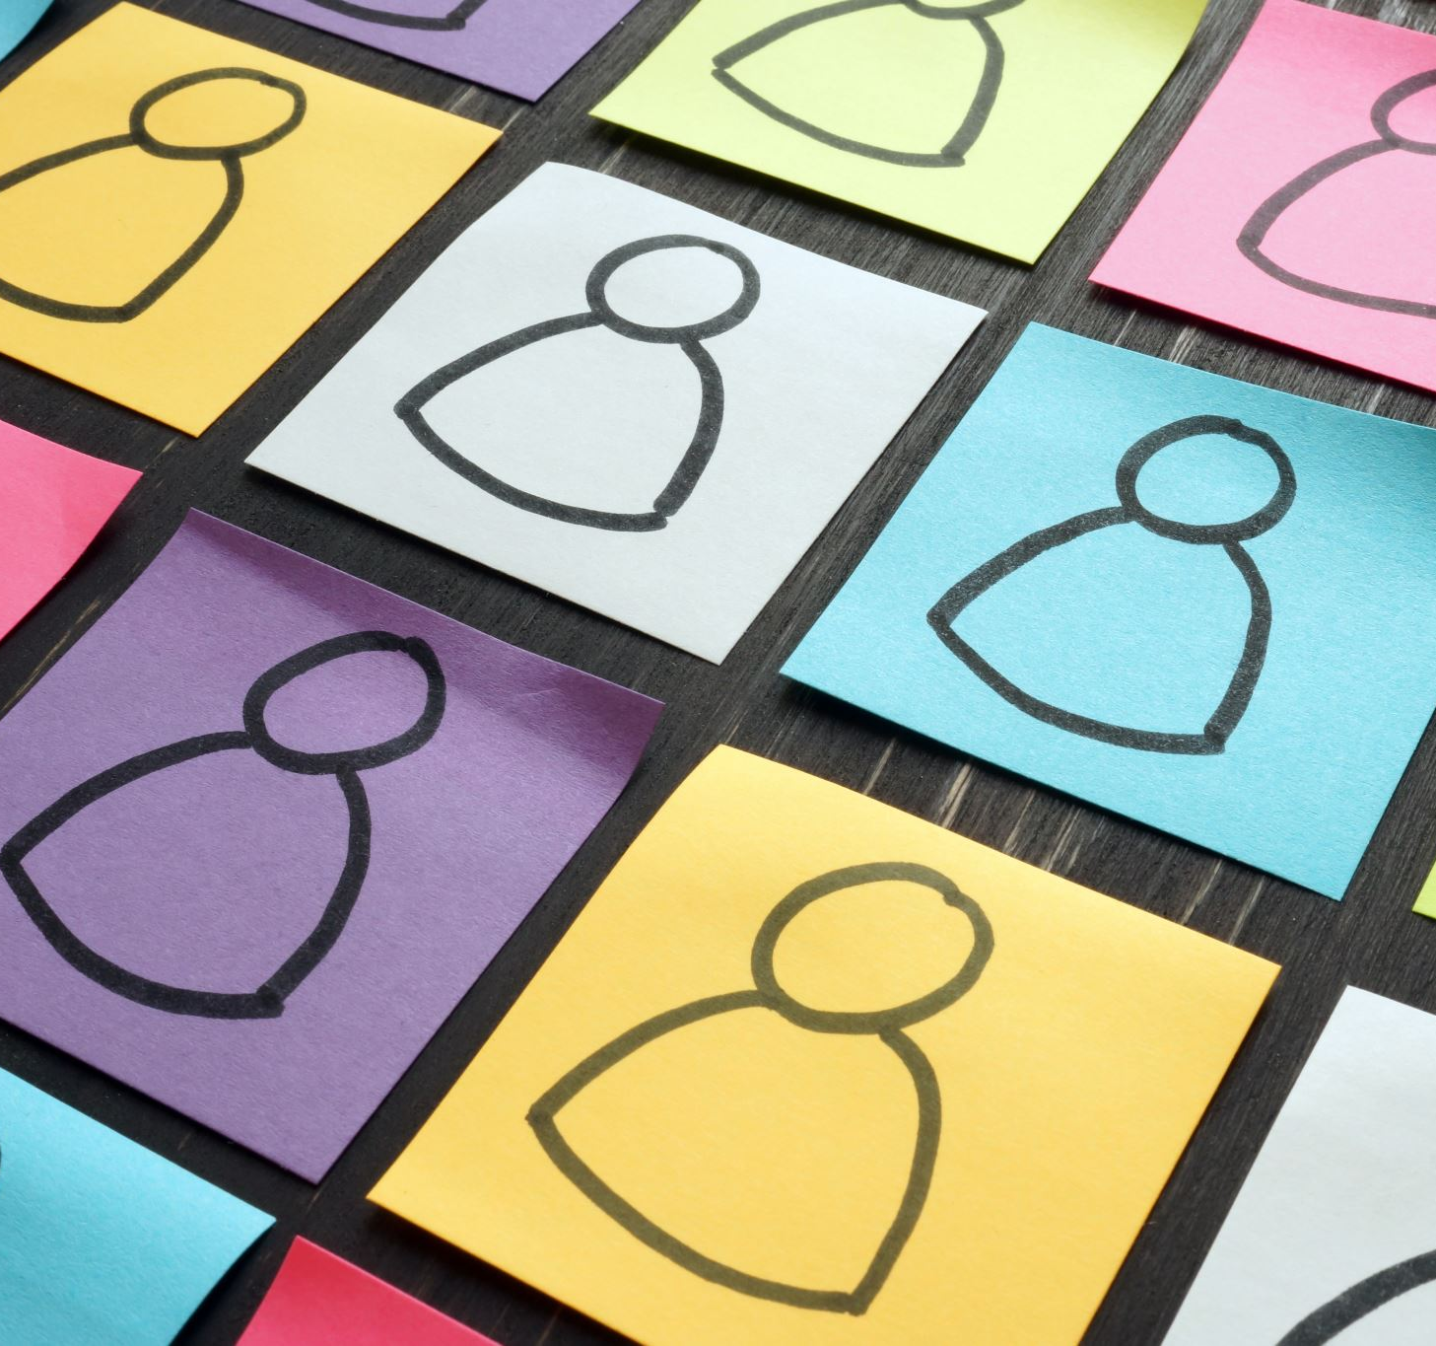
When to end a relationship
Signs:
constant unhappiness
lack of trust
repeated patterns of conflict
emotional or physical abuse
misalignment of values
feeling stagnant or held back
loss of respect
Notes:
Knowing when it's time to leave a relationship, like friendship, team, work, romantic relationship can be deeply personal, but signs that it might be time for us to move on include: constant unhappiness; if we feel unhappy being with the other person. Lack of trust; if we cannot trust the other person. Repeated patterns of conflict, that escalate and cannot be resolved respectfully. Emotional or physical abuse; bullying, constant criticism, threatening, are included here. Misalignment of values; as we grow older our values interfere in our actions. If the other person does not share the same or similar values, there is a great possibility that their behavior is different than we want. Feeling stagnant or held back; in some relationships, one person always put his/her needs aside to please or help the other person. This is normal if it happens occasionally or for minor things but is unhealthy to be held back constantly and then regret it. Loss of respect; if a person does not respect us will soon engage in other problematic behaviors as well, like abuse, cheat, fight.
 Ask students their opinion about these signs. Do they have other indications to add?

Slide 20

Last activity
Did you learn anything new about yourself?
How do you feel?
Notes:
This is an activity in pairs, and it aims at helping students practice their emotional intelligence, active listening, recognizing verbal and nonverbal messages and focus on the positive aspects of another person. Instruct the students to form pairs. Try to put each pair of students sit in a small distance from another pair. Hand post-it notes and pens to both students in each pair. Announce the instructions
This is one last activity, that puts all we discussed together. It is not a test and there are no right or wrong answers. The one person in each pair will narrate a personal story of his/her choice for 2-3 minutes. The second person will listen without interrupting or asking questions, and while listening, will right down on a different post-it note a positive thing he/she notices about the other person. Then, you will turn sides. Now, the second person will share a personal story, and the other person will note positive things on different post-it notes, based on the story.
When all pairs have finished, ask each pair to come in front and each person in every pair to praise the other for the positive aspects they noticed and at the same time give the relevant post-it note to the other person : “based on your story, I think you are …brave, you have patience, you are strong, honest, etc). This is repeated until all pairs have presented their results. At the end of the exercise, each person of the group will have collected some post-it notes with positive things about themselves, which helps them feel good and proud about themselves. Ask the class if they learnt anything new about themselves that they had not realized before, and how do they feel. Allow students to answer these questions voluntarily.

Slide 21








Eurhope
EU as a solidarity's house for minors out of home
Erasmus+ project n. 2023-2-IT03-KA220-YOU-000184370
Funded by the European Union. Views and opinions expressed are however those of the author(s) only and do not necessarily reflect those of the European Union or the European Education and Culture Executive Agency (EACEA). Neither the European Union nor EACEA can be held responsible for them.

