Slide 1














Eurhope
EU as a solidarity's house for minors out of home
Erasmus+ project n. 2023-2-IT03-KA220-YOU-000184370
Digital Skills Module 3
Security
Notes:
This is a 4-hour module. You can teach it in one session, or two 2-hour sessions. Arrange for a 10-minute break every hour.
🛈 You will need:
a PC/laptop with access to the Internet and speaker to be able to listen to the videos.
A data projector to project this presentation.
A note on the videos used: Most videos are in English. You can add subtitles if you click CC at the bottom of the video. If you don’t see your language, click on settings, auto-translate, and select your language. Since most videos start with a short ad, it is advisable to open the video before class, skip the ad and stop. Open it again when it is time and start it. In this module there are several videos (slides: 6, 13, 14, 15).
Symbols used in the notes to help you teach the module:
☺ It is used for something you have to say or read in class. It represents your speaking.
📄 It is used for instructions. It gives you info on what to do.
🖈 It is used in any of the above (speaking or instructions). It represents a question to ask students, or an activity to do with students.

Slide 2



In this module we will discuss:
Protecting Privacy and Data
Privacy protection strategies
Impact of New Technologies on Well-being
Understanding the importance of privacy protection
Understanding and managing digital footprint
Safe online practices (phishing, scam. Grooming, privacy settings on social media)
Discussion on the potential risks and benefits of technology use
The impact of social media, constant connectivity, and screen time on mental health.
Strategies for maintaining digital well-being (balance with technology use, digital detox practices)
Notes:
Hello again, in this module we will discuss important things that have to do with our protection online and offline. Technology has brough so many good things in our lives, but of course, it has also brought crime to the next level. It is important to know how to protect our privacy and our data, be aware of our digital footprint, and how to use the Internet in a safe way. The last part of this module is dedicated on the impact of new technologies on our well-being. Are you ready?

Slide 3
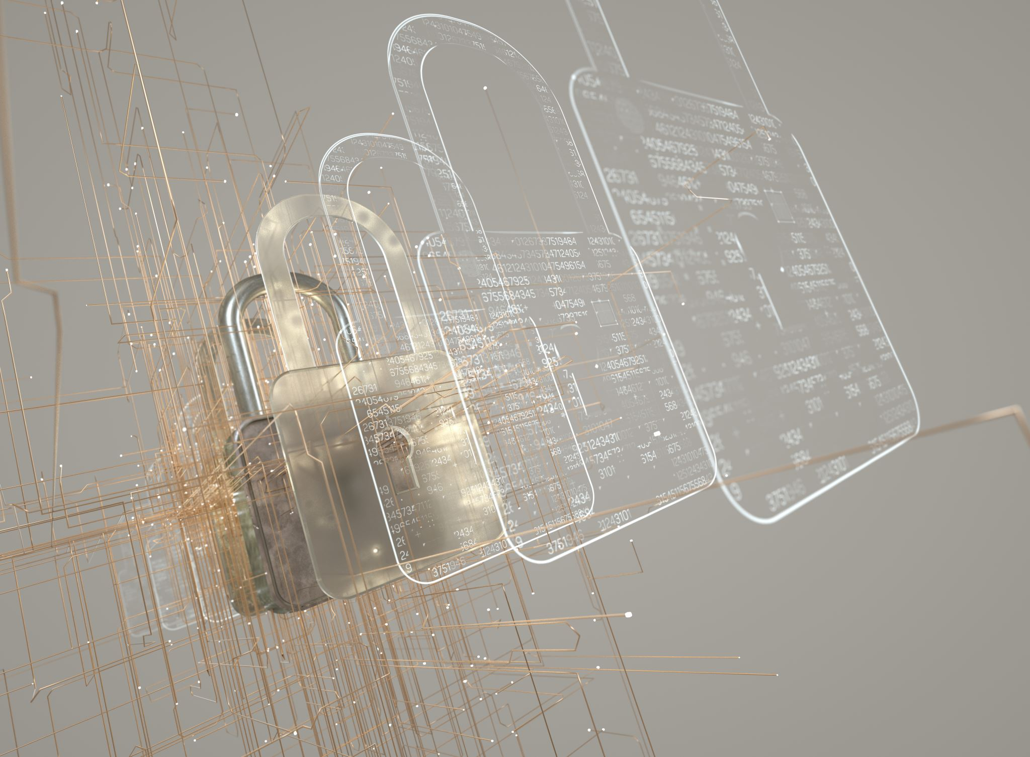
Protecting Privacy and Data
Notes:
We will start by understanding how we can protect our privacy and data.

Slide 4

Why is protection of personal information important?
Privacy Protection: Personal information (addresses, phone numbers, and social media accounts). If this information falls into the wrong hands, it can lead to a loss of privacy and potential misuse.
Preventing Identity Theft: identity thieves can use your personal information to commit fraud, open accounts, or incur debt in your name.
Online Safety: Sharing personal information online can make you vulnerable to cyberbullying, online predators, and scams.
Future Implications: Information shared online can remain accessible for years. Embarrassing or inappropriate posts can affect future opportunities, such as college admissions or job prospects.
Notes:
Why should we care about privacy? Protecting our personal data, such as our address, phone number, social media accounts, age, email password, etc is important for four main reasons: Privacy protection: we don’t want our information to fall into the wrong hands or be misused. This can put us in danger. We will see examples of misuse later on. Identity theft prevention: thieves can use our information to commit fraud or illegal actions under our name, or in other words to pretend it is us who committed some illegal action. For example, they can open an account under our name and collect money from people for fake services. Online safety: equally important is that we keep ourselves safe online, as we do in real life. We must avoid becoming victims. We will see further on, how pictures can be misused and the consequences of that. Lastly, we need to consider future implications: Before we do anything online, we have to think about our online reputation today and in the future. e.g. what would a future employer think about an embarrassing moment we shared?

Slide 5

But, I have nothing to hide…
Protecting your personal information is not about hiding but having the autonomy and freedom to make your own decisions.
AND:
You need to protect yourself from threats that don’t exist yet
  You never know what combination of personal information and new technologies will lead to future threats. To prepare for these unknown assaults on your data, the only thing you can do is to make it less accessible.
Notes:
A lot of people say: “I’m not anyone important or famous, and I have nothing to hide”. But, protecting our personal information gives us freedom and autonomy to make our own decisions and not fall for the appetite of online criminals who might blackmail us. Furthermore, as the technology advances in a very fast pace, we need to try to protect ourselves from threats that do not even exist right now. Turning on our mobile phones with our fingerprints only became available the last decade. But, if someone copy our fingerprint, and combine it with other personal information, increases the possibility that we become victims in the near future. To prepare ourselves for unknown, future problems, we need to make our personal data less accessible.
Use the following example to help students understand future threats: there was a story on the news about students who found naked pictures of themselves online, although they never sent such pictures. What happened is that a very new app that is based on AI, could take any person’s picture, remove the clothes and show the person naked. This app is a new threat; it did not exist 2 years ago.

Slide 6
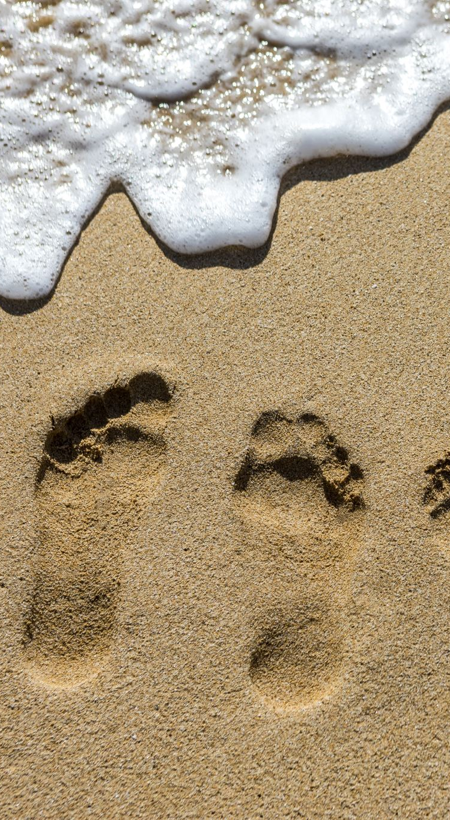
What is your digital footprint?
We leave footprints on the sand as we walk. In a similar way, we leave digital footprints as we are doing anything online.
Watch the following video:
https://www.youtube.com/watch?v=7bRZdUtmH8k
Why should you care?
Because anything you search, browse, text, write, upload, click, like, etc is PERMANENT and can affect your life today and tomorrow.
Notes:
📄 Don’t reveal the content of the slide yet, just the title
☺🖈Have you heard of this term – digital footprint? Can you guess what it is?
Allow students to share their ideas and then click to reveal the content of the slide.
The easier way to remember this, is to imagine that we are walking on a beach. With every step we leave our footprint on the sand. In a similar way, with everything we do online we leave traces. Those traces are called digital footprint. Let’s watch a short video together. It explains in a very simple way what a digital footprint is.
Watch the video and before you return to the presentation ask students 🖈Is it clear what the digital footprint is? Do you have any questions? Then return to the slide
Why should we care about our digital footprint? Because it follows us forever. We cannot delete it. Others can search our digital footprint. Remember, we leave traces with any action online. This information can translate to money for some professionals, e.g. marketing professionals, or be exploited by criminals. It also reveals an image for us. And this image, whether good or bad can affect our personal reputation.
Let’s play the Privacy Chicken game together. You will see that simple, everyday actions you make, put you in danger

Slide 7

The privacy chicken
https://www.nytimes.com/interactive/2020/01/21/opinion/privacy-chicken-game.html
It’s easy to win! Just give up your personal information. Or are you too chicken?
Notes:
Whenever we go online, we share personal information more often than we think. This game shows the questions or actions requested by platforms, social media, games, or just websites. We usually don’t think about it, but the game asks us to make a choice so that you pay attention. Let’s see what happens.
Open the game and play with all the students. The game is in English, and no subtitles are supported. However, it is simple language and short messages that you must translate to students. Depending on their choices, the game can finish very soon or last longer. Although funny, it reveals how easy it is to share private data.

Slide 8
Privacy Protection Strategies
Notes:
As we said before, the Internet opens the whole world on our screen, but we need to make sure that we will have a positive experience with it. So, now, let’s see how we can protect ourselves online.

Slide 9
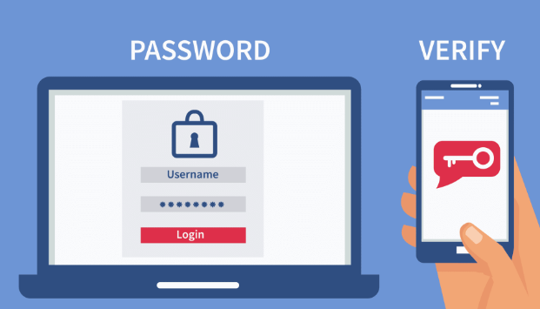
Strong passwords and two-factor authentication
Use combinations of uppercase and lowercase letters, numbers, and symbols for complex, difficult-to-guess passwords. Try to set up passwords that are 8-12 characters long. Keep your passwords private.
Compare:
john23102015 and j0hn2eF@!
When a two-factor authentication option is given, take it. It adds another security layer to your accounts.
Notes:
We start with passwords, as for any account that we open – email account, social media account, game account - we need to set a password. So, this information applies to almost everywhere. Setting a strong password is very important. To do that, we need to use combinations of letters, numbers and symbols. Birthdates, or other dates that someone could guess should be avoided. Letters and numbers next to each other should also be avoided. A strong password is 8-12 characters long. It is not a good idea to use the same password for different platforms. If one of them is hacked, we don’t want all our accounts to be hacked. And of course, once we set up a strong password, we should keep it to ourselves. 🖈Check the example on the screen. Which of the two is a strong password and why?
Allow students to express their views and exchange ideas. The correct answer is the second password, as it combines uppercase and lowercase letters, numbers and symbols in a way that cannot be guessed.
Great! Now, most email and social media accounts nowadays give the option of a two-factor authentication. This adds another security layer to our accounts, and we should use it, when it is available. For instance, entering Facebook with username, password and a code that will be sent as an SMS to our mobile phone (password and code are two security factors).

Slide 10

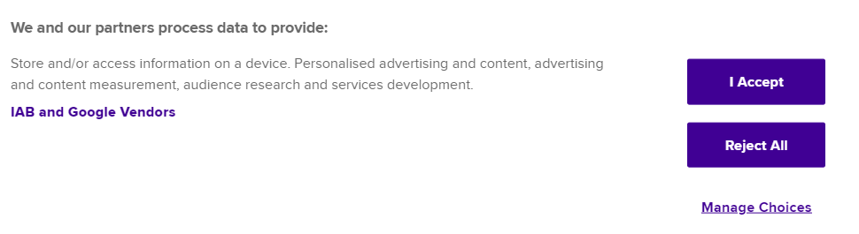
Block tracking cookies
Notes:
Another strategy we can use to protect our privacy is to block tracking cookies. Cookies are small pieces of text sent to our browser by a website we visit. Cookies are intended to help us navigate easier, according to our preferences, as this type of information is stored. We’ve all seen the pop-up, “this site uses cookies.” If we accept a website’s cookies, they’re stored on our browsers and can be used also to collect data about our browsing behavior and send this data back to websites. Other types of cookies are placed by third parties, like advertisers or vendors. It’s a good idea to decline third-party cookies, otherwise the website could sell our browsing data to third parties we don’t have any power on. Check the example on the screen. It says, we and our partners process data…. If we accept, we give our authorization to all partners of the website to use our information. There is the option of Reject all, but this is rarely provided. What we see more often is the third option “manage choices”. If we click on this, we can manage what cookies to allow and for what reason.
📄 You can open any website on a browser and show these options live to students.

Slide 11
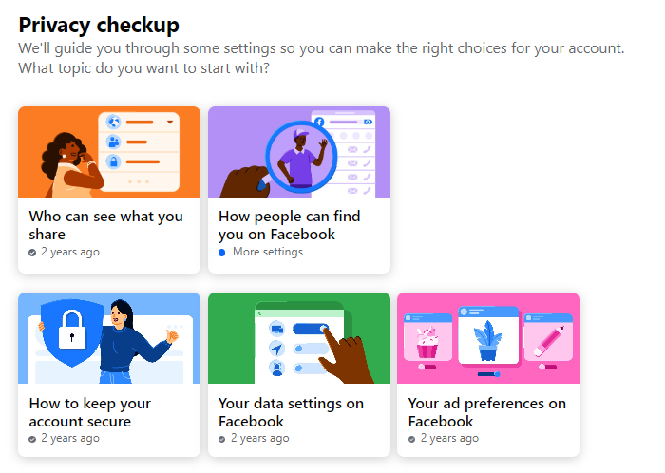
Make your social media accounts private
Add only people you know as friends. Clean your friends’ list often.
Change your social media settings to “Friends Only” to reduce the number of people who can view your posts.
Use privacy checkup
On Facebook, turn on Timeline Review so that you can review and approve all content that you’re tagged in before it appears on your timeline
Notes:
Most of us spend a lot of time on social media. It is common, although not wise, that we add people we have not met to our friends’ lists, just because they are, or pretend to be, friends of our friends or they say they find us attractive. We should be careful what friend requests we accept. Our social accounts are not a popularity contest, and having 150 online friends is not something to be proud of. We also need to remember that we share moments of our life on our social accounts. Do we want strangers to have access to these moments? Even if we have added as friends only people we know, a digital clean up of our friends list every year is a good idea. Things we need to ask: Have we talked recently? If we have friends that we have not talked to for more than 2 months, we should remove them; do they comment, like or in any way react to my post or stories? People who are in our friends’ list just to check on us, but never really react or communicate, should be removed; do they make me feel awkward? If any of our friends post insulting things, or they use hate language, or they criticize us on our weight, clothes, origin, or they make us feel weird with their content, must be deleted. On Facebook, we can use the privacy checkup option in settings, to make our account safer. On Facebook again, we can activate the timeline review so that we can approve the content we are tagged in before it appears on our timeline. This can save us from embarrassing moments. Most other social media platforms have similar settings.
If you have a Facebook or another social media account, you can show and discuss the options of the Privacy checkup.

Slide 12
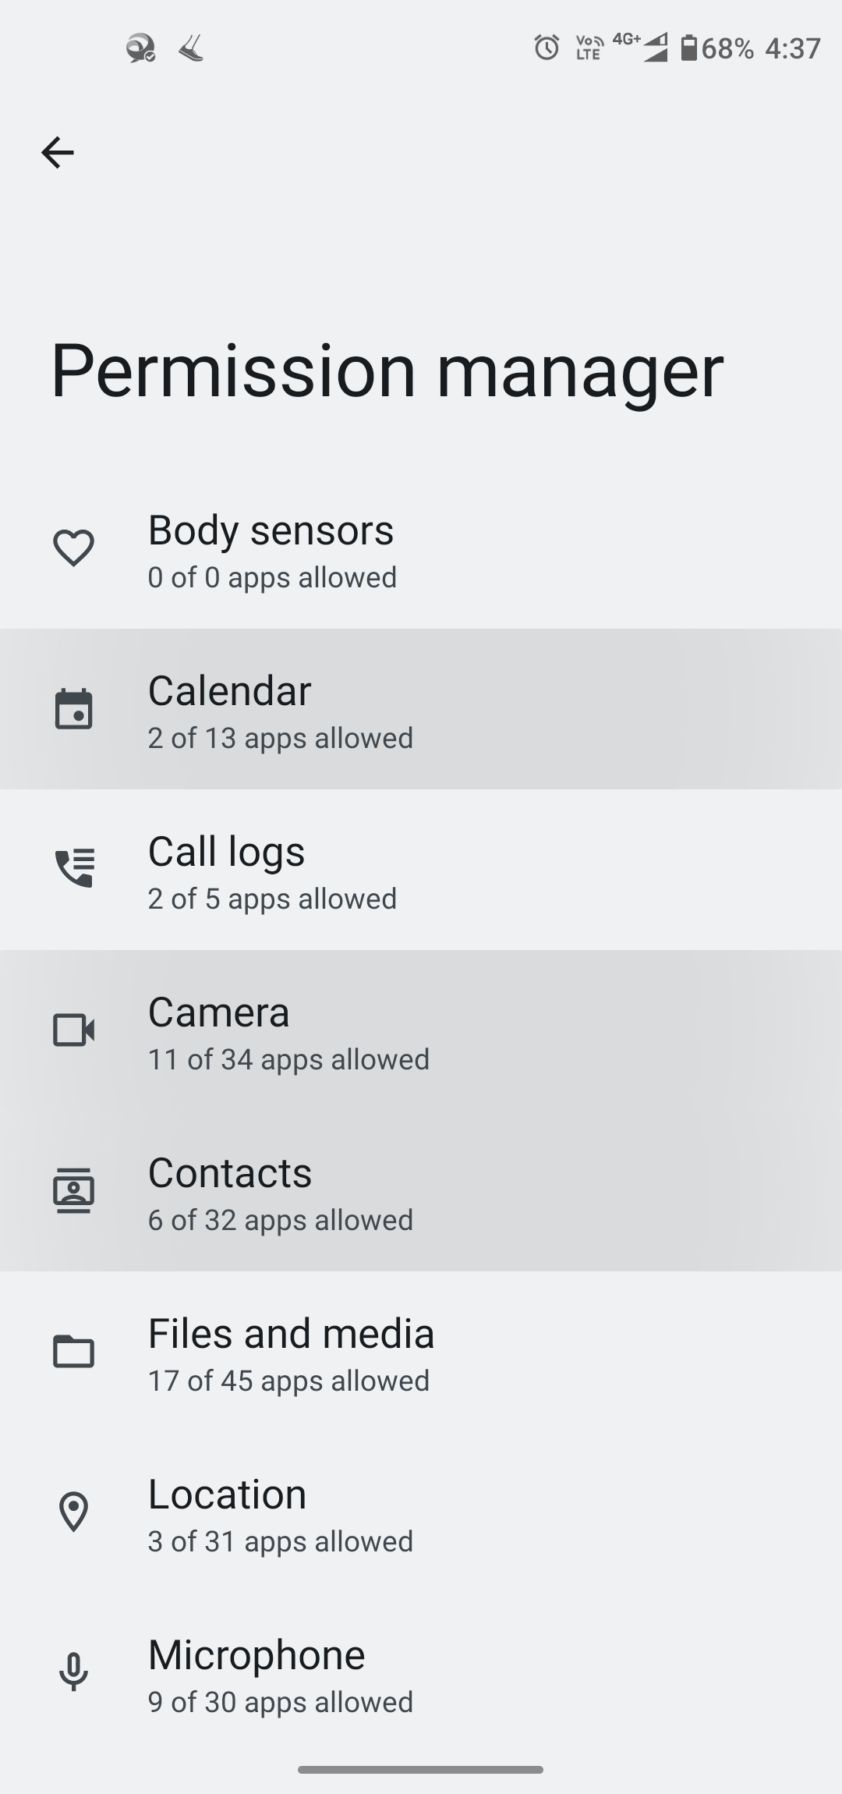
Adjust your Privacy Settings and Permissions for apps
Customizing settings on your devices and within popular applications, to have control over your data.
This is true for apps you download on your mobile phone and for apps that are available on social media, e.g. facebook.
Go to Settings, Privacy, Permission Manager, to see what kind of rights have your apps
Notes:
Now this is something that only a few people notice, but it is very important. Every app that we download on our mobile devices, or those we can get from social media, use some of our private data or ask our permission to use our data. We need to be careful with that and use our judgement to allow or reject such permissions. For instance, why should a game have access to our camera or calendar? Why should a game have access to our phone?🖈Let’s try this together. Let’s open our mobile phones. We go to Settings, Privacy, Permission Manager. We can see all our apps and the rights they have. Should they have them all? For instance, Viber needs permission to use your camera and microphone to be able to operate smoothly. But why should Instagram for example, know our location or use our contact list? On your own time, check the rights of each app and disable those that do not make sense.

Slide 13
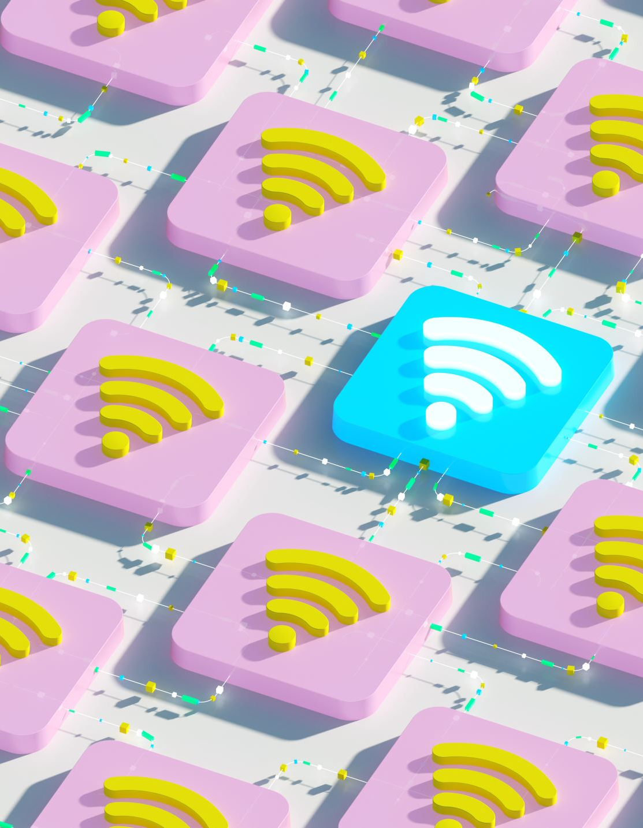
Safe browsing
You should avoid public Wi-Fi for sensitive tasks, to minimize exposure to potential malware.
Notes:
Public wi-fi services are offered in public places, and coffee shops and are convenient when we want to search for something, or to find our way by using google maps. But we should not enter any of our accounts when we use a public wi-fi. Such networks are easy to hack, and it only takes one hacker to enter everybody’s account. Especially when we use e-banking (of course this is for later on) or any other app with sensitive data.

Slide 14
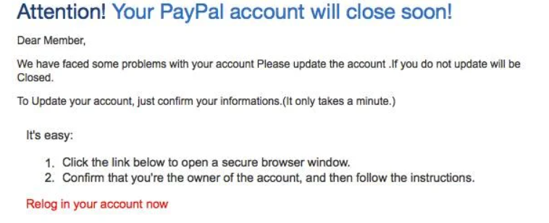
Watch out for phishing/smishing scams
These are emails or sms that try to trick you into giving away your personal information. Avoid clicking on suspicious links or downloading attachments.
The following video provides some useful advice: https://www.youtube.com/watch?v=DA4ubFS11gE&list=PL-VLWao2gONvMXuGsFVDa6xXvVILHXZbz&index=7
Notes:
We will now investigate the world of fancy words, like phishing, smishing, grooming, and sexting. 🖈 Any ideas of what such words mean? What do you think they have in common?
📄 Stop at the title of the slide. Allow students to exchange ideas and guess. Then click to reveal the content of the slide and go on.
Phising is usually emails that try to trick us into giving away our personal information. Suspicious links can appear everywhere: our email, social media, or fake ads. Many times, they try to trick us with offers, other times they say that we’ve won some prize, and other times they pretend to be officials, like the police or a bank that sends something important we need to click on. This is phishing. Smishing is the same practice, but such messages are sent via sms. We must think before we click. Nobody gives money to strangers, and emails from authorities will never ask us to click on any link. If we are not sure, we should not click on the link and ask for assistance from someone more experienced. Let’s watch a video together. It refers to 4 safety practices we should pay attention to.

Slide 15

Beware of online grooming
Online grooming is where someone befriends a child online and builds up their trust with the intention of exploiting them and causing them harm.
https://www.youtube.com/watch?v=TZ6bvYydog4
https://www.youtube.com/watch?v=kCX8f4j6wmc
Notes:
We will now discuss online grooming because, unfortunately, is very common nowadays. Online grooming is where an adult befriends a child online and builds up their trust with the intention of exploiting them and causing them harm. The statistics are very indicative. 61% of 8-12-year-olds have been contacted by someone they don’t know while playing a game. Popular digital services such as Facebook, have been used in known cases of child grooming for sexual purposes and drug trafficking. This is not fun at all. Interpol has created a short video about this danger. Let’s watch it together.
Watch the video and then open a discussion with students. 🖈What mistakes did this girl do that put her in danger? When the discussion is over, move to the next video.
☺ The second video is based on true stories. We see the parallel stories of a girl who has added a stranger as a friend, and of a boy who thinks that is talking to a girl. See what’s happening
Open a discussion with the students about the things they should avoid: talking to strangers, sending photos or money, meet strangers. If at any point they decide to meet a stranger that found online, they need to make sure that they meet in a public place and that they have notified a friend about their intention.

Slide 16

Avoid sexting
Sexting is sending, receiving, or forwarding sexually explicit messages, photographs, or videos, primarily between mobile phones.
And, it is not a good idea. Let’s see why: https://youtu.be/r7GPpSwzeT0
Notes:
Finally, sexting, is sending, receiving or forwarding sexually explicit messages, photos or videos. Recording and sharing our personal moments is another dangerous practice. We have all heard stories of people who committed suicide because an ex boyfriend/girlfriend blackmailed them with naked photos or sexual videos. Let’s see another interesting video from Cyber alert.
The video is in Greek and no subtitles are enabled. You can replace it with a video in your own language, showing the cases that sexual messages can be misused. Such videos are usually prepared by Police or agencies against cybercrime in each country.
We must not make ourselves a victim. We must not send naked photos or videos to anyone. We must not allow our partner to record our private moments. This is the last slide of the strategies we can use to protect our privacy and our life. 🖈Is there anything you want to ask, or discuss, before we move on?

Slide 17
Impact of New Technologies on Well-being
Notes:
Hi again! In this last part of the module, we will discuss how technology affects our well-being and what can we do to take advantage of technology without risking health issues.

Slide 18

How can overuse of technology affect our health?
The constant connectivity (by smartphones and social media platforms) can lead to feelings of overwhelm, and burnout. Research suggests that excessive screen time and digital multitasking can disrupt sleep patterns and contribute to feelings of isolation.
Excessive technology use can take away time from activities such as sleep, exercise, and socializing, which are all important for well-being
Notes:
Stop at the title of the slide and ask the students 🖈Technology can be addictive. Many are connected 24/7 and this can affect their health. How do you think the overuse of technology can affect our physical or mental health? Allow students to express their views and then click to reveal the content of the slide. Discuss the impact of constant connectivity (1st bullet), and screen time on mental health. Then click to reveal the second bullet.
While digital technologies have enhanced communication and access to information, they've also blurred the boundaries between work, social life, and leisure. Being online all the time can take away time from important activities for our well-being, like sleep, exercise or socializing in person.

Slide 19

Spot the signs of digital addiction and burndown
Constant anxiety
Irregular sleep patterns
Low energy levels
Signs of irritability and constant fatigue
Avoiding face-to-face interactions
Notes:
But how can we understand that we have overdone it with technology? What are the signs of digital addiction and burndown? Let’s see some common ones.
📄 Read the list and discuss any point that students may have questions about. Can students add more signs? Have they felt any of the above?

Slide 20




Creating your digital detox plan
Balance your day so that there is enough time to sleep, eat, study, exercise, meet friends and go online
Consider how many social media you really need and keep just a couple of accounts
Set up a notification plan. Don’t allow notifications for just about everything.
Try to meet with friends face-to-face. This is your real world. 1000 digital friends or followers does not make you popular or happy. 2 friends in real life can make you feel more connected.
Notes:
So, ok. We may have noticed that we have been addicted to the Internet. What can we do to correct this? Although there is no magic solution, balancing connection and screen time is very important for our whole life. Let’s see some tips we can use to create our digital detox plan
Go through the bullets, starting from the first row, left to right, and then the second row. When you have finished, and if students don’t want to discuss any of the bullets further, go back to the “Set a notification plan” bullet and tell students that they will see a funny video to understand this better. Open https://twisted-toys.com/ and check Wakey Wakey with the students. Twisted toys is a brilliant idea of the 5Rights Foundation to make kids understand the dangers of technology. They have added all the harmful features of the digital world in traditional toys. Unfortunately, the videos are only in English. If student speak English, share this link with them. The Wakey Wakey video is about the regular night lamp that exists in almost every kid’s room. They have added different notifications to resemble the notifications a kid receive on their mobile phone, day and night, and how it can affect them.

Slide 21

Things to keep in mind
Information is money. Your information allow others to make money
Don’t victimize yourself by overexposing your life
Nothing is free
Not everyone online is who they say they are
If something is too good to be true, then probably it is not
Don’t be long in your digital life and forget about the real one
Notes:
At the end of this module, we have prepared a short summary of very important information to remember. This is useful for today but also for our adult life. Information is money. By sharing your information and not taking any measures to keep it private, you simply make someone rich (i.e. marketer, company that sells personal data to other companies etc). Overexposing our life increase the possibility of becoming a victim. We need to be careful what and how much we share. Nothing is free. No stranger will send us money and we cannot win contests that we have not applied for; so let’s think before we click the links we receive. Not everyone online is who they say they are. We saw some examples of this. It is safer to talk to and add friends we know in real life only. If something is too good to be true, then probably it is not. Something expensive that is sold for just €2 is suspicious. Again, we need to think before we click. Our real life is more important than our digital life. We should not isolate ourselves from our real friends, activities and hobbies. 🖈Is there anything you want to share or discuss before we close the module?

Slide 22








Eurhope
EU as a solidarity's house for minors out of home
Erasmus+ project n. 2023-2-IT03-KA220-YOU-000184370
Funded by the European Union. Views and opinions expressed are however those of the author(s) only and do not necessarily reflect those of the European Union or the European Education and Culture Executive Agency (EACEA). Neither the European Union nor EACEA can be held responsible for them.

