Slide 1














Eurhope
EU as a solidarity's house for minors out of home
Erasmus+ project n. 2023-2-IT03-KA220-YOU-000184370
Life Skills Module 3
Critical and Creative Thinking
Notes:
This is a 4-hour module. You can teach it in one session, or two 2-hour sessions. As the concepts of this module are deep, arrange short breaks when you feel that students need some time to digest the content.
🛈 You will need:
A PC/laptop with access to the Internet
A data projector to project this presentation.
A4 papers and pens for the students (activity in slide 10)
A4 papers with empty circles as preparation for the activity in slide 12
Post-it notes and pens for the students (activity in slide 18)
Blue tag for the activity in slide 18
A room with white or empty walls that the studens can work on
It is better if the seats can move in the classroom, for the activities of slides 11 and 20
Symbols used in the notes to help you teach the module:
☺ It is used for something you have to say or read in class. It represents your speaking.
 It is used for instructions. It gives you info on what to do.
🖈 It is used in any of the above (speaking or instructions). It represents a question to ask students, or an activity to do with students.

Slide 2
In this module, we will talk about:
Critical thinking
Effective questioning techniques
Analyzing information
Problem solving
Creative thinking
Developing new ideas
Finding solutions to problems
Personal growth
Understanding different learning styles
Developing strategies for personal development
Notes:
Welcome back! This is our final and most interesting of all modules in the life skills part! Here, we will talk about
 Read the agenda to the students

Slide 3

Processes of the brain
Impression, preservation, regeneration
Finding a reasonable solution
Critical
Thinking
Finding many, original, innovative solutions
Memory
Decoding, interpreting, understanding
Comprehension
Creative Thinking
Inputs
Outputs
Notes:
Before we begin, we need to check the 4 main processes of the brain, to understand how our mind works. The 4 processes of our brain are comprehension, memory, critical thinking and creative thinking. Comprehension helps us decode and understand information. Memory helps us preserve information. Critical thinking helps us use logic to find a solution. Creative thinking helps us find many alternative and innovative solutions to problems. When we have incoming information (inputs) our brain goes through the 4 processes to create the products, or outputs. All human beings have these 4 brain processes. What is different from person to person, is that some processes are stronger, and others are weaker. But all 4 can be further developed with guidance and practice.

Slide 4

Critical thinking
Notes:
☺ We will not discuss comprehension and memory as they are self-explanatory concepts. We will now talk about critical thinking.

Slide 5
If you have it, you don’t share it
If you share it, you don’t have it
What is it?
?
Notes:
☺ Let’s start with some quizzes.
 Read the quiz. Allow students to guess. Then, give the answer: the secret

Slide 6
If there are three apples
and you take two,
How many do you have?
?
Notes:
☺ What about this one?
 Read the quiz. Allow students to guess. Then, give the answer: two

Slide 7
Two people were playing chess
and both won.
How did this happen?
?
?
Notes:
☺ And our final one!
 Read the quiz. Allow students to guess. Then, give the answer: they were playing against other opponents
When we try to solve a quiz like the ones we presented here, or a problem, we use Critical thinking, to analyze the given information and make a logical decision for a possible answer to the quiz.

Slide 8

What is critical thinking?
Critical thinking is the ability to interpret, evaluate, and analyze the available facts and information, to form a judgment, find a solution or decide if something is right or wrong.
Notes:
Critical thinking is the ability to interpret, evaluate, and analyze the available facts and information, to form a judgment, find a solution or decide if something is right or wrong. Developing critical thinking skills allow us to analyze information, think independently and make informed decisions. The ability to break down complex problems, assess information objectively, and draw logical conclusions, are all based on critical thinking. And all these are important for our life and the challenges we face at personal or professional level.

Slide 9

How to improve your critical thinking
  Ask effective questions that promote deeper understanding (e.g., who, what, where, when, why, how).
  Seek feedback. Receiving feedback can help you identify areas of improvement, learn from your errors, and gain new perspectives.
  Be aware of your biases. Think about and acknowledge your personal opinions, biases and assumptions. Your tendency to favor one thing over another can prevent you from making fair, accurate and objective decisions.
  Analyze existing information. Evaluate all the information and evidence you have, to make sure it is accurate and relevant.
  Learn new skills. Through learning new skills, you can broaden your horizons, challenge your mind, expand your knowledge, acquire new abilities
Notes:
We said that all skills can improve with practice. So, how can we improve our critical skills? Being curious about the world around us and ask effective questions that promote deeper understanding, is one way. For example: how does this work? When did this happen? Another way is that we seek feedback on how we are doing and learn from our errors or identify areas of improvement. This can apply to school projects, art classes, sports, etc. When we must make an objective judgement, a lot of subjective things interfere. These are our biases, and we need to be aware of them. Our tendency to favor one thing over another can prevent us from making fair and objective decisions. For example, we may prefer to complete a school project with students that come from the same country as us, although other students could cooperate better. Then, we need to evaluate all existing information and evidence we have to make sure that it is accurate and relevant, to be certain of our decisions. Finally, learning new skills help us broaden our horizons, and expand our knowledge. It also helps us challenging our mind and acquire new abilities. The more we learn, the better equipped we are to handle complicated situations.

Slide 10

The Survival Game
………. A bag of dried fruit
………. 6 bottles of drinking water
………. A jackknife
………. Matches
………. A blanket
………. A bathing suit
………. A can opener
………. 10 cans of vegetables
………. 10 bunches of bananas
………. Chewing gum
………. Soap
………. Ketchup and mustard
………. A change of clothes
………. A compass
………. A raincoat
………. A device that converts salt water to drinking water
………. A radio
………. A camera
………. A flashlight
………. A sack of potatoes
You are on an uninhabited island. Your watch stopped and you missed the boat back to civilization. The next boat will be in a week’s time. Below is a list of 20 items that could help you during your stay. Rank them in order of most important (1) to least important (20)
Notes:
We will practice our critical thinking skills together, right away, with the Survival Game. There is no right or wrong answer to this game. We only try to practice and understand the logic that each of us will use.
Read the game to the students. Hand a piece of paper and pen to the students. Ask them to think about the list individually. Allow them 5-10 minutes to complete the exercise. Then ask some students randomly to name the most important item at the top of their list, and to justify their choice. There may be different answers as of the priority of one item. This is because people use their critical thinking to process information according to their own knowledge, and previous experiences. If this happens in class, it is a good idea to stress again that all people are different, and therefore, even when they are faced with the same situation, they act differently.
.

Slide 11

Creative thinking
Notes:
We will now move on to creative thinking. As we go further into this part, we will realize that creative thinking is not just for artists. It can literally change our lives.

Slide 12

How many circles can you complete in 3 minutes?
☺
Notes:
☺ We will start this part with a pleasant exercise.
Don’t reveal the content of the slide right away. Give each student an A4 page with the circles and a pen. Then, click to reveal the content of the slide. Ask students not to start before you give them the instructions
You have 3 minutes to complete as many circles as you can, in order to create faces, objects or conditions. Name each of the circle then. For example: you can add eyes and a smile to one circle to create a smiley face. Then you write underneath “happy face”. Is it clear?
Set the timer to 3 minutes.
☺ Start now!
 When the 3 minutes are over, ask students how many circles they have completed. Then use blue tag to hang the students’ A4s on a wall. They can see each other’s ideas during the break.
To complete the circles, we used our creativity. We can all be creative and, similarly to all skills, we can practice and improve our creativity.

Slide 13

Group Activity
What things would you change the shape of to make them more practical?
i.e. I would make the apples rectangle to stand on a shelf.
Notes:
Let’s try something different all together. 🖈What things would you change the shape of to make them more practical? For instance: I would make the apples rectangle to stand on a shelf. Let’s hear your ideas! Don’t be afraid to suggest something crazy.
Allow students to think, raise their hand and give the suggestion in front of the class.
To answer this question, we used our imagination and creativity. And some companies act on a similar way to improve their products. They brainstorm on different characteristics of a product, like color, shape, taste, to create a new product or to improve the current one. Toast bread is a rectangular variation of bread that works better for toasts. Coca cola and coca cola zero is another example.

Slide 14

What is creative thinking?
Creative thinking is the ability to produce many, unique, original, alternative ideas or solutions.
Creative thinking is a safeguard against deadlocks.
Notes:
So, what is creative thinking after all? Creative thinking is the ability to produce many, unique, original, alternative ideas or solutions. Creative thinking can help us create original things or come up with innovative ideas that we can exploit professionally. And most importantly, just because we can find alternative solutions to problems we face, creative thinking is a safeguard against deadlocks.

Slide 15
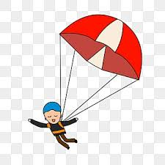
However,…
Creativity is like a parachute. It only works if you open it !
Notes:
However, creativity is like a parachute. It only works if we open it. That means of course, practice.

Slide 16

How to enhance your creative thinking skills
Practice on your own
Collaborate with others
Be curious and keep interesting things in a folder
Challenge yourself
Ask “what if” questions.
Notes:
The good thing is that we can even practice on our own. When we have some free time, we can try to find many alternative uses of everyday items, like a pencil, a piece of rope, a shirt that does not fit us any longer. Some of the ideas might be crazy. This is a good thing; we should not fight it and we should not criticize ourself. In creative thinking, quality has to do with quantity. We don’t look for the best idea or solution. We explore many different ideas or solutions. If we practice daily, we will soon understand that we come up with more, and more original ideas after a few days. Decorators use creative thinking to find new uses of old items. We can see an old shutter that has become clothes hanger. We can also collaborate with others. Brainstorming with others and joining together to find creative solutions can be fun and it can also break down our mental blocks. We will engage in an interesting brainstorming activity in a little while. Curiosity helps creativity. We can keep interesting things or things that caught our attention in a folder. When we see, listen, read something interesting, whatever it is, we keep it in a folder. For example, we loved the slogan of an ad. We can write it on a piece of paper or cut the page from a magazine and put it in the folder. Or, we saw the picture of an invention. That goes into the folder as well. We will soon have plenty of interesting, but unrelated things in the folder. What we can do, when we have some free time, is to open the folder, put all the ideas, pictures, etc on the floor and try to create relations. We may create something interesting or not; but certainly, we will have a good time. Another way to enhance our creative thinking is to challenge ourselves. From time to time, we can test the opposite of our hobbies or activities. For example, if we love the sea, we can try to climb a hill. If we play the guitar, we can try drums. We should not care about the outcome. The point is to have our brain thinking differently than before. To change our routine. Finally, "what if” questions can turn to an interesting game which we can play alone or with friends to boost our creativity. We question things around us and try to find as many answers as possible. For example: “what if trees were blue?” “what if there was water in the dessert?” “what if we walked backwards?” The more answers we give, the better. This can be a very funny activity too. All answers, even the craziest ones, are valid.

Slide 17
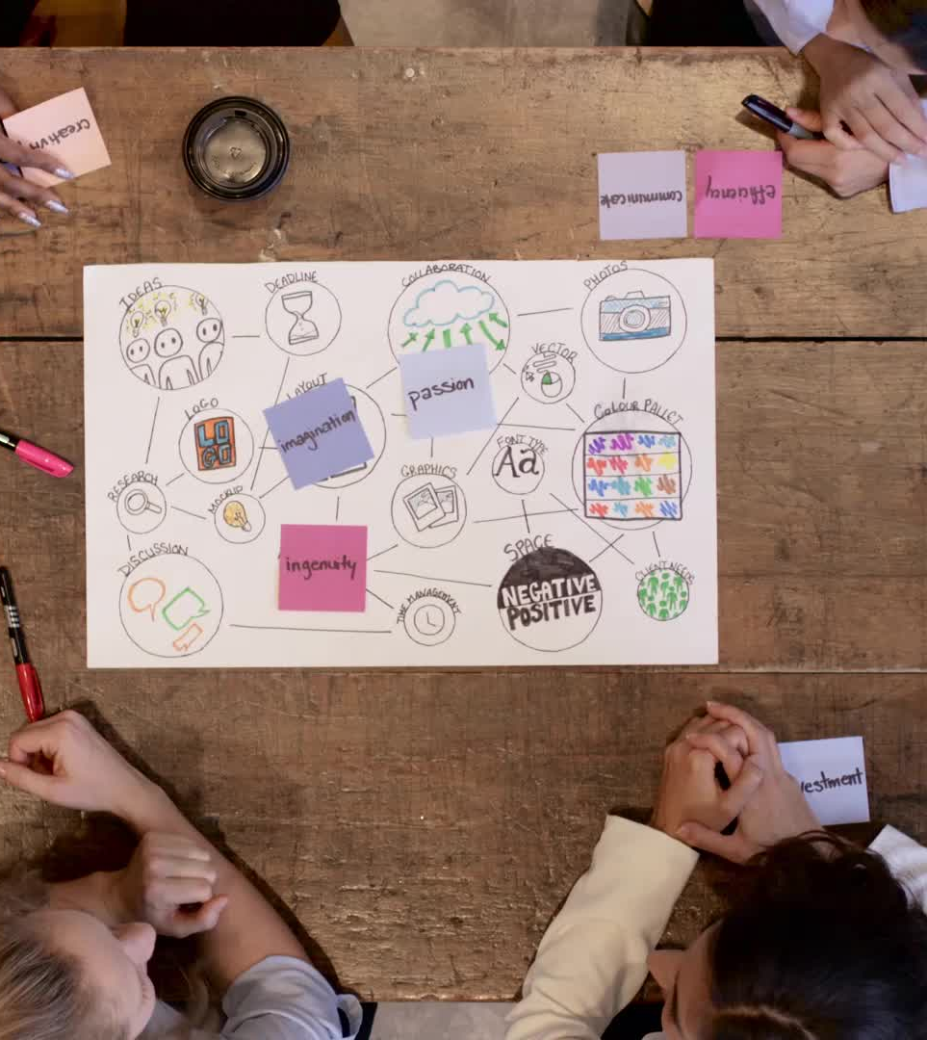
Brainstorming
Rules:
There are no winners or losers.
No criticism or judgment of ideas
Build ideas on another team member ideas
The activity will end in 5 minutes. During this time, each of you must give at least one suggestion.
You write your answer on a post-it note, and you put the note on the wall. If you come up with more answers, you write each one on a separate post-it note and put in on the wall.
Notes:
Now, we referred to brainstorming before, but now we will practice it. Brainstorming is all about thinking out of the box. Originality is the heart of creative thinking. It’s about coming up with new, unique ideas that haven’t been expressed before.
Brainstorming boost students’ confidence and enhances their communication skills and creative thinking ability. Depending on the number of the students, you create small teams of up to 5 people each. You give them post-it notes and pens and you assign them a specific space of the wall, where they will stick their post-it notes.
Before I introduce the topic that we are going to brainstorm on together, let’s see some important rules of brainstorming: There are no winners or losers. Someone can be more creative on a certain stimulus and less creative on another. This is perfectly normal. This is a judgment-free zone – no judgment, criticism or negative facial expression is allowed. The goal is to get as many ideas on the wall as possible in the allotted time. We welcome crazy ideas. Some ideas build on another person’s ideas. So, while thinking we should keep an eye to the wall. We will allow 5 minutes for the first part of brainstorming. During this period, each of us has to put at least one idea on the wall. We write the idea on a post-it note and stick it to the wall. If another idea comes up, again we write it on a new post-it note and we stick it to the wall. I will introduce the topic, and each team member will think individually. The more ideas per person, the better. Is it clear? Are you ready?

Slide 18

Brainstorming group activity
Find as many unusual uses for a shoe as possible
Notes:
Introduce the topic and start the timer. When the time is up, instruct the students to view the post-it notes on the wall, discuss and find different categories that they fall under and then add relevant ideas underneath (they write the category on a post-it note and glue all relevant ideas underneath). For example: decoration, everyday use, etc. Allow 5 more minutes for this. Pass by the different groups and encourage those who do not contribute or talk, to participate as well. At the end, you bring all students in front of each wall and examine together what each team has produced. You should praise all students for their work.

Slide 19
Creative and critical thinking for problem solving
First: creative thinking: to find many alterative ideas to solve the problem
Then: critical thinking: to use logic to examine the ideas generated and find the best solution
Notes:
Reveal only the title of the slide.
We have discussed critical and creative thinking separately, why they are important and how we can further enhance them. But, when we need to solve a problem, which one do we use? In other words, how does critical and creative thinking collaborate to produce a solution?
Pause and ask the student’s opinion. Then, click to reveal the content of the slide and go on.
We must use creative thinking first to find many alternative ideas to solve the problem. Then, we should use critical thinking to evaluate the ideas generated with logic and conclude to the best solution. Sometimes, this process comes automatically in our head. If not, we need to practice both skills further and work on hypothetical problems or challenges, before we tackle the real ones. We have now reached the end of this part. Do you have any questions? Is there anything you would like to discuss further?

Slide 20

Personal Growth
Notes:
We will finish this module by discussing strategies for personal development. We will look at the different learning styles, and how we can become the best version of ourselves.

Slide 21
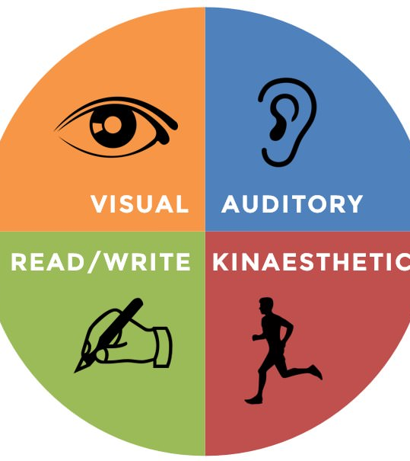
Learning styles
There are 4 predominant learning styles:
  Visual learning style
  Auditory learning style
  Reading/Writing
  Kinesthetic learning style
Notes:
What is a learning style and why is it useful to know our own? In simple words, a learning style is the way a person takes in, understands, expresses and remembers information. When we know our predominant learning style, it is easier, and it takes less time and effort to learn and to remember information, such as coursework. We said in the previous part, that ongoing learning, and acquiring new skills, is important for both critical and creative thinking. So, if we know what is the preferred way to learn these new things, we can learn more in less time and with much less effort. There are 4 predominant learning styles: Visual, Auditory, Read/Write, and Kinaesthetic. Let’s see each style in more detail.

Slide 22
Visual learning style
Visual learners learn through seeing
Visual display of information is important (charts, pictures, diagrams, etc)
Replace words with symbols
Underline and use highlighters with different colors
Notes:
Visual learners learn best through seeing, so tools like diagrams, flowcharts, pictures and symbols can be key to understanding new concepts. When taking notes in class, something we can try is developing a system of symbols to replace a word. For instance, instead of “and” put a +. This makes note taking faster. It can also be useful to color code our notes, like highlighting key concepts, to create more visual stimulation.

Slide 23
Auditory learning style
Auditory learners learn through listening
Lectures and discussions are important
Read text out loud
Discuss the topics with other persons
Notes:
Auditory learners learn through listening. As such, attending lectures and group discussions are essential for these learners. Reading our courses out loud, so we can hear how the words sound, makes learning easier. Creating a study group or getting together with co-students just to talk about the things being discussed in lectures, helps us learn faster.

Slide 24
Reading/Writing learning style
Read/write learners learn through reading and writing
Glossaries, re-reading and re-writing notes
Create lists
Re-write notes into your own words
Notes:
Read/write learners learn through—what else?—reading and writing. Creating glossaries, reading and re-writing notes or key points or summaries of what we learn, help us learning faster and easier. Creating lists can also be a very useful tool. Rewriting explanations and notes into our own words help us retain this knowledge.

Slide 25
Kinaesthetic learning style
Kinaesthetic Learners learn through doing
Use all of your senses into the experience – sight, touch, taste, smell
Include many examples for each concept in your notes
Use of practice questions and exams as possible
Notes:
Finally, kinaesthetic learners learn through doing. While studying, it is important to incorporate all of our senses into the experience—the more of this we can do, the higher percentage of information we recall. Examples of new concepts should accompany our notes. A good way is that we take an example from the text, or lecture, or lab, and then try to create our own example. Making as much use of practice questions, experiments and tests as possible, help us retain more information. 🖈Do you recognize yourself in any of the learning styles?

Slide 26

How to become the best version of yourself
Explore Interests and Passions
  Experiment: Try different activities and hobbies to see what resonates with you.
  Learn from others: Seek out mentors and role models in a field.
  Stay curious: Keep exploring, asking questions, and pushing boundaries.
Invest in education
  Education is not just about textbooks and exams; it's about equipping yourself with the tools to shape your future.
Building Healthy Relationships
  Effective communication: Be a good listener and express your thoughts and feelings clearly.
  Support system: Surround yourself with people who uplift and support you.
Notes:
Teenage is a crucial part of all people’s life. It is the time that we develop our personality, we learn how to socialize and how to deal with challenges, and also the time that we prepare for our adult life and the way we are going to live in the future. Now it is the time to invest on ourselves and prepare for adulthood. What can we do? We can explore our interests and passions. We can experiment with different activities or hobbies, alone or in teams, to see what suits us more and to find possible tendencies that could translate to a professional field in the future. We can ask the advice of mentors, people who already work in a certain field and who can share a lot of details. There are many relevant videos on Youtube as well. We can be curious. We talked about the need for curiosity before. Curiosity helps us explore new areas, ask questions, seek more information on something that interests us. Then, we should invest in education. Apart from the knowledge itself, education also equip us with the tools we need to shape our future: be alert, be persistent, work in teams, set goals, combine information from different fields to make a project, respect deadlines. We need to build healthy relationships. We should try to relate to people who can be supportive instead of judgmental, listen to the other people and try to understand them and express ourselves to be understood. Becoming the best version of ourselves depends mainly on us. We rule our life. And if we work with ourselves everyday, we can deal with whatever comes our way. Good luck!
Since this is the last slide of this module, ask students if they want to share something, if they found the module interesting, if they are thinking on applying anything of what they’ve learnt in the coming days.

Slide 27








Eurhope
EU as a solidarity's house for minors out of home
Erasmus+ project n. 2023-2-IT03-KA220-YOU-000184370
Funded by the European Union. Views and opinions expressed are however those of the author(s) only and do not necessarily reflect those of the European Union or the European Education and Culture Executive Agency (EACEA). Neither the European Union nor EACEA can be held responsible for them.

