Slide 1









Eurhope
EU as a solidarity's house for minors out of home
E R A S M U S + P R O J E C T N . 2 0 2 3 - 2 - I T 0 3 - K A 2 2 0 - Y O U - 0 0 0 1 8 4 3 7 0
ACTIVITY 4
Training socio-political knowledge
Notes:
This is a 8-hour module. You can teach it in two session, or four 2-hour sessions. Arrange for a 10-minute break every hour.
🛈 You will need:
a PC/laptop with access to the Internet and speaker to be able to listen to the videos.
A data projector to project this presentation.
A couple of pictures stored on your desktop before class (check slide 16)
Symbols used in the notes to help you teach the module:
☺ It is used for something you have to say or read in class. It represents your speaking.
📄 It is used for instructions. It gives you info on what to do.
🖈 It is used in any of the above (speaking or instructions). It represents a question to ask students, or an activity to do with students.

Slide 2






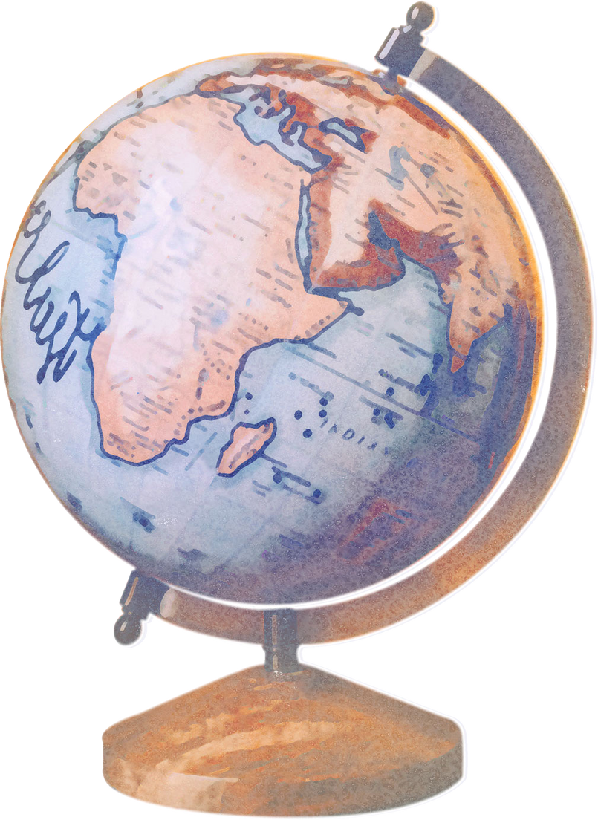


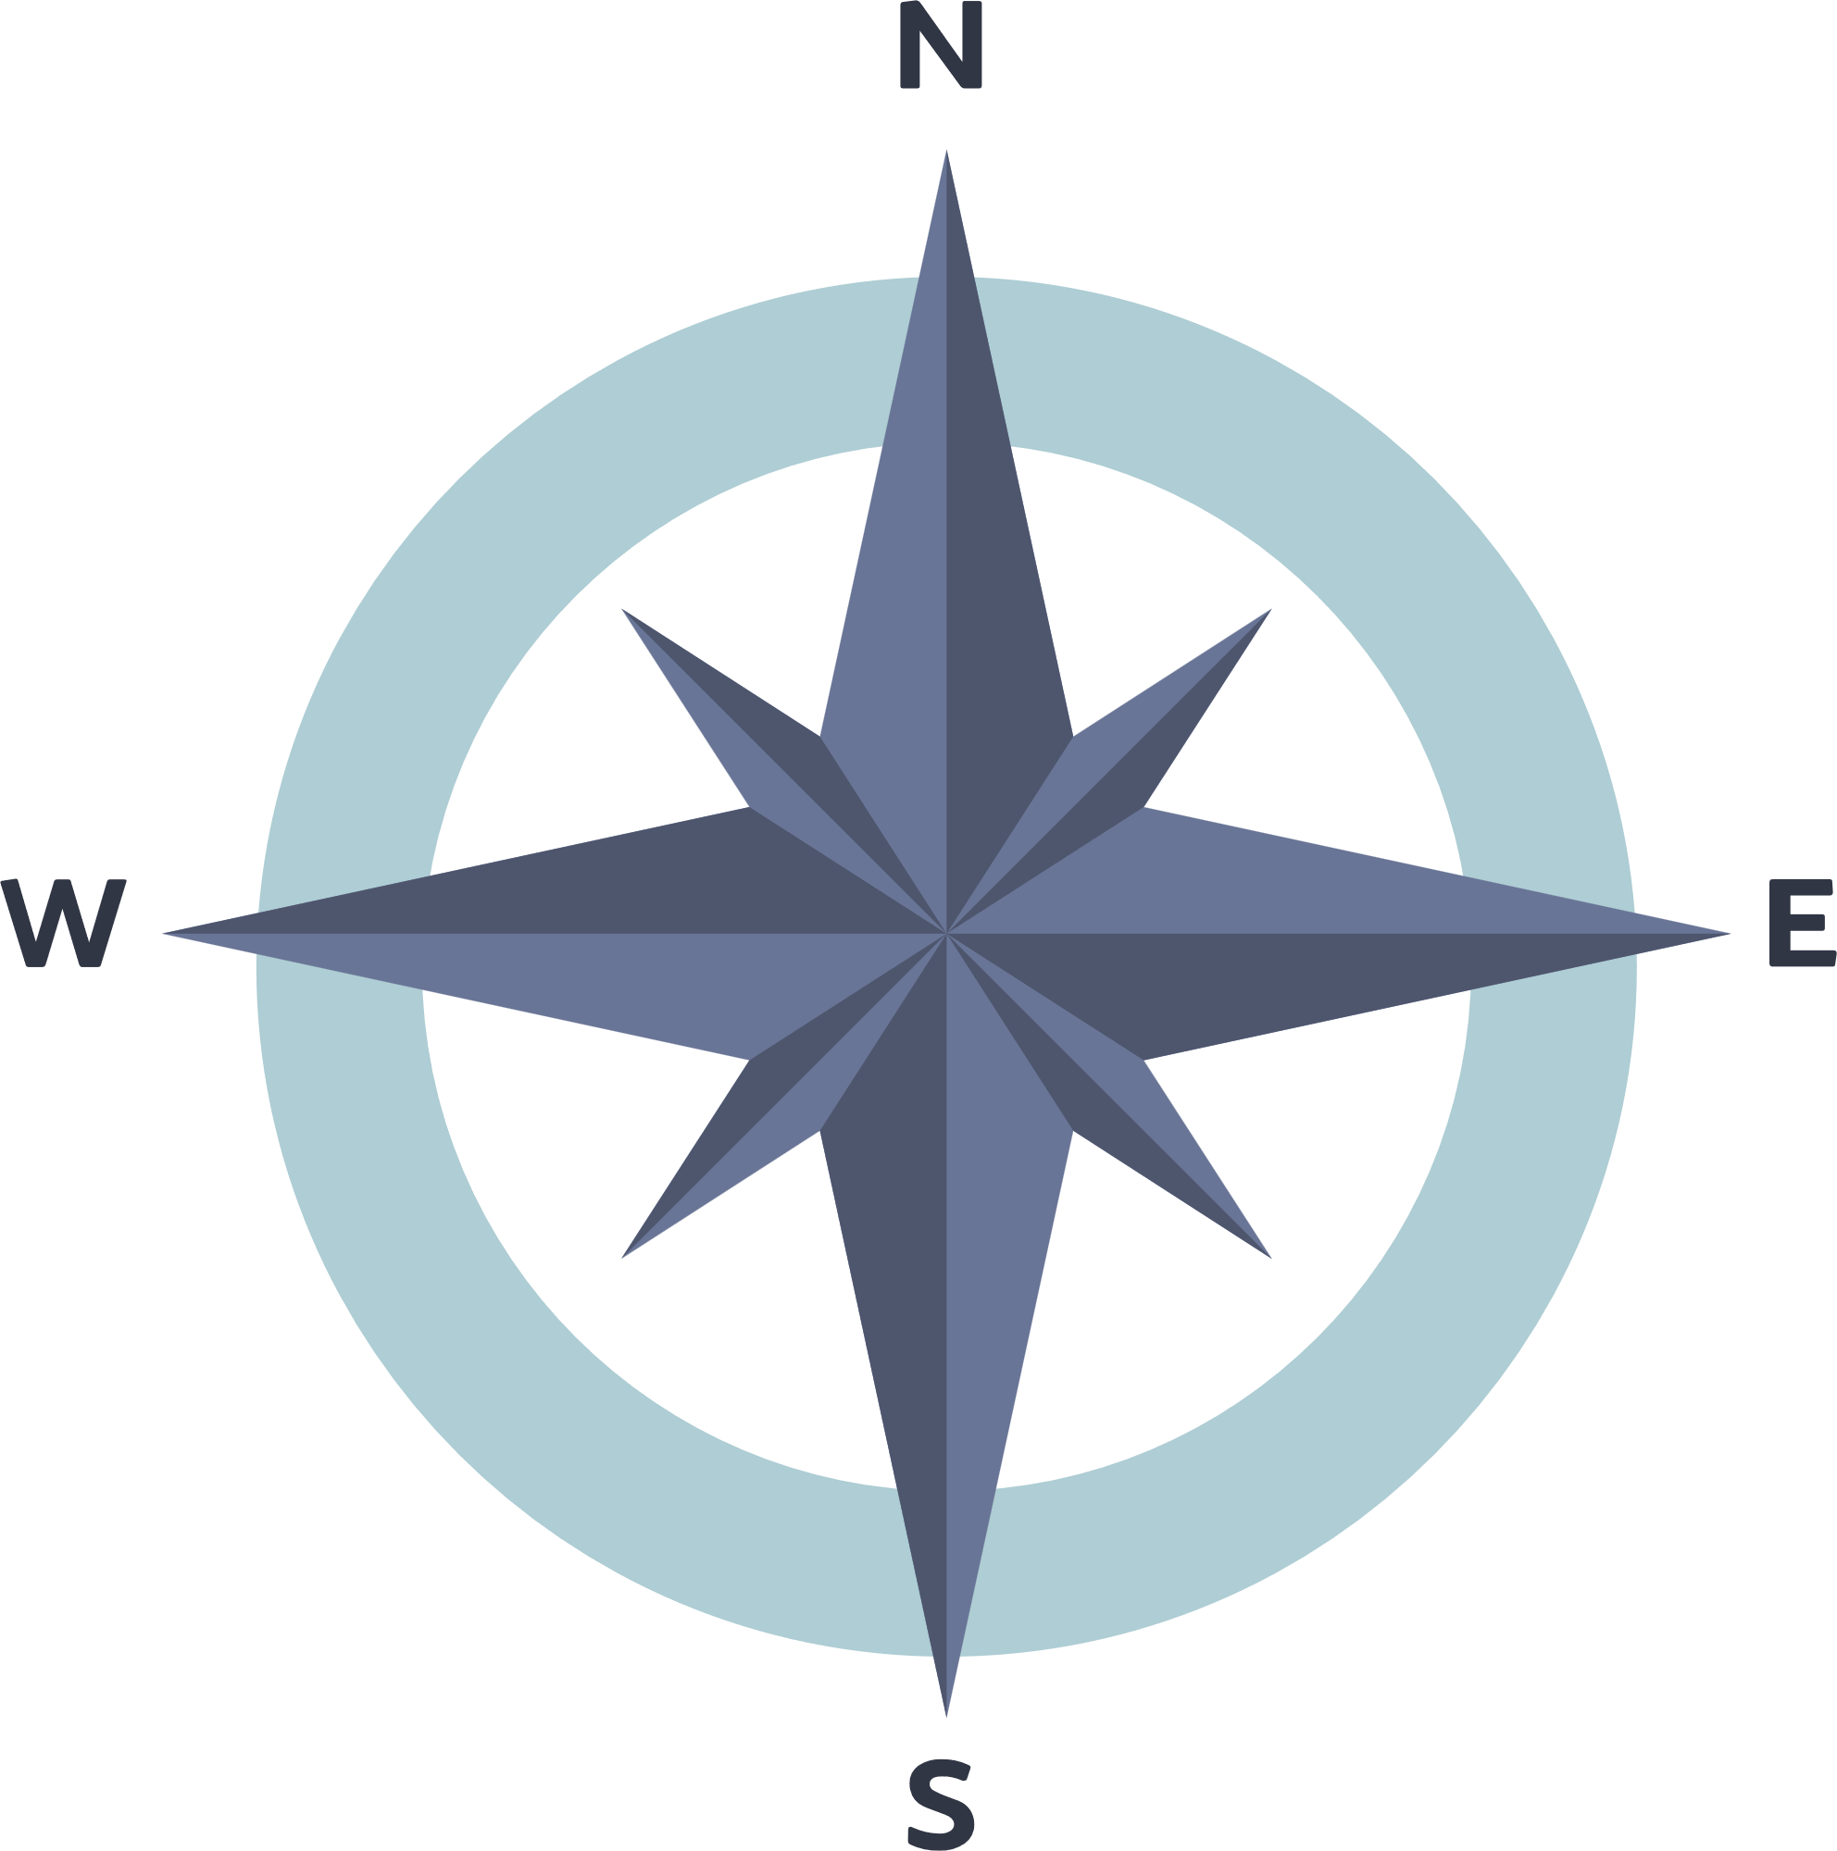
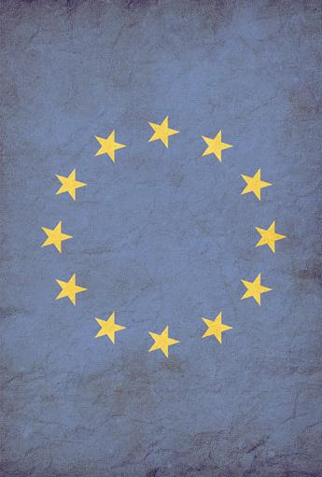
Co-founded by the European Union
EUROPEAN UNION
Work Together for a better world
E R A S M U S + P R O J E C T N . 2 0 2 3 - 2 - I T 0 3 - K A 2 2 0 - Y O U - 0 0 0 1 8 4 3 7 0
Notes:
Welcome the students. Use ice breaker technique to help students connect and feel more comfortable. (ej. If you were an animal, which animal would you want to be?). Start introducing yourself saying “If I were an animal, I would be….” and then ask to the students to introduce themselves in a similar way. Only when everybody is finished, show slide 2 and read the agenda.
Hi and welcome to this class. Together, we will discover interesting, useful and funny things about ourselves and the world around us. Before we proceed, let's introduce ourselves by imagining what kind of animals we might be and describing ourselves in those terms. My name is…. If I were an animal I may be… and I would like to share 3 statements about myself: I owe a cat. My favorite color is blue. And, this is not my natural hair color [you can use your own statements]. Now, who wants to start? Just share your name, and 3 statements about yourself; it can be anything, like when you come from, what is your favorite food or artist, or whatever you want to share.
…………………….

Slide 3

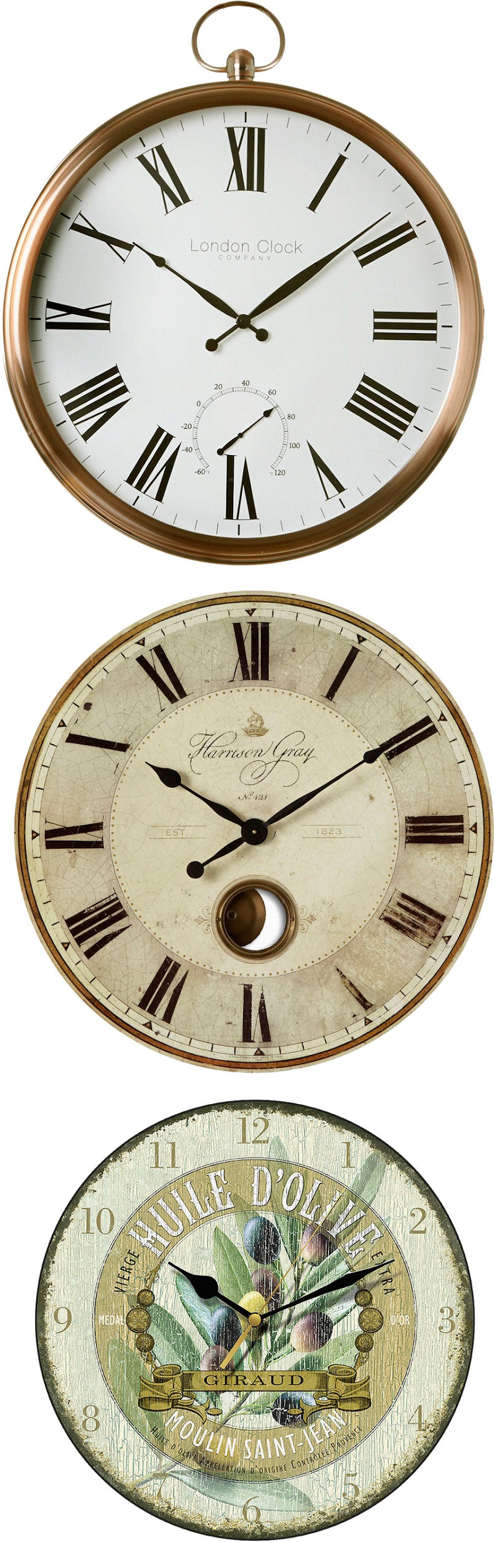

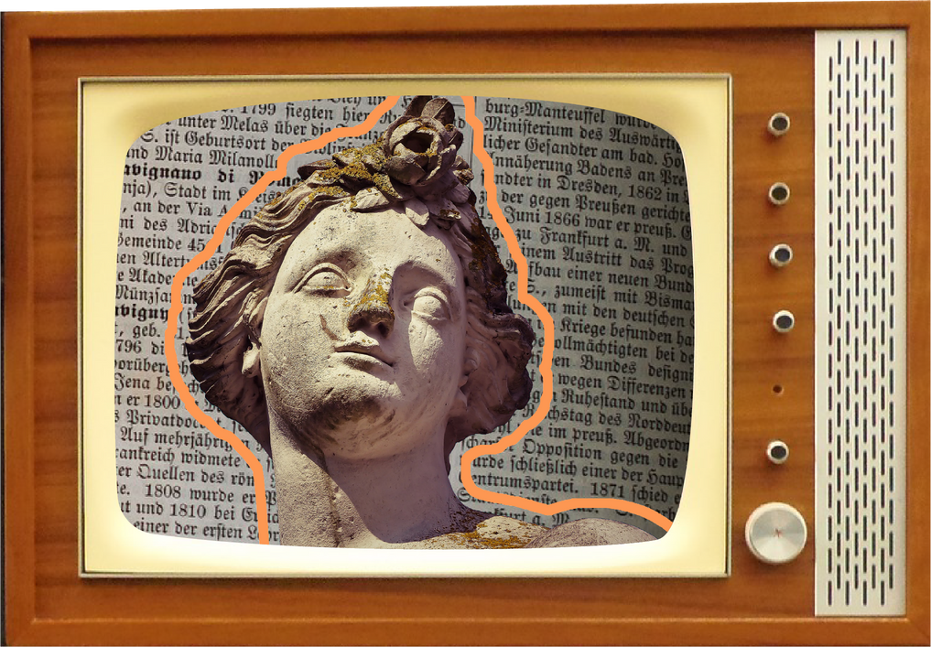
Table
of contents
01
04
The European Countries
Values, Duties, and Rights of the European Citizen
02
05
The European Political Structure
The Profile of the Global Citizen
03
06
European
Regulations
European Projects and Opportunities for Citizens
Notes:
Read the table of contents to the students and add a bit of storytelling by talking about the importance of being a European citizen and the benefits it brings to people.

Slide 4
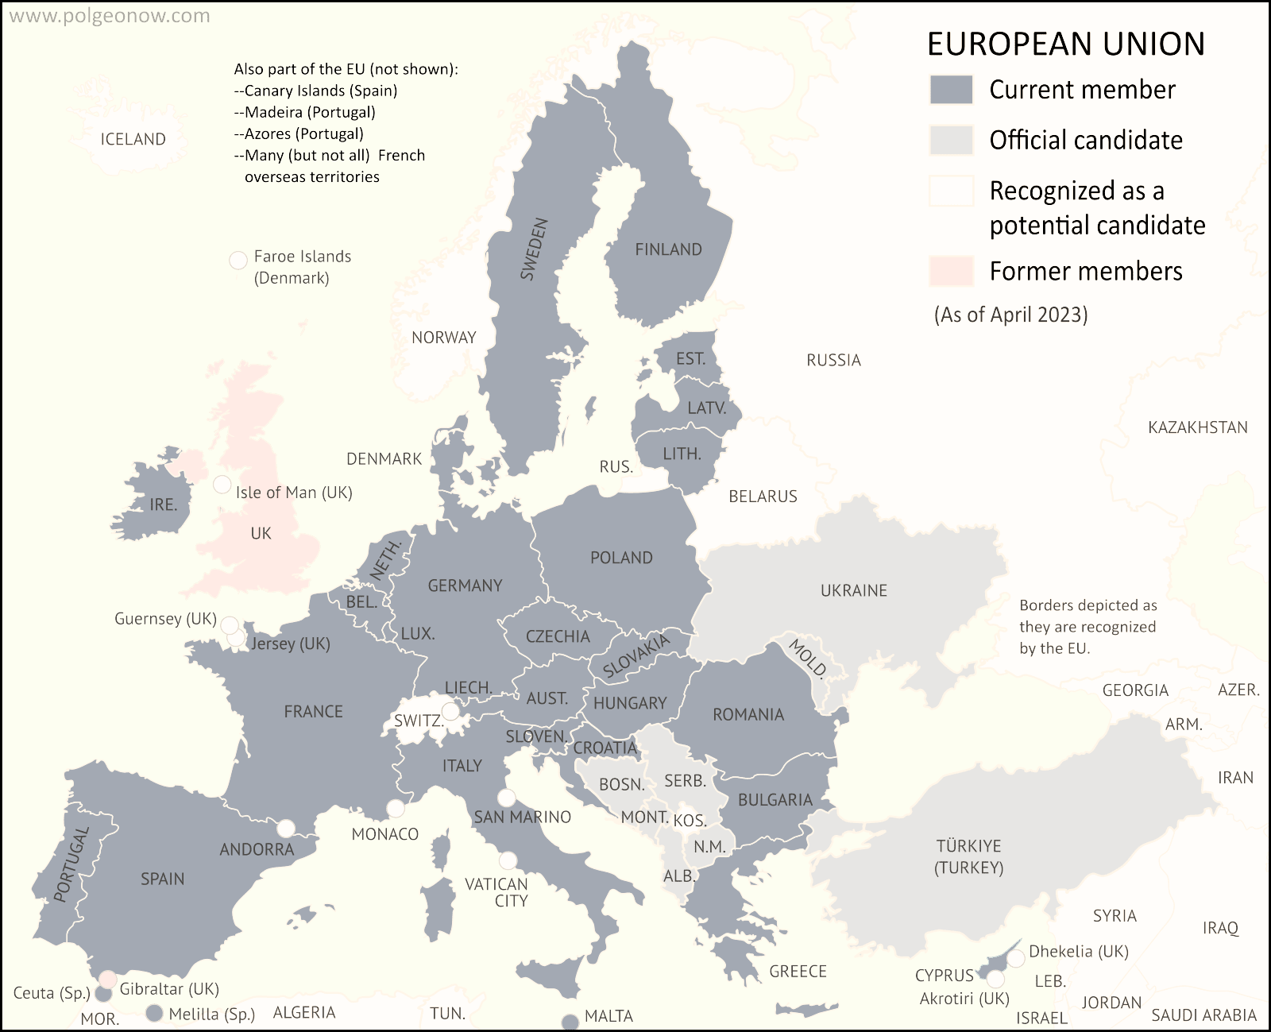
1. The European Countries
Notes:
Let's start by exploring why the European Union exists.
The European Union (EU) exists to help European countries work together more closely. Imagine it's like a big team where countries join forces to solve problems, trade goods, and make decisions together. This teamwork helps them stay peaceful, make travel easier, and boost their economies. By working together, they can solve big challenges that might be tough for one country to handle alone.
Imagine one country is struggling with a big problem, like a severe food shortage. Without help, it might be hard for that country to get the supplies it needs. But since it’s part of the European Union, other EU countries can step in and provide support. They can send food, share resources, and work together to solve the problem. By helping each other out, the EU countries make sure that everyone is better off and can overcome challenges more effectively.
Now, do we all remember which countries are in the European Union?
📄 Move to the next slide.

Slide 5
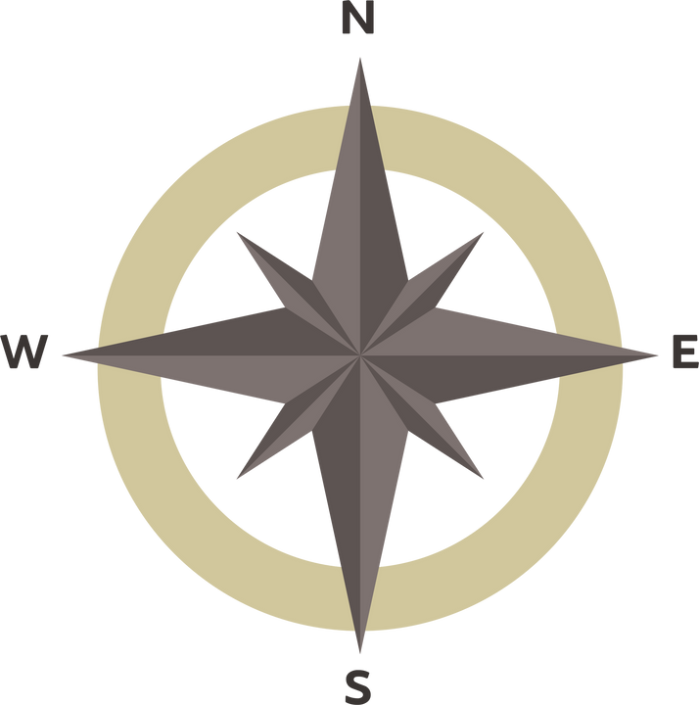
Exercise 1
Which countries are part of the European Union?
Notes:
Let’s include a small exercise to see how much we know about the countries that are part of the European Union,
📄 Move to the next slide.

Slide 6
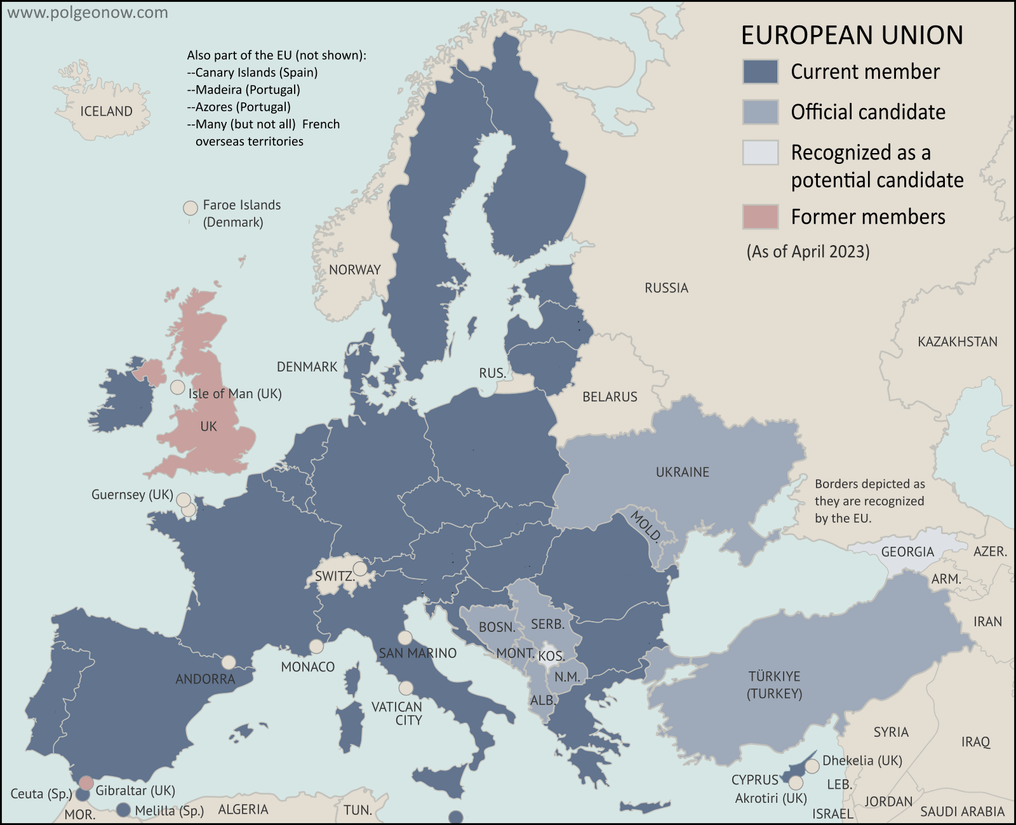
Exercise 1
Cipro
Malta
Notes:
I invite you to take a close look at the map, and then let's try together to remember all the countries that are part of the European Union.,
📄 You can point to the countries with a pointer, a laser, or a pen, and ask the students to name them. Start with the easiest ones. After 3/5 minutes you can move to next slide.

Slide 7
Finland
Sweden
Estonia
Latvia
Lithuania
Exercise 1
Ireland
Nether.
Poland
Belgio
Germany
Lux.
Cezech
Hungary
Austria
Slovakia
Romania
France
Slovenia
Italy
Croatia
Bulgaria
Portugal
Spain
Grecia
Cipro
Malta
Notes:
Okay, now let's look at them all together on the map.
📄 Invite the students to read the names. Once all the names have been read. Move to the next slide.

Slide 8
Which countries are part of the European Union?
Finland
Solution Exercise 1
Sweden
Estonia
Latvia
1 Austria
2 Belgium
3 Bulgaria
4 Croatia
5 Cyprus
6 Czech Republic
7 Denmark
8 Estonia
9 Finland
10 France
11 Germany
12 Greece
13 Hungary
14 Ireland
15 Italy
16 Latvia
17 Lithuania
18 Luxembourg
19 Malta
20 Netherlands
21 Poland
22 Portugal
23 Romania
24 Slovakia
25 Slovenia
26 Spain
27 Sweden
Lithuania
Ireland
Nether.
Poland
Belgio
Germany
Lux.
Cezech
Slovakia
Austria
France
Hungary
Romania
Slovenia
Italy
Croatia
Bulgaria
Portugal
Spain
Grecia
Cipro
Malta
Notes:
Who is going to help me?
📄 Invite a student to indicate the countries while you are reading. Once all the names have been read. Move to the next slide

Slide 9
Exercise 2
Try to draw the borders of the European countries and write the names of the countries
Notes:
Okay, now that we've become good at remembering all the European countries, let's see if we can recall where they are located.
📄 Ask the students to complete this exercise. Provide each student with a printed map of Europe, as shown in the following slide. Organize them into groups of 3 to 5 students, and give them 10 minutes to draw a map outlining the borders of European countries. Each student should create their own map, and then each group should collaborate to produce a consensus map that they believe is the best. Afterward, proceed to the next slide. Afterward, proceed to the next slide.

Slide 10
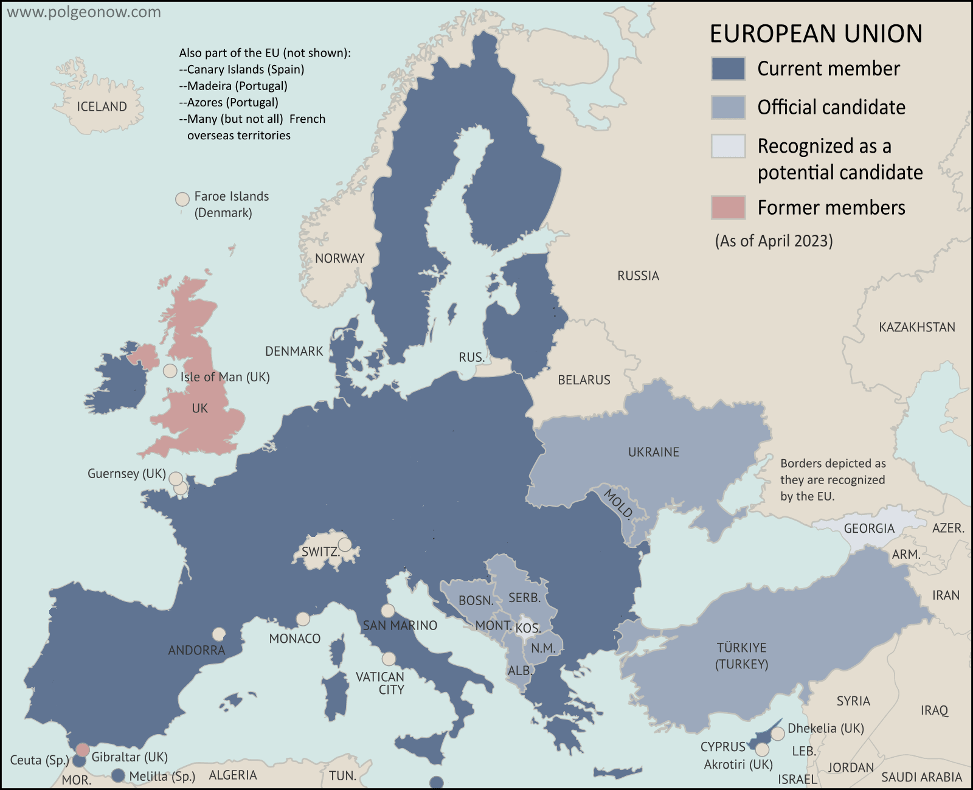
Exercise 2
Cipro
Malta
Notes:
Okay, let’s start.
📄 Leave this slide while they are working. When they finished show slide 7 with all the countries, to see which group did better.

Slide 11
2. The European Political Structure
Notes:
Now that we know which countries are in the European Union, let's start looking at how the EU works and what its structure is.
Move to the next slide

Slide 12



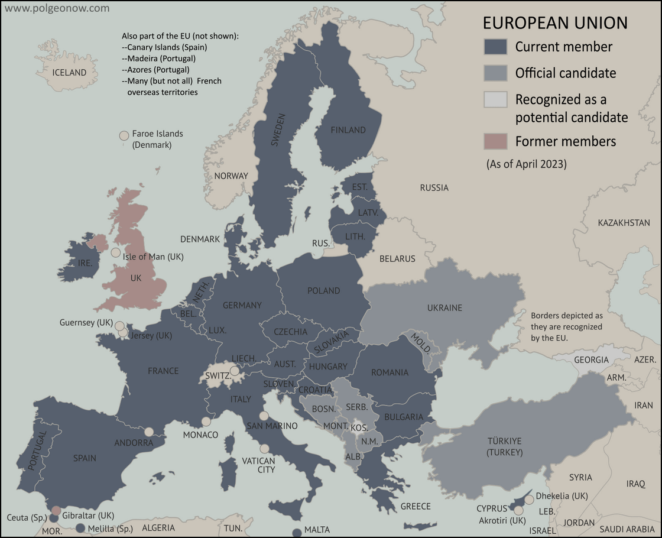
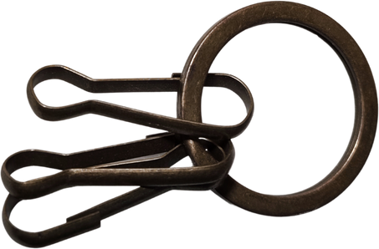





The European Political Structure
European Parliament
The European Council
The Council of European Unionl
The European
Commission
The Court of Justice
of the European Union
Notes:
☺ The European Union (EU) has different groups that help it run smoothly and make important decisions. These are the main ones:
The European Parliament
The European Council
The Council of the European Union (Council of Ministers)
The European Commission
The Court of Justice of the European Union (CJEU).
Together, these groups help the EU work well and make decisions that affect everyone in the union.
Move to the next slide

Slide 13
The European Political Structure
The key institutions of European Union (EU) include:
  The European Parliament: represents EU citizens and is directly elected by them. It works with the Council to create new rules and makes sure the EU's money is used properly.
  The European Council: is made up of the leaders of each EU country. They decide the main goals and plans for the EU.
  The Council of the European Union also called the Council of Ministers, represents the governments of each EU country. It works with the European Parliament to create EU laws and organize important policies.
  The European Commission: is the main group in charge of suggesting new laws, making sure decisions are carried out, and handling the everyday work of the EU.
  The Court of Justice of the European Union (CJEU): makes sure that EU laws are understood and followed in the same way by all EU countries.
Notes:
Who would like to read?
The European Parliament: This group is made up of people elected by citizens from all over the EU. They help make laws and check how the EU’s money is used.
The European Council: This group includes the leaders of each EU country. They decide on big goals and directions for the EU.
The Council of the European Union (Council of Ministers): This group represents each country's government. They work with the Parliament to make laws and manage policies.
The European Commission: This team suggests new laws, makes sure decisions are carried out, and handles the everyday work of the EU.
The Court of Justice of the European Union (CJEU): This court makes sure that EU laws are applied the same way in every country.
☺ As we said before, together, these groups help the EU work well and make decisions that affect everyone in the union.
Invite students to read, when finish move to the next slide

Slide 14
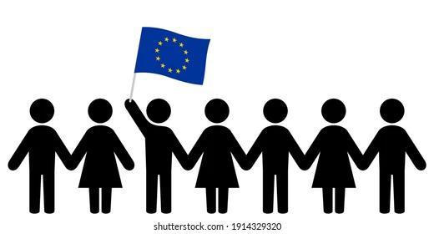

The European Political Structure
EUROPEAN CITIZENS
EUROPEAN PARLIAMENT
Members of the European Parliament are directly elected by European CITIZENS.
Notes:
Alright, let’s talk about the European Parliament. This is one of the main groups that helps make decisions for the EU. Members of the European Parliament are chosen by people from all EU countries through voting. These members represent everyone’s interests and work on making new laws and rules. They also keep an eye on how the EU’s money is used. This group is important because it helps make sure everyone’s voice is heard in the EU!
Move to the next slide

Slide 15
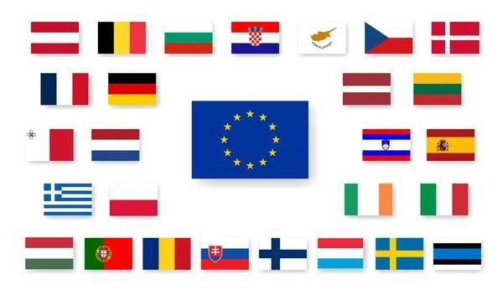

The European Political Structure
LEADERS OF EUROPEAN COUNTRIES
EUROPEAN COUNCIL
European Council, made up of the leaders of each EU country.
Notes:
☺ Next, let’s talk about the European Council. This group is made up of the leaders from each EU country, like presidents or prime ministers. They get together to talk about big issues and decide on the main goals and plans for the EU.
Now, look closely at the European Council’s logo. It’s important to remember this symbol because we’ll have an activity at the end where you’ll need to recognize it.
Move to the next slide

Slide 16
The European Political Structure
GOVERNMENTS OF EUROPEAN COUNTRIES
COUNCIL OF EUROPEAN UNION
GOV
Council of European Union
also called the Council of Ministers,
represents the governments of each EU country
Notes:
☺ Let's move on to the Council of Ministers, also known as the Council of the European Union. This group is a bit different from the European Council because it’s made up of ministers from each EU country’s government, like the ministers of finance, health, or education. They meet to discuss and make decisions on specific issues, such as new laws or policies that affect the entire EU.
Just like with the other groups, it’s useful to recognize their logo. We’ll have an activity later where you’ll need to identify it. So, make sure to take a good look at the logo now and remember it for our exercise
Move to the next slide

Slide 17
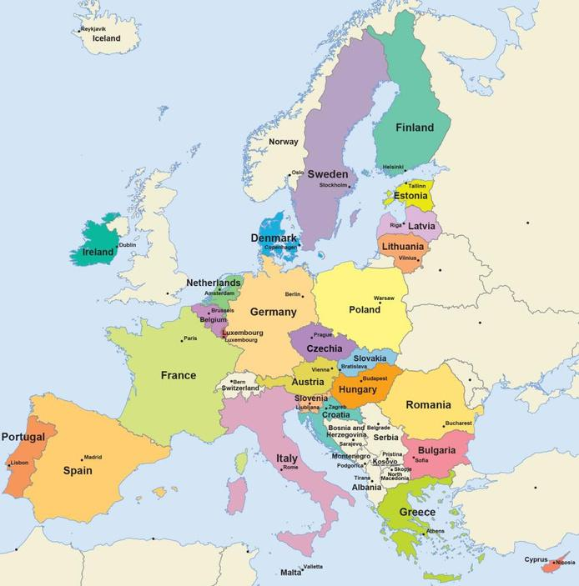

The European Political Structure
EUROPEAN COUNTRIES
EUROPEAN COMMISSION
Each country chooses their Commissioner, to be part of European Commission, and then all of them are approved by the European Parliament.
The Commission President, who leads the group, is also chosen and approved by the EU leaders and the Parliament.
Notes:
Now let’s talk about the European Commission. Think of it like the 'team in charge' of the EU.
This group of people, called commissioners, is chosen by each EU country.
They come up with new ideas for laws, make sure decisions are carried out, and handle everyday tasks for the EU.
They also check that all the EU rules are followed by every country.
Look closely at the European Commission’s logo now
Move to the next slide

Slide 18
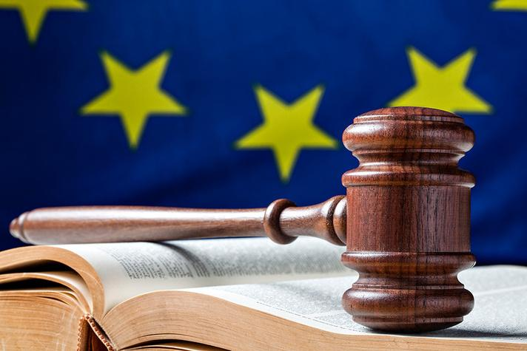
The European Political Structure
COURT OF JUSTICE
EU LAW
Makes sure that EU laws are understood and followed in the same way by all EU countries.
Notes:
☺ Finally, let’s talk about the Court of Justice of the European Union, often called the CJEU. Think of it like the 'rule-keeper' for the EU. This court makes sure that the laws of the EU are followed correctly and equally in all member countries.
If there’s ever a disagreement about how EU laws should be applied, the CJEU helps sort it out and make sure everyone follows the rules the same way.
Move to the next slide

Slide 19
Exercise 3
Can you recognize these LOGOS?
Notes:
Okay, now let’s see if we can recognize the different groups of the European Union by their logos
Move to the next slide

Slide 20
The European Political Structure
Exercise 3
Notes:
Who wants to start first?
Point to one of the logos with the pen or laser and ask which group the logo belongs to. Try to give small hints if needed. Once done, move to the next slide

Slide 21
The European Political Structure
Solution Exercise 3
European Parliament
The European Council
The Council of European Union
The European
Commission
The Court of Justice
of the European Union
Notes:
Let’s see if we were right.
Read the names to the class.

Slide 22
3. European
Regulations
Notes:
Now that we’re starting to understand how the European Union is set up, let’s look at the rules it has for all the citizens living there.
Move to the next slide

Slide 23

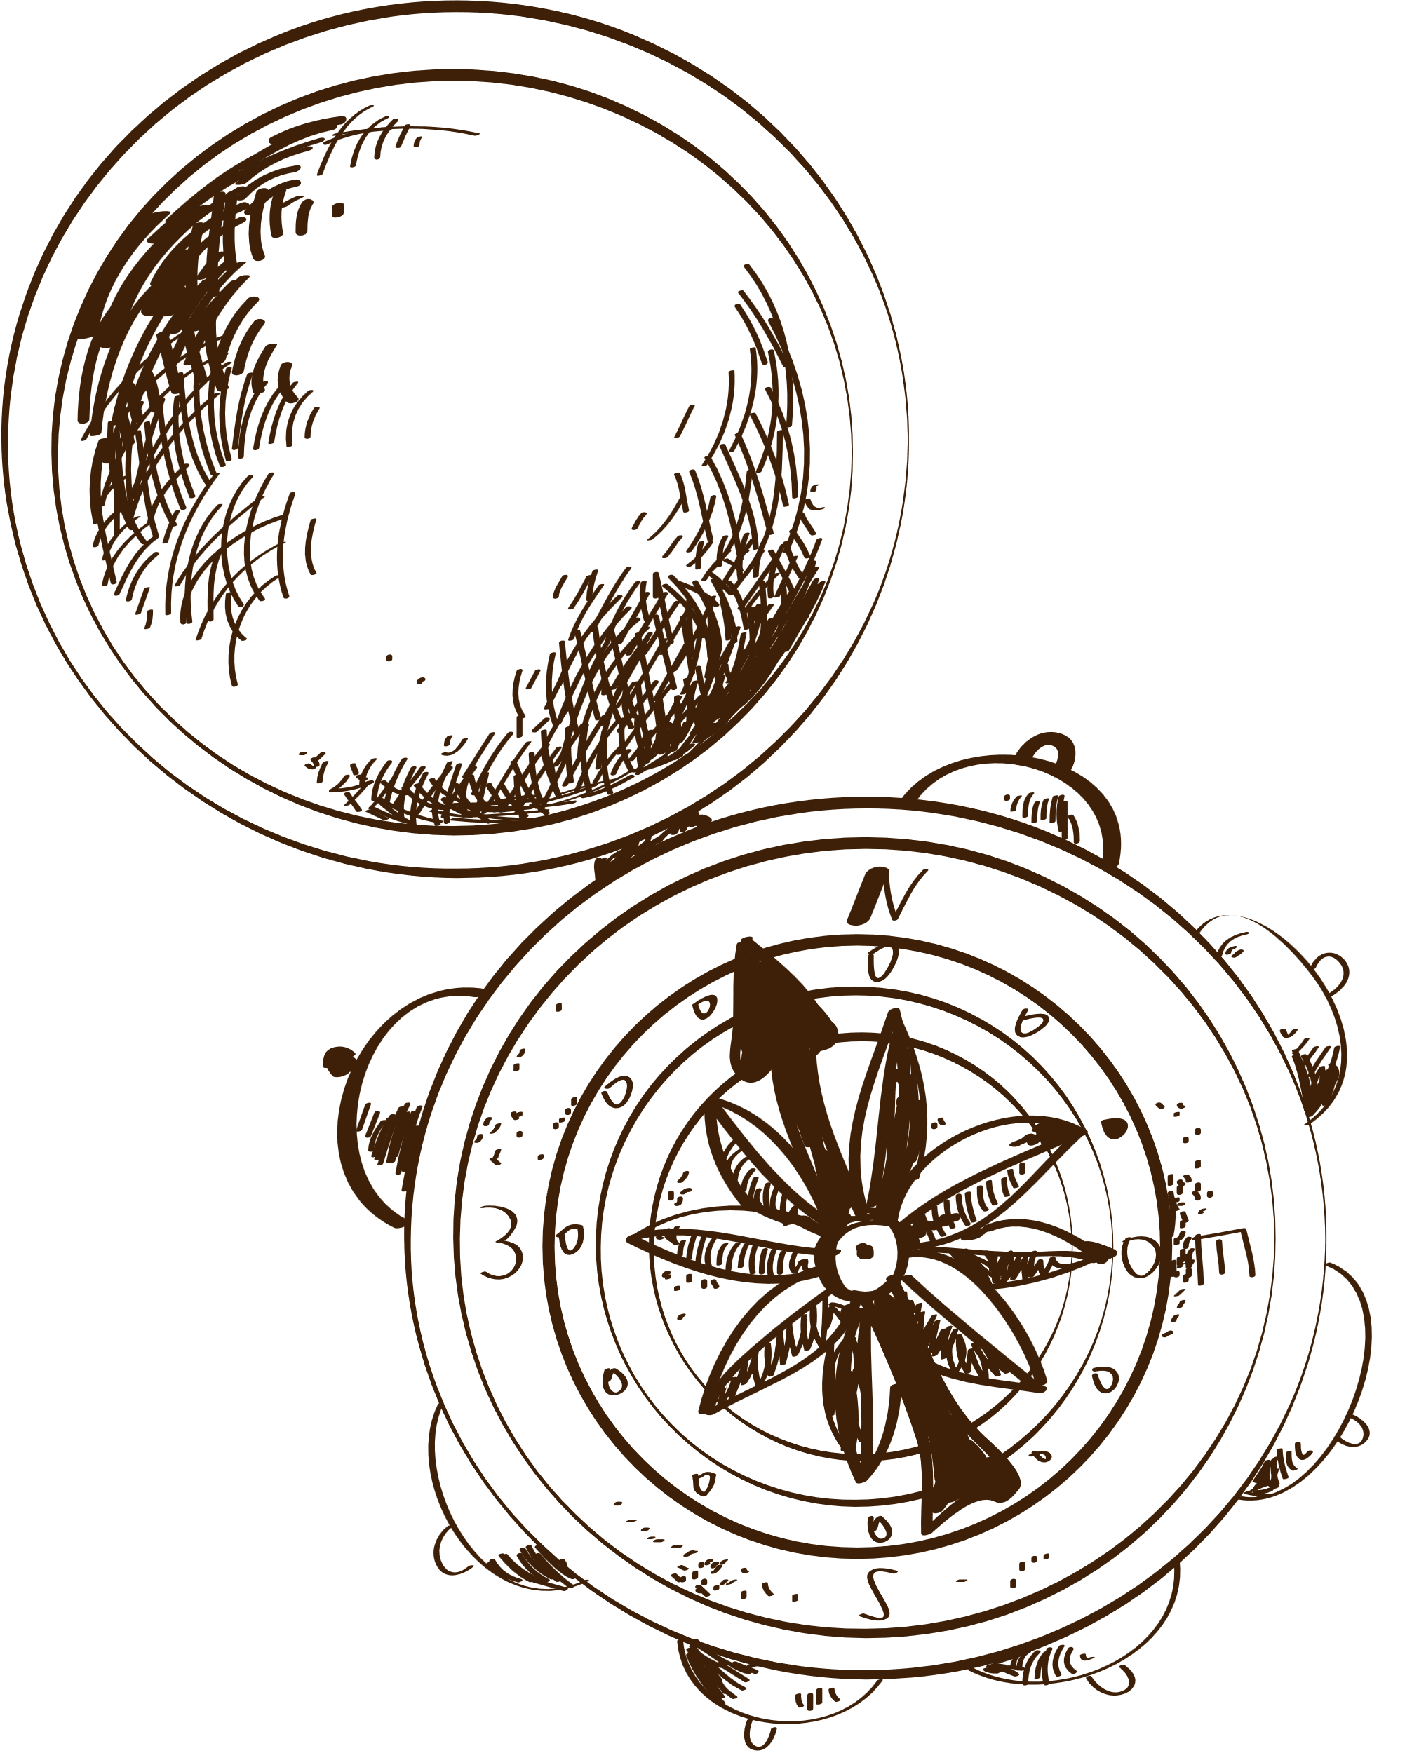
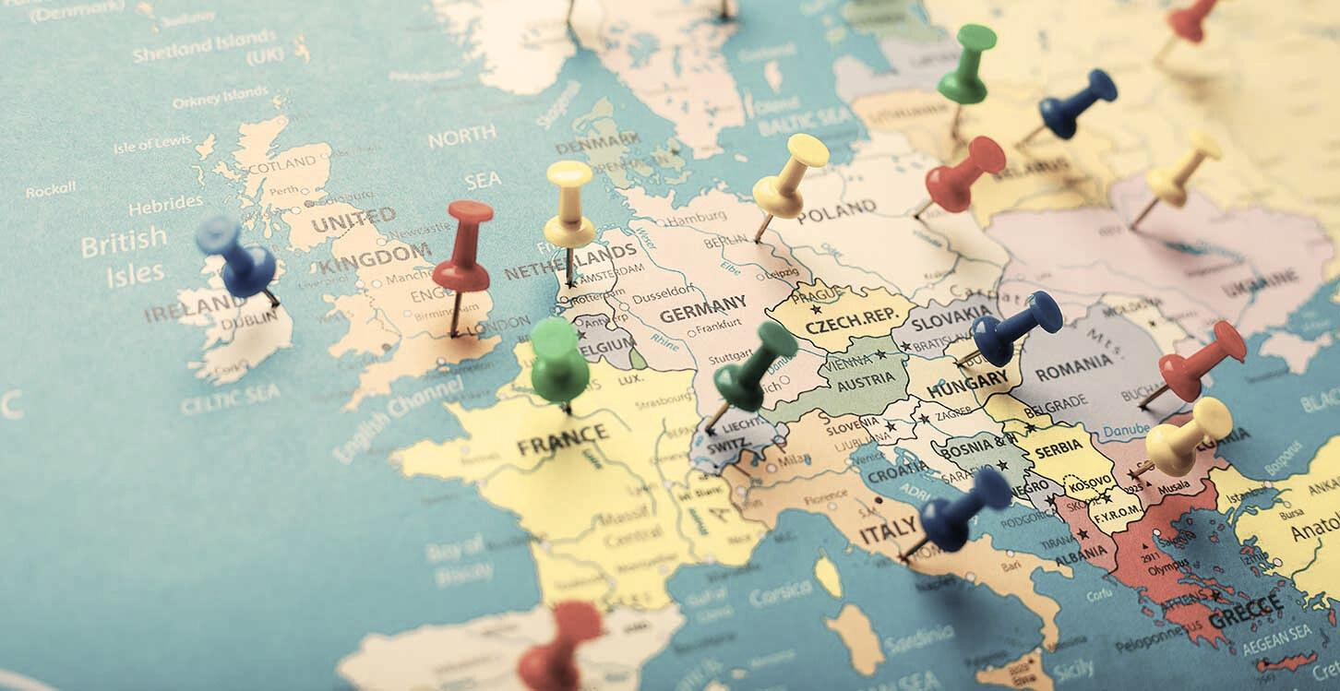





Displacement of Citizens:
One of the most fundamental freedoms within the European Union (EU) is the freedom of movement.
Notes:
Alright, let's talk about something called 'Displacement of Citizens' in the European Union.
This term refers to the idea that people can move from one EU country to another more easily than outside the EU.
For example, if someone from France wants to live or work in Spain, they can do so without too many extra rules or paperwork.
This helps people find new opportunities and experience different cultures within the EU.
So, it's like having a big area where you can move around freely and enjoy different places in Europe!
Move to the next slide

Slide 24
Displacement of Citizens:
A special rule called the Free Movement Directive makes sure that EU citizens and their families have the right to stay in any EU country if they follow certain rules.
The EU allows people to move freely between its countries.
This means EU citizens can live, work, and travel in any EU country.
Notes:
☺ The EU allows people to move freely between its countries. This means EU citizens can live, work, and travel in any EU country.
A special rule called the Free Movement Directive makes sure that EU citizens and their families have the right to stay in any EU country if they follow certain rules.
Move to the next slide

Slide 25
Exercise 4
Travelling among
European Countries
Notes:
☺ Let's play together.
Game: Travelling among European Contries
Objective: Understand the freedom to move between EU countries through a simple, fun roleplay.
Materials Needed:
Country name cards (one for each EU member country)
“Move Card” (simple card saying “You can move”)
Sticky notes or markers for names
Instructions:
Introduction (3 minutes): Explain that in the EU, people can easily move between countries to live, work, or study. This freedom is called "Displacement of Citizens."
Assign Countries (3 minutes): Give each student a country card from the EU. This is their starting country.
Roleplay Movement (10 minutes):
Students take turns drawing a new country card from the pile.
When a student moves to a new country, they should say why they are moving (e.g., for a new job or adventure).
If their reason is good, give them a “Move Card” to show they can move. If not, they stay in their current country.
Share and Discuss (4 minutes): After a few moves, have students share their experiences about moving and what they learned.
Wrap-Up: Explain how easy it is to move between EU countries and how it helps people find new opportunities and learn about different cultures.
Once done. Move to the next slide

Slide 26

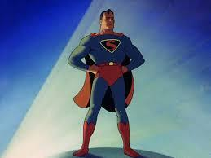
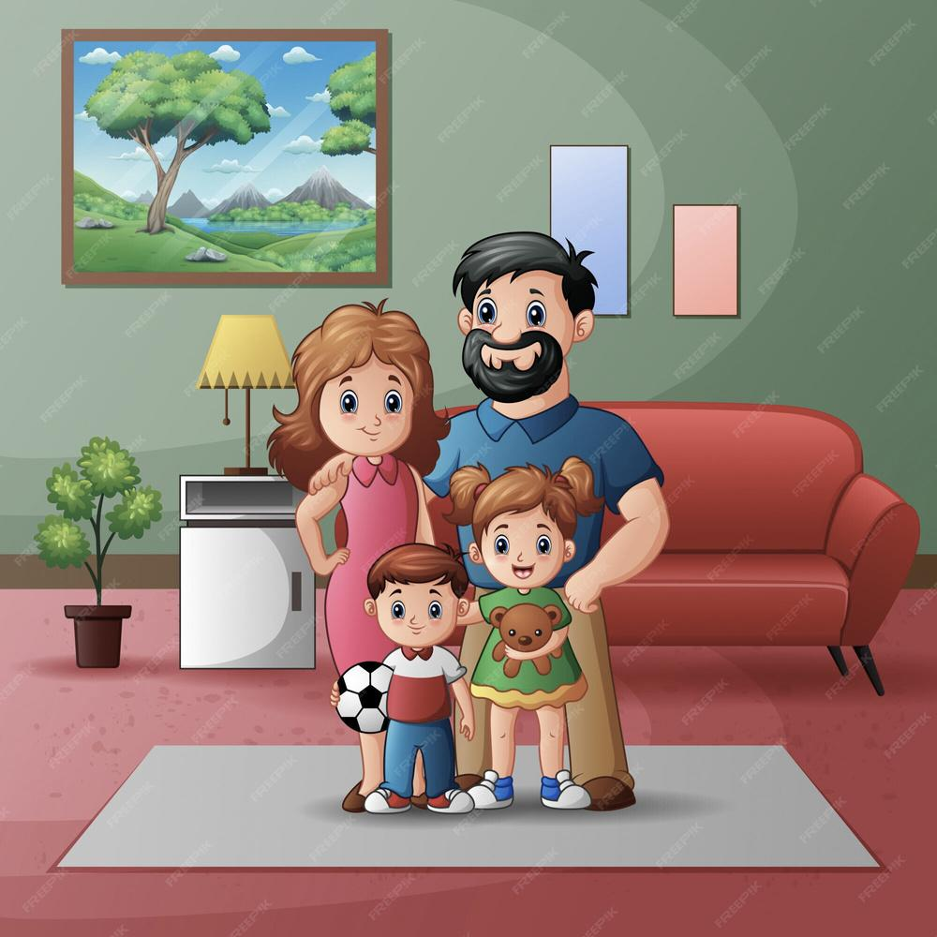
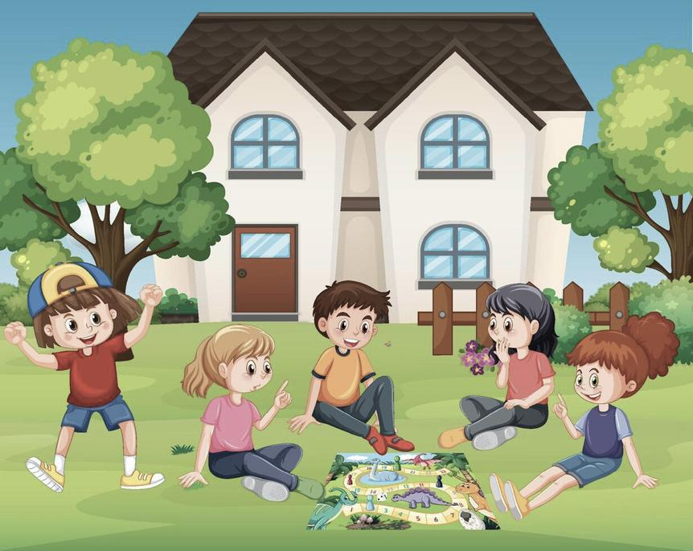
Protection of Privacy:
The EU has strict rules to protect people’s personal information and privacy.
These rules are part of a law called the GDPR (General Data Protection Regulation).
It makes sure that companies and organizations must ask for permission before collecting and using your personal data, like your name, address, or phone number.
Notes:
Let's talk about Protection of Privacy in the European Union.
This means that the EU has rules to keep people’s personal information safe and private.
For example, when you sign up for a website or use an app, your personal details like your name or address shouldn’t be shared without your permission.
The EU has strict laws to make sure that companies handle your information carefully and only use it for the right reasons.
So, Protection of Privacy means making sure your private information stays private and secure
You can make some example, and then move to the next slide.

Slide 27
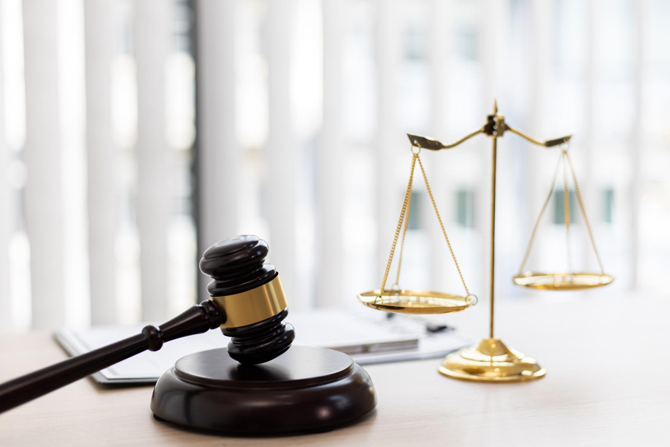

European
Anti-Corruption Regulations:
No one can gain an unfair advantage by breaking the law.
The EU also has strong rules to stop corruption.
Corruption is when people in power use their position to get money or special favors unfairly.
The EU makes laws to ensure that governments and businesses are honest and fair. These rules protect citizens from unfair practices and help keep things transparent.
Notes:
The European Anti-Corruption Regulations
These are rules the EU has set up to stop corruption.
Corruption happens when people use their power in the wrong way, like taking bribes or using their position to benefit themselves unfairly.
The EU has these rules to make sure everyone plays fair and that leaders and businesses follow the law.
The goal is to keep things honest and transparent, so everyone can trust that decisions are made fairly and that no one is cheating or getting special treatment.
You can make some example, and then move to the next slide.

Slide 28


European
Anti-Corruption Regulations:
No one can gain an unfair advantage by breaking the law.
The EU also works with member countries to investigate corruption cases.
This helps protect citizens and build trust in governments and institutions.
Notes:
The EU also works with member countries to investigate corruption cases. This helps protect citizens and build trust in governments and institutions.
So remember, European Anti-Corruption Regulations ensure that no one can gain an unfair advantage by breaking the law.
Let’s play, to understand better. Move to the next slide.

Slide 29
Exercise 5
Roleplay Game:
"Fair or Not Fair"
Notes:
Game: "Fair or Not Fair?"
Objective: Understand how rules prevent unfair behavior and ensure fairness.
Materials Needed:
Simple scenario cards (with brief situations about making decisions)
Sticky notes or markers
Instructions:
Introduction (3 minutes): Explain that today’s game will help them see how rules stop unfair actions, like cheating or taking bribes.
Group Activity (15 minutes):
Divide the students into small groups.
Give each group a scenario card. For example, one card might say:
Scenario Card: "You are the judge in a contest to pick the best project. Two students have great projects. One student offers you a gift to get extra points."
Each group will act out the scenario twice:
First, with unfair actions: One student offers the gift, and the judge accepts it, showing how corruption might happen.
Then, with fair actions: The judge makes a decision based on the project quality alone, without accepting any gifts.
Discussion (5/10 minutes):
After acting out the scenarios, ask the groups:
How did it feel when the situation was unfair?
What was better about the fair situation?
Why is it important to be fair?
Wrap-Up (2 minutes): Explain that just like in their game, the EU has rules to make sure everyone is treated fairly and that no one gets special treatment. This helps keep things honest for everyone.
Let’s play, to understand better. Move to the next slide.

Slide 30

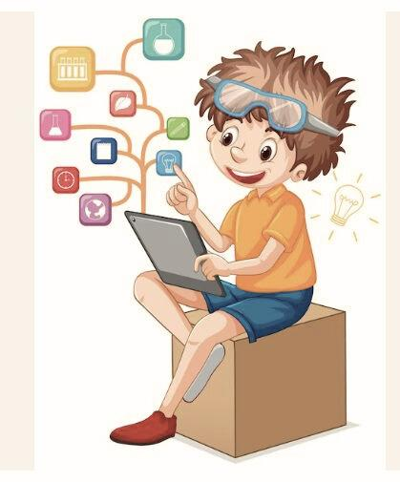
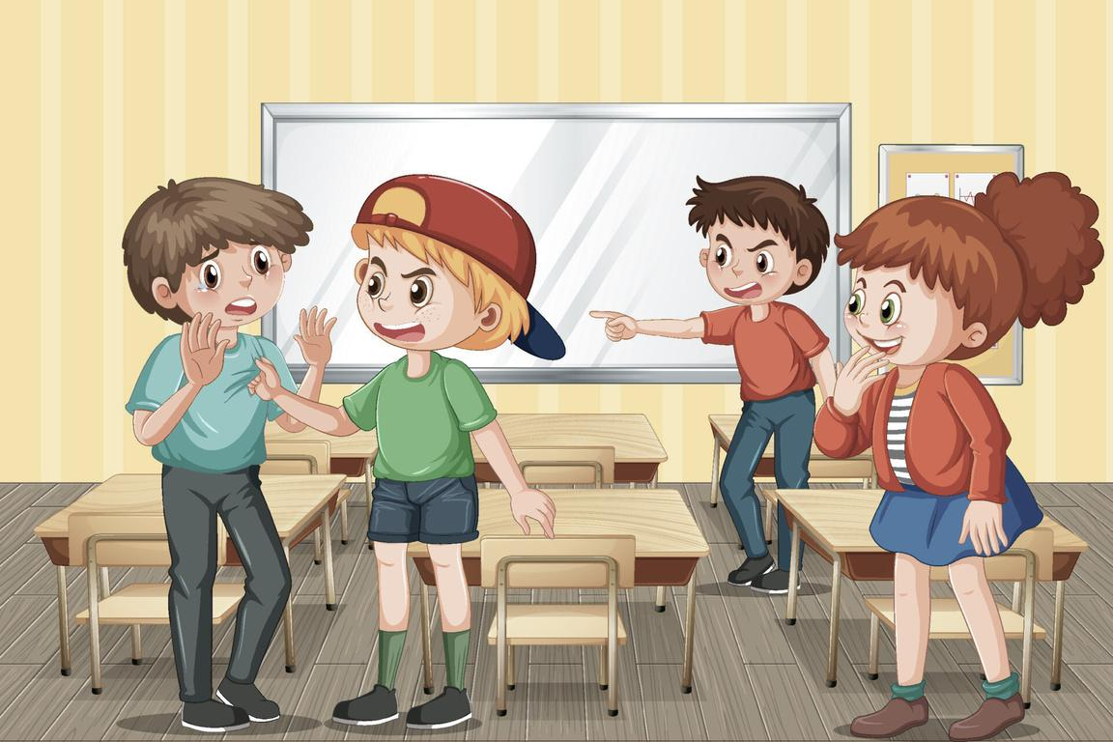
Protection of minor:
The EU has special rules to protect children and teenagers (minors) from harmful content on the internet, unsafe products, and dangerous working conditions. These rules make sure that young people are safe online, at school, and in everyday life.
The goal is to keep children safe and make sure they have the right to grow up in a healthy and protected environment.
Notes:
☺ Let’s talk about the European rules for protecting children. These rules are in place to make sure that all kids in Europe are kept safe and treated well.
The European Union has set up special guidelines to protect children from things like abuse, exploitation, and harmful content online.
These rules help ensure that schools, websites, and other places where kids go follow strict guidelines to keep them safe.
For example, websites must have safety measures to protect kids from inappropriate content, and schools need to have clear rules to keep students safe from bullying.
The goal of these rules is to create a safe environment where all children can grow up happy and healthy, without having to worry about their safety or well-being.
You can make some example, and then move to the next slide.

Slide 31
Exercise 6
Describe in your own words the four regulations you saw in these slides!
Notes:
Alright, now let’s see if we can recall these four regulations.
Can you remember them?
Which one comes to mind first?
Try to explain what it is and what this regulation is about.
Move to the next slide

Slide 32
Exercise 6
Displacement Citizen
Protection Privacy
Anti-Corruption
Protection Minors
Notes:
Okay, now let’s see if we can remember these four regulations
Move to the next slide

Slide 33
4. Values, Duties, and Rights of the European Citizen
Notes:
Now let's start talking about the rights and responsibilities of citizens living in the European Union.
Does everyone understand the difference between rights and responsibilities?
Make some example and then, move to the next slide

Slide 34


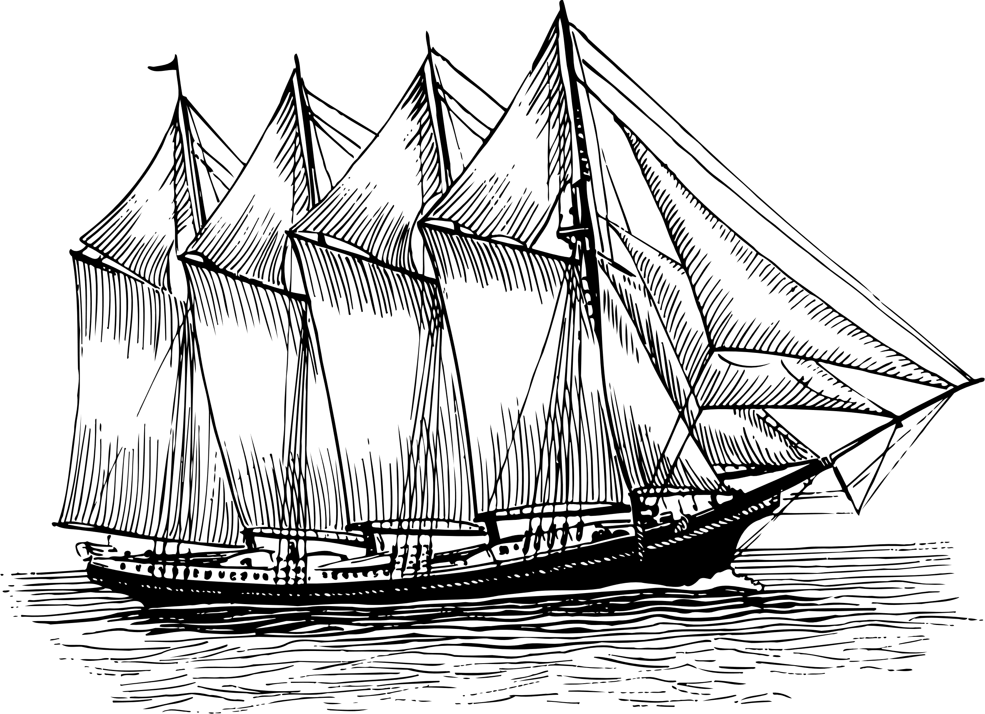
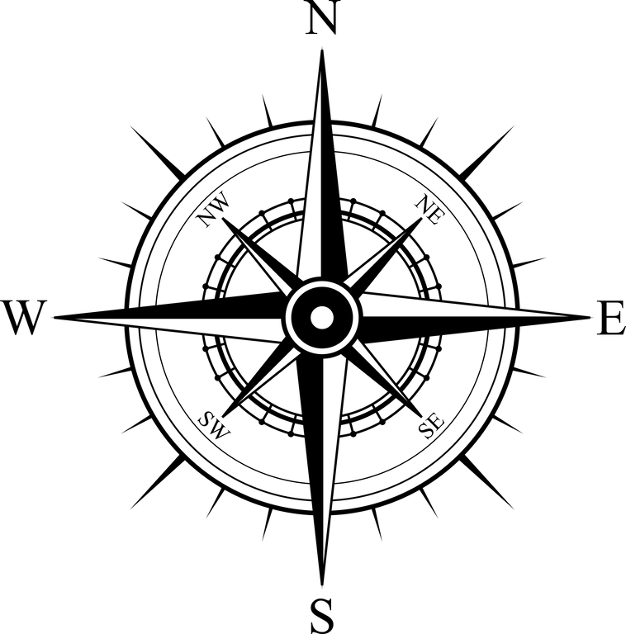
European citizenship is founded on a set of values and principles that shape the rights and duties of every EU citizen.
These rights and responsibilities are codified in the Charter of Fundamental Rights of the European Union, which ensures that citizens enjoy protection, equal treatment, and the freedom to engage in the political and social life of the Union.
These values promote unity, respect for human dignity, democracy, and solidarity across all member states.
Notes:
European citizenship is founded on a set of values and principles that shape the rights and duties of every EU citizen.
These rights and responsibilities are codified in the Charter of Fundamental Rights of the European Union, which ensures that citizens enjoy protection, equal treatment,
and the freedom to engage in the political and social life of the Union.
These values promote unity, respect for human dignity, democracy, and solidarity across all member states.
Move to the next slide

Slide 35

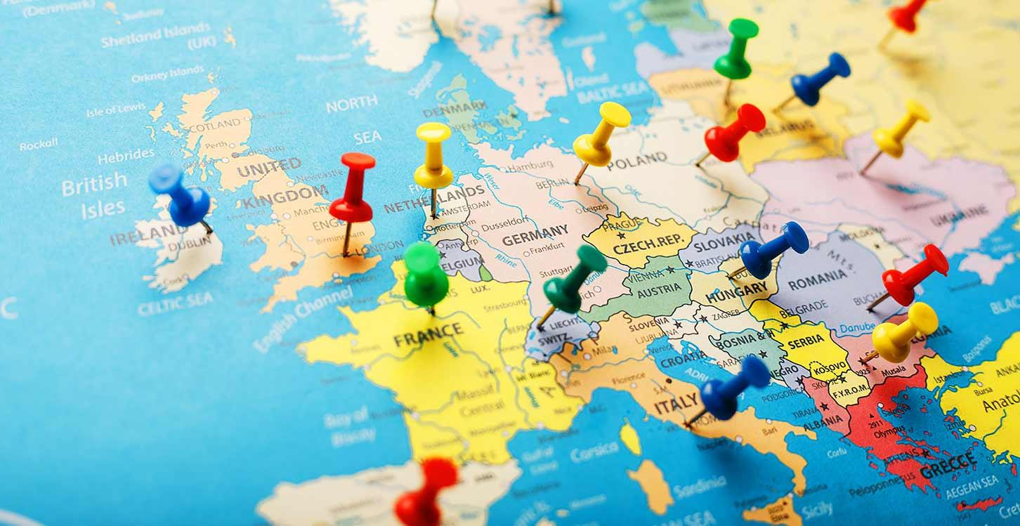
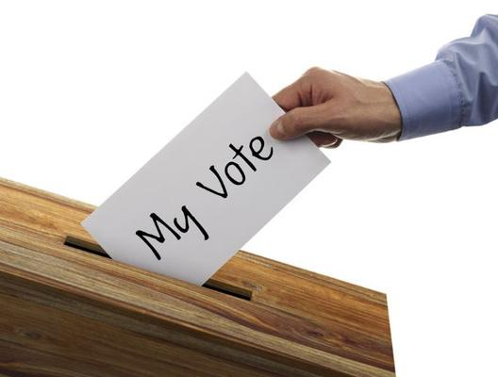
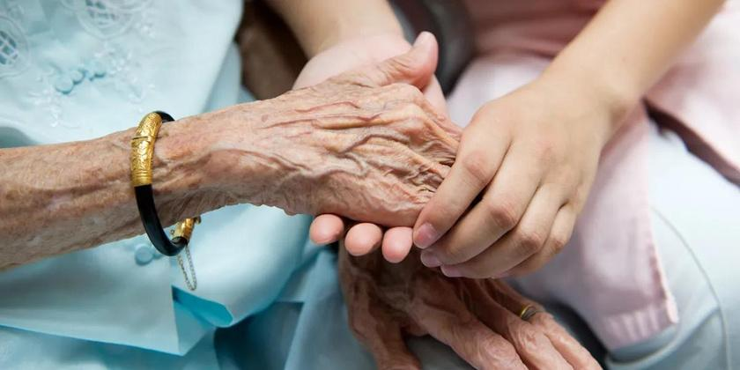
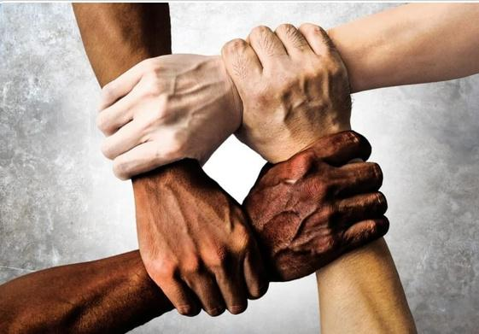
Rights of the European Citizen
The right to move and reside freely within the EU.
The right to participate in the democratic life of the EU
Respect for human dignity
Equality between people.
Notes:
☺ Let's take a closer look at these rights.
The Right to Move and Reside Freely within the EU:
This means you can travel to and live in any EU country you want. For example, if you want to study in France or work in Spain, you can do that without needing special permission.
(Example)
The Right to Participate in the Democratic Life of the EU:
This means you can take part in decisions about how the EU is run. You can vote in elections to choose leaders and have your say in how things are done in the EU.
(Example)
Respect for Human Dignity:
Everyone should be treated with respect and kindness. No one should be treated badly or unfairly, no matter who they are or where they come from.
(Example)
Equality Between People:
This means everyone should have the same chances and be treated equally. No one should be treated differently because of their gender, race, or other personal characteristics.
(Example)
Move to the next slide

Slide 36
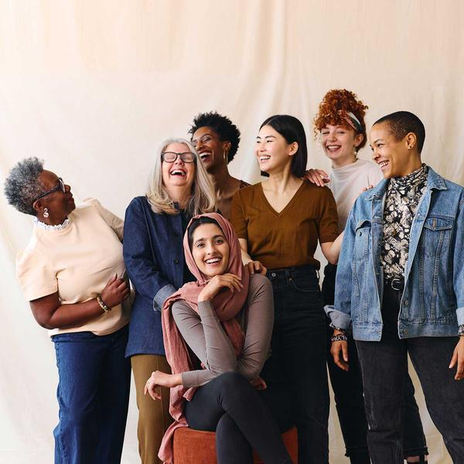
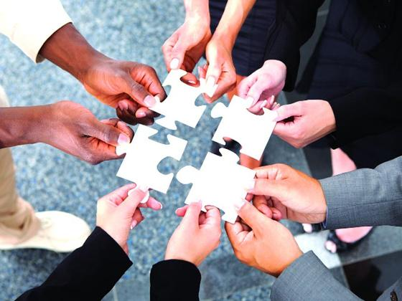
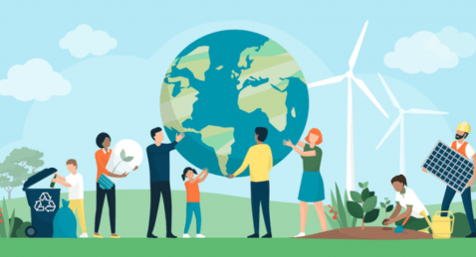
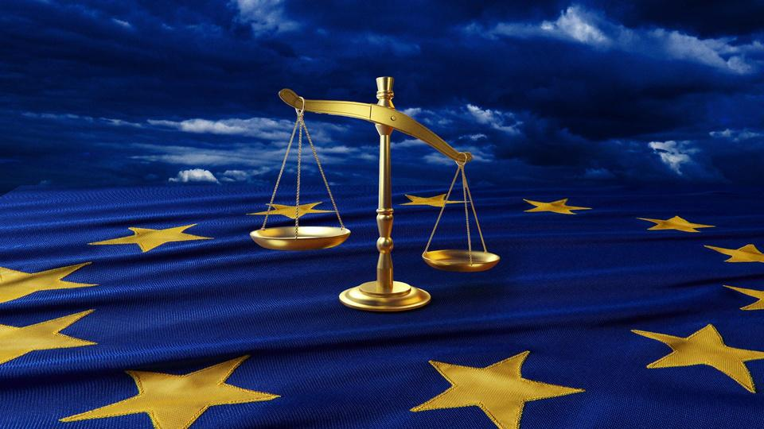
Duties of the European Citizen
Solidarity and Support for Fundamental Values
Engagement in Democratic Processes
Contribute to Society and the Economy
Respect for the Law
Notes:
☺ Now that we’ve looked at our rights, let’s take a closer look at our duties as European citizens.
Solidarity and Support for Fundamental Values:
This means that everyone should help each other and support important values like freedom and respect.
For example, if you see someone in need or someone being treated unfairly, it’s good to help and stand up for what’s right.
Engagement in Democratic Processes:
This means you should be involved in how decisions are made in your country.
For example, you can vote in elections when you’re old enough, and you can also speak up and share your opinions on important issues.
Contribute to Society and the Economy:
This means everyone should try to help their community and contribute to the economy.
For instance, you can help out with community activities, and later on, when you work, you’ll help by paying taxes and creating value through your job.
Respect for the Law:
This means you should follow the rules and laws in your country.
For example, if there are laws about safety or behavior, it’s important to obey them to keep everyone safe and ensure things run smoothly.
Move to the next slide

Slide 37
Exercise 7
Roleplay Game:
“Citizen’s duties”
Notes:
Let’s play to understand better our duties.
Roleplay Game: "Citizens' Duties"
Objective: Help students understand and practice their duties as European citizens through simple, engaging scenarios.
Materials Needed:
Scenario cards (with brief situations related to each duty)
Sticky notes or markers
Instructions:
Introduction (5 minutes): Explain that today’s game will help them understand their duties as European citizens.
These duties include helping others, being involved in decisions, contributing to their community, and following the law.
Group Activity (15 minutes):
Divide the students into small groups.
Give each group a set of scenario cards, each representing one of the four duties:
Solidarity and Support for Fundamental Values: "You see a classmate being bullied. How can you help?"
Engagement in Democratic Processes: "Your school is having a vote to decide on a new club activity. How can you get involved and make your opinion count?"
Contribute to Society and the Economy: "There’s a community clean-up day. What can you do to help out?"
Respect for the Law: "A rule at school says you must wear a helmet when riding your bike. Why is it important to follow this rule?"
Each group will discuss and act out their scenarios, showing how they would handle the situation based on the duty it represents.
Presentation and Discussion (10/15 minutes):
After the groups perform their scenarios, have them share their ideas and actions with the class.
Discuss:
How did their actions reflect each duty?
Why is it important to fulfill these duties as European citizens?
Wrap-Up (5 minutes):
Summarize by highlighting how these duties help create a better community and ensure everyone is treated fairly and respectfully.
Explain that fulfilling these duties helps make a positive impact in their own lives and in the lives of others.
Move to the next slide

Slide 38
5. The Profile of the Global Citizen
Notes:
Let’s talk about what it means to be a global citizen.
A global citizen is someone who feels connected to people all around the world, not just in their own country.
This means caring about global issues and trying to make the world a better place for everyone.
Move to the next slide

Slide 39

Global citizen works to make the world a better place by respecting diversity and supporting common values like fairness and sustainability.
Diversity and Cultural Identities
A global citizen understands that people have different languages, traditions, and ways of life, and that these differences make the world more interesting and connected.
At the same time, people from different backgrounds share common values, like respecting each other and working together.
Values of Europe
World Events and History
People, Groups and Society
Everyone must be treated with respect, have their freedom protected, and have equal rights.
These rules are written in the Treaty on European Union and the Charter of Fundamental Rights, which all countries agree to follow.
To be a good global citizen, you need to understand what’s happening in the world today and why it matters. Climate change, wars, and protests affect everyone.
It’s important to learn from history, like how events such as World War II or the fall of the Berlin Wall changed Europe and the world.
Every person is part of many groups, like their family,
school, or a sports team.
These groups, along with work organizations and communities, make up society. Together, they help shape things like the economy (money and jobs) and culture (traditions, beliefs) and ways of life.
Notes:
Let's look at some of the principles that a global citizen should know.
People, Groups and Society
Every person is part of many groups, like their family,
school, or a sports team.
These groups, along with work organizations and communities, make up society. Together, they help shape things like the economy (money and jobs) and culture (traditions, beliefs) and ways of life.
Values of Europe
Everyone must be treated with respect, have their freedom protected, and have equal rights.
These rules are written in the Treaty on European Union and the Charter of Fundamental Rights, which all countries agree to follow.
World Events and History
To be a good global citizen, you need to understand what’s happening in the world today and why it matters. Climate change, wars, and protests affect everyone.
It’s important to learn from history, like how events such as World War II or the fall of the Berlin Wall changed Europe and the world.
Diversity and Cultural Identities
At the same time, people from different backgrounds share common values, like respecting each other and working together.
Move to the next slide

Slide 40

Europe is built on some important shared values that everyone agrees on
People have the right to make their own choices, like where to live, what to believe, and what to say, as long as they don’t harm others.
Everyone should be treated equally, no matter their gender, race, or background.
These are basic rights that everyone should have, like the right to privacy, education, and protection from harm.
Every person deserves to be treated with respect and should have their basic needs and rights protected.
Equality
Freedom
Respect for
human rights:
In Europe, people can vote and have a say in how their country is run. Leaders are chosen by the people.
Laws apply to everyone, and no one is above the law.
Respect for human dignity
Article II of the
Treaty on European Union
and
the Charter of Fundamental Rights.
Democracy
Rule of law
Notes:
Europe is built on some important shared values that everyone agrees on, Let’s see them in detail.
These values are written down in Article 2 of the Treaty on European Union and the Charter of Fundamental Rights.
Respect for human dignity: Every person deserves to be treated with respect and should have their basic needs and rights protected.
Freedom: People have the right to make their own choices, like where to live, what to believe, and what to say, as long as they don’t harm others.
Democracy: In Europe, people can vote and have a say in how their country is run. Leaders are chosen by the people.
Equality: Everyone should be treated equally, no matter their gender, race, or background.
Rule of law: Laws apply to everyone, and no one is above the law.
Respect for human rights: These are basic rights that everyone should have, like the right to privacy, education, and protection from harm.
Move to the next slide

Slide 41
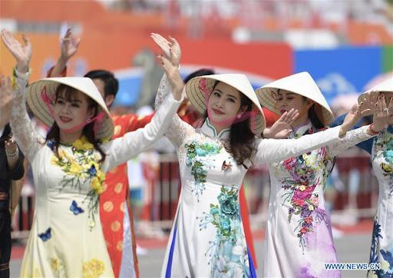
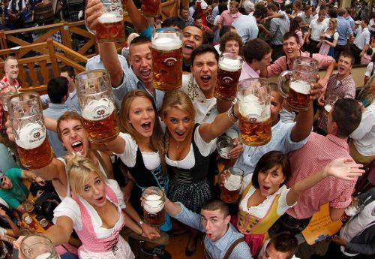
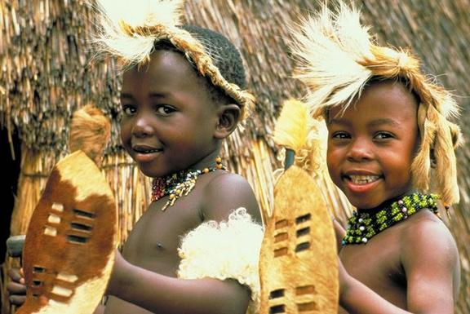
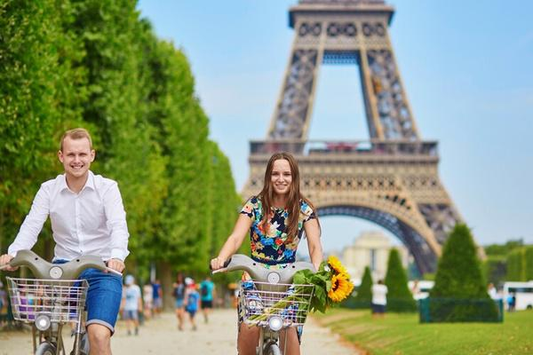
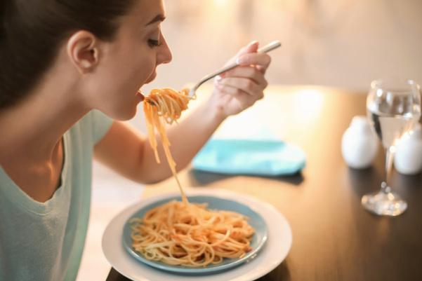
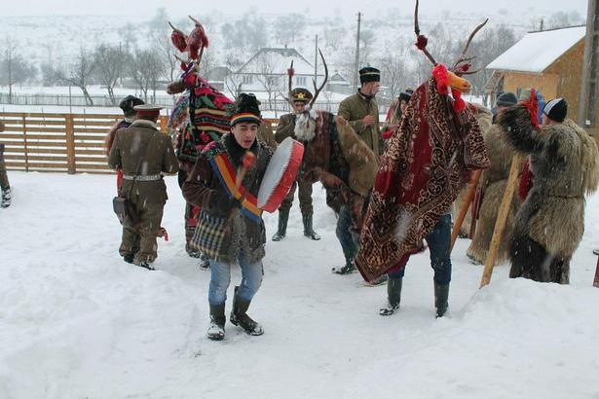
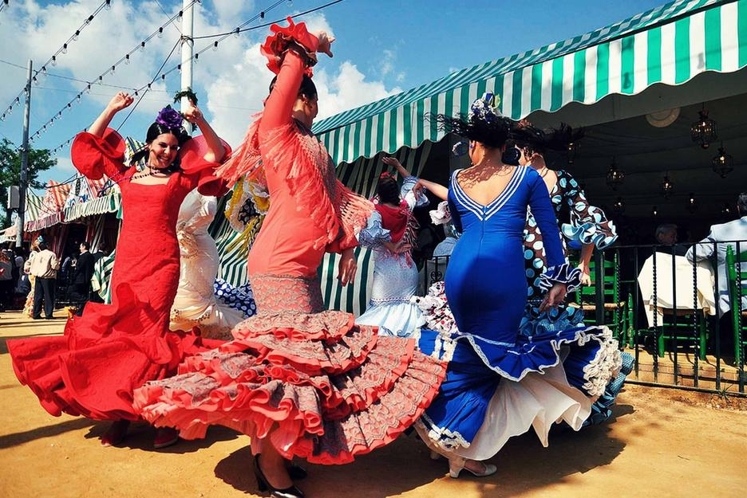
Diversity means that people come from different backgrounds, countries, and traditions.
ASIA
Germany
Sud Africa
FRANCE
Italy
Romania
SPAIN
Notes:
Europe and the world are made up of many different cultures and identities, and this diversity is what makes life interesting and unique.
Diversity means that people come from different backgrounds, countries, and traditions.
In Europe, for example, there are many different languages, foods, holidays, and customs.
A person from Italy might celebrate with pasta and pizza, while someone from Spain dancing and enjoying paella.
In Germany, people make a particular festival for beer, while in France, they speak French and use to eat lots of cheeses.
These differences in language, traditions, and ways of life are part of what makes each culture special.
Around the world, this diversity becomes even greater.
People from Africa, Asia, and other places all have their own unique ways of living and celebrating their cultures.
Some people wear different types of clothing, eat different foods, or have different beliefs.
Understanding and respecting these cultural identities helps us appreciate each other and live together peacefully.
Even though people may seem different, we all share common values like kindness, fairness, and respect for one another.
Diversity makes the world a more exciting place because we can learn from each other and experience new things!
Ask the students what they think. Listen to them. Then move to the next slide.

Slide 42
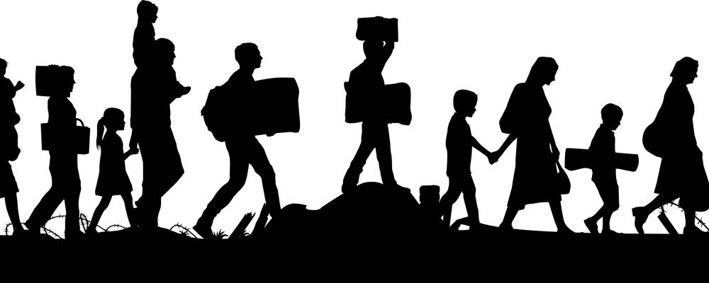
EUROPEAN UNION
AND THE MIGRATION ISSUE
A global citizen facing the migration challenge in their country would act in a way that promotes compassion, understanding, and responsibility towards both migrants and the local community.
Understanding the causes of migration:
A global citizen would seek to understand why people migrate, which can include escaping war, poverty, or environmental disasters.
Advocating for human rights: In line with EU values, a global citizen would support the idea that all people, regardless of where they come from, deserve to be treated with dignity and respect.
Promoting integration and inclusion:
A global citizen would encourage policies and actions that help migrants integrate into society.
Supporting EU policies on migration:
The EU has frameworks for handling migration, such as the Common European Asylum System, which ensures that those fleeing persecution can seek asylum.
GLOBAL CITIZEN
BEHAVIOUR
Notes:
☺ A global citizen facing the migration challenge in their country would act in a way that promotes compassion, understanding, and responsibility towards both migrants and the local community.
Understanding the causes of migration: A global citizen would seek to understand why people migrate, which can include escaping war, poverty, or environmental disasters. By educating themselves and others, they can help combat misinformation and stereotypes about migrants.
Advocating for human rights: In line with EU values, a global citizen would support the idea that all people, regardless of where they come from, deserve to be treated with dignity and respect. This includes advocating for fair treatment of migrants and refugees, supporting their right to safety, education, and employment.
Promoting integration and inclusion: A global citizen would encourage policies and actions that help migrants integrate into society. This could include volunteering to help migrants learn the local language, assisting them in finding work, or supporting cultural exchange initiatives that promote understanding between migrants and the local population.
Supporting EU policies on migration: The EU has frameworks for handling migration, such as the Common European Asylum System, which ensures that those fleeing persecution can seek asylum. A global citizen would support these policies while also pushing for improvements that ensure fairness and efficiency in the process.
Move to the next slide

Slide 43
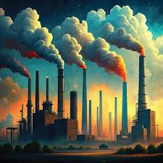
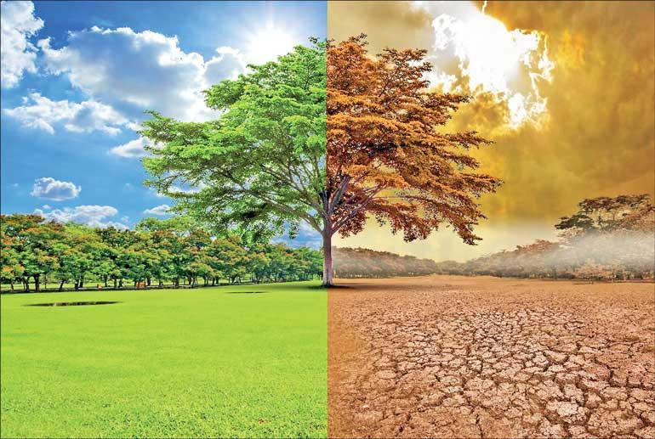
Global climate change is caused by things like pollution and deforestation, and it’s making the planet warmer.
POLLUTION
Notes:
☺ Being a global citizen means thinking about how we can all help solve problems.
As human beings we are currently facing a Global Climate Changes: Global climate change is caused by things like pollution and deforestation, and it’s making the planet warmer.
This affects everyone, so we need to work together to solve it.
These changes impact how we live and what resources we need, no matter where we live!
It is your responsibility to understand how both your actions and the actions of others can impact our Earth, and to consider how these impacts affect the environment, society, and future generations.
Ask the students what they think about it. What they know. Listen to them. Then move to the next slide.

Slide 44
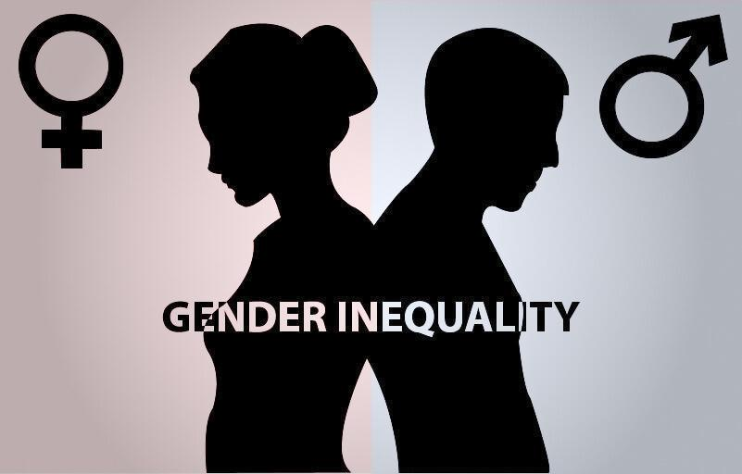
The EU works to ensure that everyone, regardless of gender, has equal opportunities
EU policies aim to create an inclusive environment where all women, regardless of their background, have equal opportunities.
The EU is working to stop gender-based violence, which includes things like domestic abuse, sexual harassment, and human trafficking.
Despite progress, there is still a gap between the average earnings of men and women in the EU.
Intersectionality and Inclusiveness
Gender Pay Gap
Gender-Based Violence
EU works with international organizations like the United Nations to support gender equality in areas affected by poverty or conflict.
The Women on Boards Directive requires large companies to have at least 40% women in non-executive director roles by 2026.
EU supports policies that help women advance in their careers, including access to childcare services, parental leave, and lifelong learning opportunities
Global Advocacy for Gender Equality
Women in Leadership
Equality in Education and Employment
Notes:
The European Union (EU) places a strong emphasis on gender equality as a core value and a key part of building a fair and just society. The EU works to ensure that everyone, regardless of gender, has equal opportunities in areas such as employment, education, political participation, and access to services.
The EU has passed several laws and directives to promote gender equality.
1. Gender Pay Gap:
Despite progress, there is still a gap between the average earnings of men and women in the EU. The EU is actively working to close this gap by:
Promoting pay transparency in companies.
Supporting policies that encourage women to enter traditionally male-dominated sectors, like technology and engineering.
Encouraging companies to create more flexible work environments that help women balance family and work commitments.
2. Women in Leadership:
The EU promotes women’s representation in decision-making roles:
The Women on Boards Directive requires large companies to have at least 40% women in non-executive director roles by 2026.
The EU encourages political parties and organizations to nominate more women for leadership roles, helping to increase female participation in politics and business.
3. Gender-Based Violence:
The EU is committed to ending gender-based violence, such as domestic abuse, sexual harassment, and human trafficking. Domestic abuse is when someone is hurt or controlled by a family member, and sexual harassment is when someone is treated in a bad way because of their gender, like being bullied or disrespected. Human trafficking is when people are forced to work or do things against their will.
4. Promoting Gender Equality in Education and Employment:
The EU encourages equal access to education for boys and girls, particularly in fields like STEM (Science, Technology, Engineering, and Mathematics), where women are underrepresented.
It supports policies that help women advance in their careers, including access to childcare services, parental leave, and lifelong learning opportunities.
5. Intersectionality and Inclusiveness:
The EU also recognizes that gender inequality can be worsened by other forms of discrimination, such as race, age, disability, or sexual orientation. EU policies aim to create an inclusive environment where all women, regardless of their background, have equal opportunities.
6. Global Advocacy for Gender Equality:
The EU also advocates for gender equality on the global stage, promoting women's rights through its foreign policies and international development programs. It works with international organizations like the United Nations to support gender equality in areas affected by poverty or conflict.

Slide 45
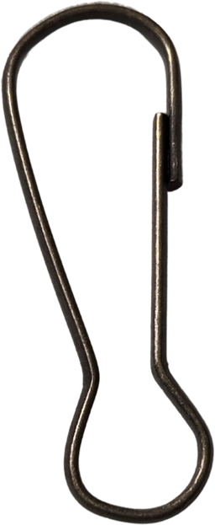
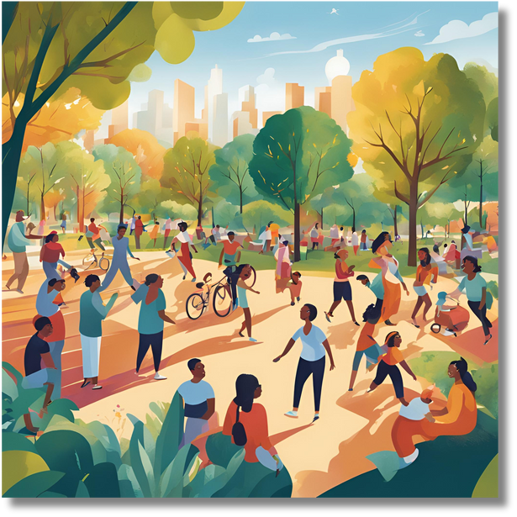
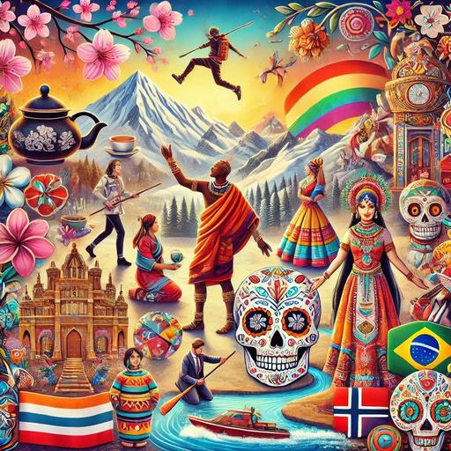

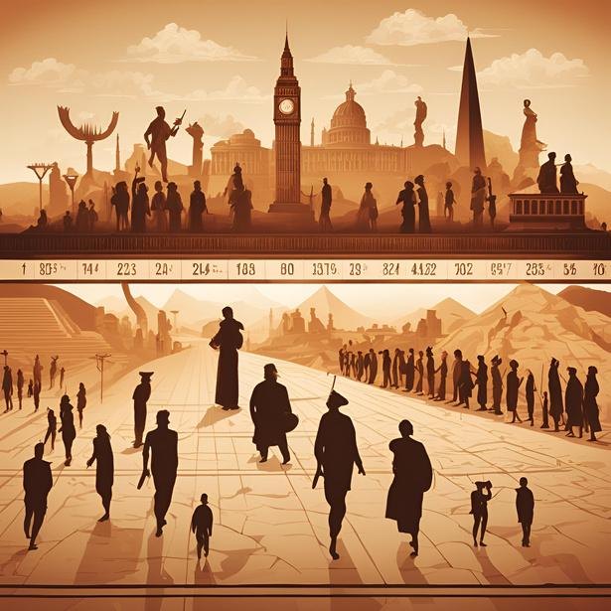
A Global Citizen understands how people, history, and cultures are connected, and they work to make the world a better place by respecting diversity and supporting common values like fairness and sustainability.
PEOPLE
CULTURE
HISTORY
Notes:
A Global citizen understands how people, history, and cultures are connected,
and they work to make the world a better place by respecting diversity and supporting common values like fairness and sustainability.
- Understanding History
Imagine you're playing a board game, but you don’t know the rules or how the game was played in the past. Without understanding the history of the game, you might make mistakes or not fully enjoy the game.
Similarly, understanding history helps us learn from past mistakes, appreciate how things have changed, and make better decisions for the future.
For example, knowing about historical events like the Civil Rights Movement helps us understand the importance of equality and how much effort it took to make changes in society.
- Understanding Different Cultures:
Think about meeting a friend from another country who has different customs and traditions. If you understand their culture, you can better appreciate their unique way of life and avoid misunderstandings.
For instance, if you know that in some cultures, people greet each other with a bow instead of a handshake, you won’t feel awkward or disrespectful.
Understanding different cultures helps us build friendships, respect each other’s differences, and work together more smoothly.
By learning about people’s cultures and histories, you can understand them much better. Knowing where they come from and what their traditions are helps you see why they think and act the way they do. This can help you avoid misunderstandings and get along better with them. It also makes it easier to live together happily and peacefully, because you respect and appreciate each other’s differences and shared experiences.
Move to the next slide

Slide 46
Exercise 7
Roleplay Game:
“Culture and History Exchange”
Notes:
☺ Let’s play! And have fun
Roleplay Game: "Culture and History Exchange"
Objective: Help students understand and appreciate different cultures and histories through a fun roleplay activity.
Materials Needed: Simple roleplay scenario cards (each with a brief situation related to a different culture or historical event)
Instructions:
Introduction (5 minutes): Explain that today’s roleplay will help them learn about different cultures and histories. They’ll get to act out situations that show how understanding these topics can help us get along better with others.
Roleplay Setup (5 minutes):
Divide the students into small groups.
Give each group a roleplay scenario card. Each card describes a simple situation involving a cultural or historical context. For example:
Scenario Card: “You’re hosting an international dinner party. A guest from Japan is coming. How will you make sure they feel welcome?”
Scenario Card: “You’re learning about ancient Egypt in school. How can you explain to your friends why the pyramids were so important?”
Roleplay Activity (15 minutes):
Each group has 5 minutes to prepare and act out their scenario. They should show how they would handle the situation by understanding and respecting the cultural or historical context.
For example, in the first scenario, the group might show how to greet the guest politely and include Japanese dishes. In the second scenario, they might explain the significance of pyramids in a fun way.
Share and Discuss (15 minutes):
After all the groups have performed, ask each group to share what they learned from their scenario.
Discuss as a class how understanding different cultures and histories helps us communicate better and build friendships.
Wrap-Up (5 minutes):
Summarize by explaining that learning about and respecting different cultures and histories helps us get along with others and live together more harmoniously.
Make some reflection about the game they played and then move to the next slide

Slide 47
6. European Projects and Opportunities for Citizens
Notes:
European Project Opportunities
European projects, like Erasmus+ and the European Solidarity Corps, offer citizens the chance to participate in programs across Europe.

Slide 48
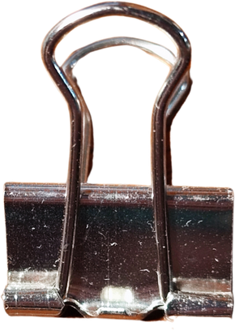
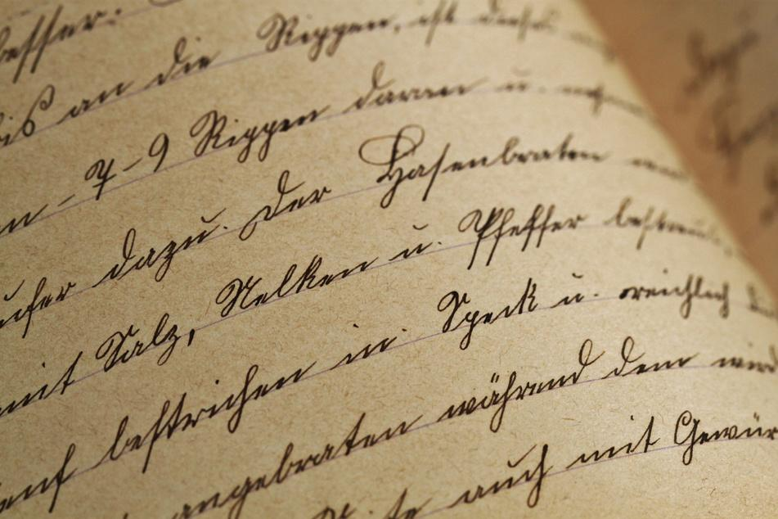
What Are European Projects?
European Projects are programs funded by the European Union (EU) that aim to bring people from different European countries together. They offer opportunities to learn, work, and experience new things. Think of them like cool, big-school projects but on a European level!
Notes:
☺ European Projects are programs funded by the European Union (EU) that aim to bring people from different European countries together. They offer opportunities to learn, work, and experience new things. Think of them like cool, big-school projects but on a European level!

Slide 49

Solidarity Projects:
Other Opportunities
The European Solidarity Corps (ESC) is a flagship initiative aimed at engaging young people in volunteer work and solidarity projects that benefit communities across Europe. These projects focus on helping communities and people in need.
Citizens might volunteer to help with social issues like environmental protection or supporting those in difficult situations. It’s a chance to gain experience.
Erasmus+
Mobility
Horizon Europe: This program is the EU’s key funding initiative for research and innovation. It supports projects that address global challenges and drive technological and scientific advancements.
Creative Europe: This program aims to support and promote the cultural and creative sectors. It fosters artistic collaboration and enhances the cultural diversity of Europe.
Erasmus+ is a program that helps students and young people study, work, or train in different EU countries. It’s like having a chance to study abroad or do an internship, but with support from the EU.
Citizens might get a chance to spend time studying or working in a different European country, learn a new language, and experience a new culture.
Notes:
☺ Solidarity Projects:
The European Solidarity Corps (ESC) is a flagship initiative aimed at engaging young people in volunteer work and solidarity projects that benefit communities across Europe. These projects focus on helping communities and people in need. Citizens might volunteer to help with social issues like environmental protection or supporting those in difficult situations. It’s a chance to gain experience.
Why Participate?
Social Impact: Make a real difference in communities by addressing pressing social challenges and promoting solidarity among diverse populations.
Personal Development: Gain essential skills such as teamwork, leadership, and problem-solving, all while stepping out of your comfort zone.
Cultural Experience: Immerse yourself in different cultures, learn new languages, and form lasting friendships with peers from across Europe.
Financial Support: The ESC covers travel costs, accommodation, and meals, making these opportunities accessible for all teenagers.
Career Enhancement: Participating in an ESC project enriches your resume, demonstrating your commitment to social issues and your ability to work in diverse settings.
How to Get Involved
Teenagers interested in ESC projects can explore opportunities through the official ESC website or local youth organizations. The application process typically involves finding a project that matches your interests and skills, submitting an application, and preparing for an adventure that will not only change your life but also the lives of others.
Seize the opportunity to explore Europe, develop personally and professionally, and make a positive impact in the world through the European Solidarity Corps!
☺ Erasmus+ Mobility
Erasmus+ is a program that helps students and young people study, work, or train in different EU countries. It’s like having a chance to study abroad or do an internship, but with support from the EU. Citizens might get a chance to spend time studying or working in a different European country, learn a new language, and experience a new culture.
How to Join an Erasmus+ Project
Erasmus+ lets young people travel to other countries to study, volunteer, or join fun projects. Here's how to get involved:
Check If You Can Join
You can join if you’re a student, teacher, or young person (13-30 years old).
Find Opportunities
Projects include youth exchanges, study programs, or volunteering. Ask your school or local youth group about available projects.
Apply for Funding
Erasmus+ covers travel and living costs, so you’ll get help with money.
Get Ready
Prepare for your trip by learning about the country and activities.
☺ Other Opportunities
Horizon Europe: This program is the EU’s key funding initiative for research and innovation. It supports projects that address global challenges and drive technological and scientific advancements. Creative Europe: This program aims to support and promote the cultural and creative sectors. It fosters artistic collaboration and enhances the cultural diversity of Europe.

Slide 50



Lava Legato
Foundation
Challenge Misery by Building and Learning Together!
La Guajira
Serena, 25 years old, is currently in Rotterdam, Netherlands, where she supports the initiatives of the Lava Legato Foundation, which operates in the field of assistance for individuals with disabilities, both children and adults.
Through her project, Serena supports various daily recreational activities promoted by local organizations coordinated by her foundation, including sports, cooking, and gardening.
Serena in the Netherlands
Marika, 23 years old, has been in Almería, Spain, for a few months.
There, she manages the social media channels of "La Guajira," a socio-cultural association focused on the values of collaboration and art as a driver of positive change.
Enrico is 20 years old and is currently in Clermont-Ferrand, France, participating in the ESC project "Challenge Misery by Building and Learning Together!" at Compagnons Bâtisseurs Auvergne. The project lasts 9 months, and here, along with other volunteers, he provides assistance to families facing social and economic difficulties to improve their living conditions.
Marika in Spain
Enrico in France
Notes:
☺Serena, 25 years old, is currently in Rotterdam, Netherlands, where she supports the initiatives of the Lava Legato Foundation, which operates in the field of assistance for individuals with disabilities, both children and adults.
Through her project, Serena supports various daily recreational activities promoted by local organizations coordinated by her foundation, including sports, cooking, and gardening.
☺Enrico is 20 years old and is currently in Clermont-Ferrand, France, participating in the ESC project "Challenge Misery by Building and Learning Together!" at Compagnons Bâtisseurs Auvergne. The project lasts 9 months, and here, along with other volunteers, he provides assistance to families facing social and economic difficulties to improve their living conditions
☺Marika, 23 years old, has been in Almería, Spain, for a few months.
There, she manages the social media channels of "La Guajira," a socio-cultural association focused on the values of collaboration and art as a driver of positive change.

Slide 51



Sininauhasaatio
Association
ENERGIA
Moving Ground
Association
Andrea Carlotta is in Lleida, Spain, where she is working on the ESC project "Energeia" dedicated to social inclusion in schools, along with another girl.
The Energeia project focuses on social inclusion and takes place within schools, where we provide support during lessons and through extracurricular activities.
Emily, 22 years old, has been participating in a long-term ESC project in Helsinki with the Sininauhasaatio association since September 2023.
The main goal of the organization is to support vulnerable people in the metropolitan area: the homeless, those at risk, substance addicts, and immigrants.
Emily in Finland
Azzurra is in Antwerp, Belgium. Here, at the Moving Ground association, she is working on a communication support project, which involves photographing and filming events as well as managing social media.
Azzurra in BlegIum
Andrea Carlotta in SPAIN
Notes:
☺Emily, 22 years old, has been participating in a long-term ESC project in Helsinki with the Sininauhasaatio association since September 2023.
The main goal of the organization is to support vulnerable people in the metropolitan area: the homeless, those at risk, substance addicts, and immigrants.
☺Azzurra is in Antwerp, Belgium. Here, at the Moving Ground association, she is working on a communication support project, which involves photographing and filming events as well as managing social media.
☺Andrea Carlotta is in Lleida, Spain, where she is working on the ESC project "Energeia" dedicated to social inclusion in schools, along with another girl.
The Energeia project focuses on social inclusion and takes place within schools, where we provide support during lessons and through extracurricular activities.

Slide 52


Exercise 8
Do you remeber the main European Projects?
Where is Europe in this map?
Which are the european Countries?
Citizen’s duties and rights.
Can you write them?
Which is the political structure of Europe?
World
Map
Do you recognize the orthers countries?
Notes:
☺ Take a moment to engage students in a reflective discussion. It’s important for them to recall and solidify the knowledge and skills they’ve acquired throughout our recent lessons.
We encourage you to ask students some targeted questions that will help gauge their understanding and retention of the material. This not only reinforces their learning but also identifies areas where they may need additional support.
If any gaps in their understanding arise, let’s work together to provide the necessary resources and guidance for them to review the material.

Slide 53
Exercise 8
World
Map

Slide 54















Eurhope
EU as a solidarity's house for minors out of home
Erasmus+ project n. 2023-2-IT03-KA220-YOU-000184370
Funded by the European Union. Views and opinions expressed are however those of the author(s) only and do not necessarily reflect those of the European Union or the European Education and Culture Executive Agency (EACEA). Neither the European Union nor EACEA can be held responsible for them.

